Slide 1
Introduction to Structured Prediction and Domain Adaptation
Alexander Fraser
CIS, LMU Munich
2017-10-24
WP1: Structured Prediction and Domain Adaptation

Slide 2
Outline
Introduction to structured prediction and domain adaptation
Review of very basic structured prediction
Domain adaptation for statistical machine translation

Slide 3
Structured Prediction I
Structured prediction is a branch of machine learning dealing with outputs that have structure
  The output label is complex, such as an entire parse tree or a complete POS-tagging for a sentence
Typically one can break down individual decisions into sequential steps, but each decision depends on all previous decisions
  Often there is therefore a search problem involved in finding the best (structured) label

Slide 4
Structured Prediction II
Typical structured prediction problems in NLP include:
Tagging tasks (such as POS-tagging or named entity recognition)
  Here the structure is a sequence of labels (e.g., one per word, such as POS tags or IOB named entity labeling)
Parsing tasks, such as syntactic parsing
  Here the structure can be a parse tree (but as we will see later, parse trees can be viewed as sequences, this is popular at the moment)
Word prediction tasks
  Such as language modeling and machine translation (structure is the sequence of words chosen)

Slide 5
Domain Adaptation I
Domain adaptation is the problem in machine learning which occurs when one wishes to train on one distribution and test on another
  For example, train a POS tagger on the German Tiger corpus, which is in the "news" domain
  Test on German tweets (in the "tweet" domain?)
However, the term is overloaded, meaning different things to different people
  There are many different scenarios studied in the literature

Slide 6
Domain Adaptation II
Sometimes we are given an OLD domain training corpus (which is out of domain) and a NEW domain training corpus
The baseline is training on NEW only
The task is then to use the OLD domain corpus to improve performance
One simple way to do this is to concatenate the two corpora and train on this new corpus
  But this often results in OLD "overwriting" NEW, because OLD is often much larger

Slide 7
Domain Adaptation III
Domain adaptation of simple classifiers (like binary classifiers) is reasonably well-studied
Two examples here include:
  Frustratingly Easy by Daume (feature augmentation, more on this later)
  Instance Weighting (downweight OLD training examples in training to try to get the best performance on NEW)
There are many more approaches

Slide 8
Combining Structured Prediction and Domain Adaptation
Domain adaptation of structured prediction systems is particularly challenging
Often it is easy to see domain effects on individual decisions, such as picking the part-of-speech of "monitor"
  In the news domain, often a verb meaning "to watch"
  In the information technology domain, often a noun, e.g., "computer monitor"
But in domain adaptation one often wishes to use knowledge about the sequence that is coming from the wrong (OLD) domain
It is difficult to do this!

Slide 9
Outline
Introduction to structured prediction and domain adaptation
Quick review of very basic structured prediction
  I will go through this very fast (many of you have seen some version of this before)
Domain adaptation for statistical machine translation

Slide 10
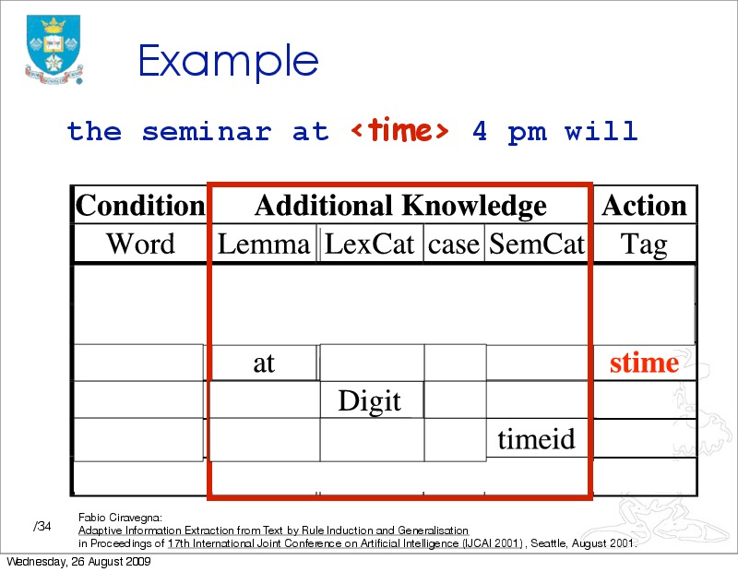

Slide 11
Binary Classification
I'm going to first discuss linear models for binary classification, using binary features
Our classifier is trying to decide whether we have a <stime> tag or not at the current position (between two words in an email)
The first thing we will do is encode the context at this position into a feature vector

Slide 12
Feature Vector
Each feature is true or false, and has a position in the feature vector
The feature vector is typically sparse, meaning it is mostly zeros (i.e., false)
The feature vector represents the full feature space. For instance, consider...

Slide 13
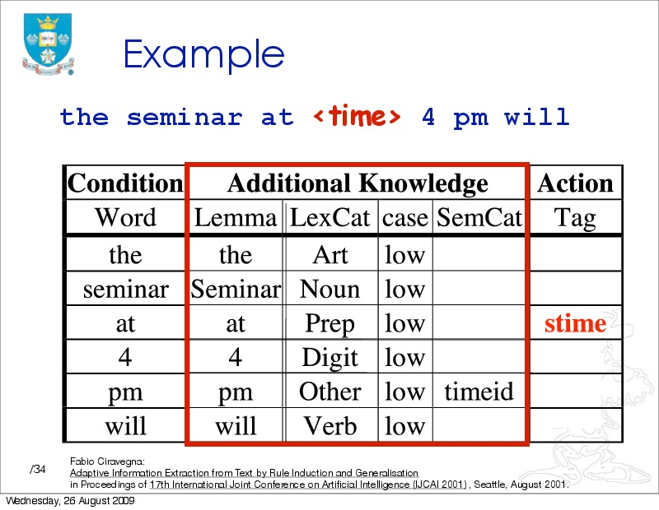

Slide 14
Our features represent this table using binary variables
For instance, consider the lemma column
Most features will be false (false = off = 0)
The lemma features that will be on (true = on = 1) are:
  -3_lemma_the
  -2_lemma_Seminar
  -1_lemma_at
  +1_lemma_4
  +2_lemma_pm
  +3_lemma_will

Slide 15
Feature Vector
We might use a feature vector like this:
(this example is simplified – really we'd have all features for all positions)
1
0
1
0
1
0
0
1
1
0
1
1
Bias term
... (say, -3_lemma_giraffe)
-3_lemma_the
...
-2_lemma_Seminar
...
...
-1_lemma_at
+1_lemma_4
...
+1_Digit
+2_timeid

Slide 16
Weight Vector
Now we'd like the dot product to be > 0 if we should insert a <stime> tag
To encode the rule we looked at before we have three features that we want to have a positive weight
  -1_lemma_at
  +1_Digit
  +2_timeid
We can give them weights of 1
Their sum will be three
To make sure that we only classify if all three weights are on, let's set the weight on the bias term to -2

Slide 17
Dot Product - I
1
0
1
0
1
0
0
1
1
0
1
1
Bias term
-3_lemma_the
-2_lemma_Seminar
-1_lemma_at
+1_lemma_4
+1_Digit
+2_timeid
-2
0
0
0
0
0
0
1
0
0
1
1
To compute the dot product first take the product of each row, and then sum these

Slide 18
Dot Product - II
1
0
1
0
1
0
0
1
1
0
1
1
Bias term
-3_lemma_the
-2_lemma_Seminar
-1_lemma_at
+1_lemma_4
+1_Digit
+2_timeid
-2
0
0
0
0
0
0
1
0
0
1
1
1*-2
0*0
1*0
0*0
1*0
0*0
0*0
1*1
1*0
0*0
1*1
1*1
1*-2
1*1
1*1
1*1
-----
1

Slide 19
Learning the Weight Vector
The general learning task is simply to find a good weight vector!
  This is sometimes also called "training"
Basic intuition: you can check weight vector candidates to see how well they classify the training data
  Better weights vectors get more of the training data right
So we need some way to make (smart) changes to the weight vector
  The goal is to make better decisions on the training data

Slide 20
Feature Extraction
We run feature extraction to get the feature vectors for each position in the text
We typically use a text representation to represent true values (which are sparse)
Often we define feature templates which describe the feature to be extracted and give the name of the feature (i.e., -1_lemma_ XXX)
-3_lemma_the -2_lemma_Seminar -1_lemma_at +1_lemma_4 +1_Digit +2_timeid STIME
-3_lemma_Seminar -2_lemma_at -1_lemma_4 -1_Digit +1_timeid +2_lemma_ will NONE
...

Slide 21
How can we get more power in linear models?
Change the features!
For instance, we can create combinations of our old features as new features
Sometimes these new compound features would be referred to as trigrams (they each combine three basic features)

Slide 22
Feature Selection
A task which includes automatically finding such new compound features is called feature selection
  This is built into some machine learning toolkits
  Or you can implement it yourself by trying out feature combinations and checking the training error
    Use human intuition to check a small number of combinations
    Or do it automatically, using a script
Deep learning is conceptually doing something like this using representation learning

Slide 23
Two classes
So far we discussed how to deal with a single label
  At each position between two words we are asking whether there is a <stime> tag
However, we are interested in <stime> and </stime> tags
How can we deal with this?
We can simply train one classifier on the <stime> prediction task
  Here we are treating </stime> positions like every other non <stime> position
And train another classifier on the </stime> prediction task
  Likewise, treating <stime> positions like every other non </stime> position
If both classifiers predict "true" for a single position, take the one that has the highest dot product

Slide 24
More than two labels
What we have had up until now is called binary classification
But we can generalize this idea to many possible labels
This is called multiclass classification
  We are picking one label (class) from a set of classes
For instance, maybe we are also interested in the <etime> and </etime> labels
  These labels indicate seminar end times, which are also often in the announcement emails (see next slide)

Slide 25
CMU Seminars - Example
<0.24.4.93.20.59.10.jgc+@NL.CS.CMU.EDU (Jaime Carbonell).0>
Type: cmu.cs.proj.mt
Topic: <speaker>Nagao</speaker> Talk
Dates: 26-Apr-93
Time: <stime>10:00</stime> - <etime>11:00 AM</etime>
PostedBy: jgc+ on 24-Apr-93 at 20:59 from NL.CS.CMU.EDU (Jaime Carbonell)
Abstract:
<paragraph><sentence>This Monday, 4/26, <speaker>Prof. Makoto Nagao</speaker> will give a seminar in the <location>CMT red conference room</location> <stime>10</stime>-<etime>11am</etime> on recent MT research results</sentence>.</paragraph>

Slide 26
One against all
We can generalize the way we handled two binary classification decisions to many labels
Let's add the <etime> and </etime> labels
We can train a classifier for each tag
  Just as before, every position that is not an <etime> is a negative example for the <etime> classifier, and likewise for </etime>
If multiple classifiers say "true", take the classifier with the highest dot product
This is called one-against-all
It is a quite reasonable way to use binary classification to predict one of multiple classes
  It is not the only option, but it is easy to understand (and to implement too!)

Slide 27
Binary classifiers and sequences
We can detect seminar start times by using two binary classifiers:
  One for <stime>
  One for </stime>
And recall that if they both say "true" to the same position, take the highest dot product

Slide 28
Then we need to actually annotate the document
But this is problematic...

Slide 29
Some concerns
Begin
Begin
End
Begin
Begin
End
End
…
Begin
End
Slide from Kauchak

Slide 30
A basic approach
One way to deal with this is to use a greedy algorithm
Loop:
  Scan the document until the <stime> classifier says true
  Then scan the document until the </stime> classifier says true
If the last tag inserted was <stime> then insert a </stime> at the end of the document
Naturally, there are smarter algorithms than this that will do a little better
But relying on these two independent classifiers is not optimal

Slide 31
How can we deal better with sequences?
We can make our classification decisions dependent on previous classification decisions
For instance, think of the Hidden Markov Model as used in POS-tagging
The probability of a verb increases after a noun

Slide 32
Basic Sequence Classification
We will do the following
  We will add a feature template into each classification decision representing the previous classification decision
  And we will change the labels we are predicting, so that in the span between a start and end boundary we are predicting a different label than outside

Slide 33
Basic idea
Seminar at 4 pm
<stime> in-stime </stime>
The basic idea is that we want to use the previous classification decision
We add a special feature template -1_label_XXX
For instance, between 4 and pm, we have:
-1_label_<stime>
Suppose we have learned reasonable classifiers
How often should we get a <stime> classification here? (Think about the training data in this sort of position)

Slide 34
-1_label_<stime>
This should be an extremely strong indicator not to annotate a <stime>
What else should it indicate?
  It should indicate that there must be either a in-stime or a </stime> here!

Slide 35
Changing the problem slightly
We'll now change the problem to a problem of annotating tokens (rather than annotating boundaries)
This is traditional in IE, and you'll see that it is slightly more powerful than the boundary style of annotation
We also make less decisions (see next slide)

Slide 36
IOB markup
Seminar at 4 pm will be on ...
O O B-stime I-stime O O O
This is called IOB markup (or BIO = begin-in-out)
This is a standardly used markup when modeling IE problems as sequence classification problems
We can use a variety of models to solve this problem
One popular model is the Hidden Markov Model, which you have seen in Statistical Methods
  There, the label is the state
However, here we will (mostly) stay more general and talk about binary classifiers and one-against-all

Slide 37
(Greedy) classification with IOB
Seminar at 4 pm will be on ...
O O B-stime I-stime O O O
To perform greedy classification, first run your classifier on "Seminar"
You can use a label feature here like
-1_Label_StartOfSentence
Suppose you correctly choose "O"
Then when classifying "at", use the feature:
-1_Label_O
Suppose you correctly choose "O"
Then when classifying "4", use the feature:
-1_Label_O
Suppose you correctly choose "B-stime"
Then when classifying "pm", use the feature:
-1_Label_B-stime
Etc...

Slide 38
Summary: very simple structured prediction
I've taught you the basics of:
  Binary classification using features
  Feature selection (vs. representation learning)
  Multiclass classification (using one-against-all)
  Sequence classification (using a feature that uses the previous decision)
    And IOB labels
I've skipped a lot of details!
  I haven't told you how to actually learn the weight vector in the binary classifier in detail (beyond the perceptron rule)
  I also haven't talked about non-greedy ways to do sequence classification
  And I didn't talk about probabilities, which are used directly, or at least approximated, in many kinds of commonly used linear models
Hopefully what I did tell you is fairly intuitive and helps you understand classification, that is the goal

Slide 39
Outline
Introduction to structured prediction and domain adaptation
Review of very basic structured prediction
Domain adaptation for statistical machine translation
  I probably can't make it through all of these slides, but hopefully this gives you an idea

Slide 40
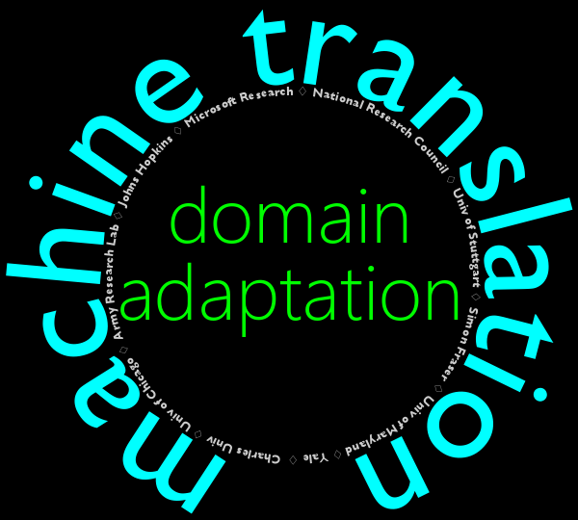
Fabienne Braune
Marine Carpuat
Ann Clifton
Hal Daumé III
Alex Fraser
Katie Henry
Anni Irvine
Jagadeesh Jagarlamudi
John Morgan
Chris Quirk
Majid Razmara
Rachel Rudinger
Ales Tamchyna
Special thanks:
George Foster
Dragos Munteanu
Everyone at CLSP
Based on the Report of the 2012 JHU Workshop
On Domain Adaptation for Machine Translation
Notes:
40

Slide 41
Domains really are different
Can you guess what domain each of these sentences is drawn from?
Many factors contributed to the French and Dutch objections
to the proposed EU constitution
Please rise, then, for this minute's silence
Latent diabetes mellitus may become manifest during thiazide
therapy
Statistical machine translation is based on sets of text to build
a translation model
News
Parliament
Medical
Science
(Science?)
Joel Tetreault sings Greg Crowther
Jenny, what is this number?
Tell me how it's defined.
Jenny, plug in this number:
Three point one four one five nine.
(Three point one four one five nine).

Slide 42
Translating across domains is hard
Old Domain (Parliament)
Original | monsieur le président, les pêcheurs de homard de la région de l'atlantique sont dans une situation catastrophique.
Reference | mr. speaker, lobster fishers in atlantic canada are facing a disaster.
System | mr. speaker, the lobster fishers in atlantic canada are in a mess.
New Domain
Original | comprimés pelliculés blancs pour voie orale.
Reference | white film-coated tablets for oral use.
System | white pelliculés tablets to oral.
New Domain
Original | mode et voie(s) d'administration
Reference | method and route(s) of administration
System | fashion and voie(s) of directors

Slide 43
Outline
Quick introduction to domain adaptation for SMT
What is the problem really?
  a new taxonomy for domain-related SMT errors
Towards solving the errors
  with comparable corpora
  with parallel corpora

Slide 44
Domain Adaptation for SMT
Problem: domain mismatch between test and training data can cause severe degradation in translation quality
General solution: adjust SMT parameters to optimize performance for a test set, based on some knowledge of its domain
Various settings:
  amount of in-domain training data: small, dev-sized, none (just source text)
  nature of out-of-domain data: size, diversity, labeling
  monolingual resources: source and target, in-domain or not, comparable or not
  latency: offline, tuning, dynamic, online, (interactive)
Slide adapted from Foster 2012

Slide 45
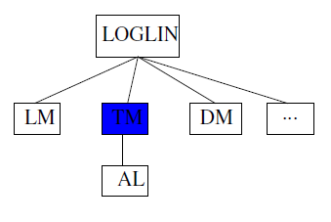
What to adapt?
Log-linear model
  limited scope if in-domain tuning set (dev) is available
Language model (LM)
  effective and simple
  previous work from ASR
  perplexity-based interpolation popular
Translation model (TM):
  most popular target, gains can be elusive
Other features: little work so far
Alignment: little work, possibly limited scope due to “one sense per discourse"
Slide adapted from Foster 2012

Slide 46
How to adapt to a new domain?
Filtering training data
  select from out-of-domain data based on similarity to our domain
Corpus weighting (generalization of filtering)
  Done at sub-corpora, sentence, or phrase-pair levels
Model combination
  train sub-models on different sub-corpora
Self-training
  generate new parallel data with SMT
Latent semantics
  exploit latent topic structure
Mining comparable corpora
  extend existing parallel resources
Slide adapted from Foster 2012

Slide 47
Translating across domains is hard
Old Domain (Parliament)
Original | monsieur le président, les pêcheurs de homard de la région de l'atlantique sont dans une situation catastrophique.
Reference | mr. speaker, lobster fishers in atlantic canada are facing a disaster.
System | mr. speaker, the lobster fishers in atlantic canada are in a mess.
New Domain
Original | comprimés pelliculés blancs pour voie orale.
Reference | white film-coated tablets for oral use.
System | white pelliculés tablets to oral.
New Domain
Original | mode et voie(s) d'administration
Reference | method and route(s) of administration
System | fashion and voie(s) of directors
Key Question: What went wrong?

Slide 48
S⁴ taxonomy of adaptation effects
Seen: Never seen this word before
  News to medical: “diabetes mellitus”
Sense: Never seen this word used in this way
  News to technical: “monitor”
Score: The wrong output is scored higher
  News to medical: “manifest”
Search: Decoding/search erred
Working with no new domain parallel data!

Slide 49
Macro-analysis of S⁴ effects
Evaluation using BLEU
 | News | Medical | Science | Subtitles
Seen | +0.3% | +8.1% | +6.1% | +5.7%
Sense | +0.6% | +6.6% | +4.4% | +8.7%
Score | +0.6% | +4.5% | +9.9% | +8.4%
  Hansard: 8m sents 161m fr-tokens
  News: 135k sents 3.9m fr-tokens
  Medical: 472k sents 6.5m fr-tokens
  Science: 139k sents 4.3m fr-tokens
  Subtitles: 19m sents 155m fr-tokens

Slide 50
Senses are domain/language specific
courir
éxécuter
virus
fenêtre
run
virus
window
走る
病原体
ウィルス
窓
ウィンドウ

Slide 51
Case 1: No NEW domain parallel data
Common situation
  Lots of data in some OLD domain (e.g., government documents)
  Need to translate many NEW domain documents
Acquiring additional NEW domain translations is critical!
Lots of past work in term mining
  Distributional similarity [Rapp 1996]
  Orthographic similarity
  Temporal similarity

Slide 52
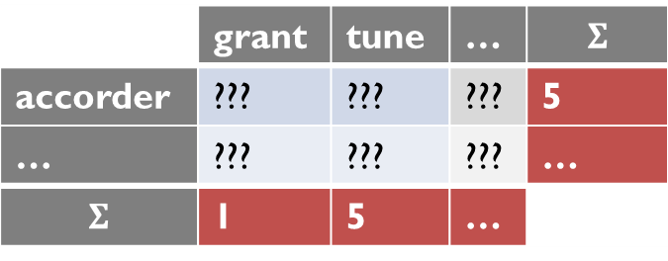
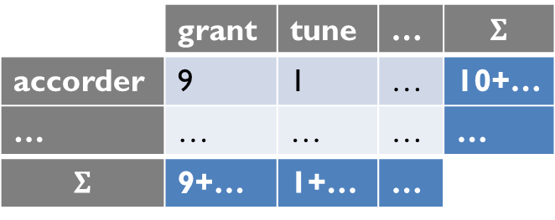
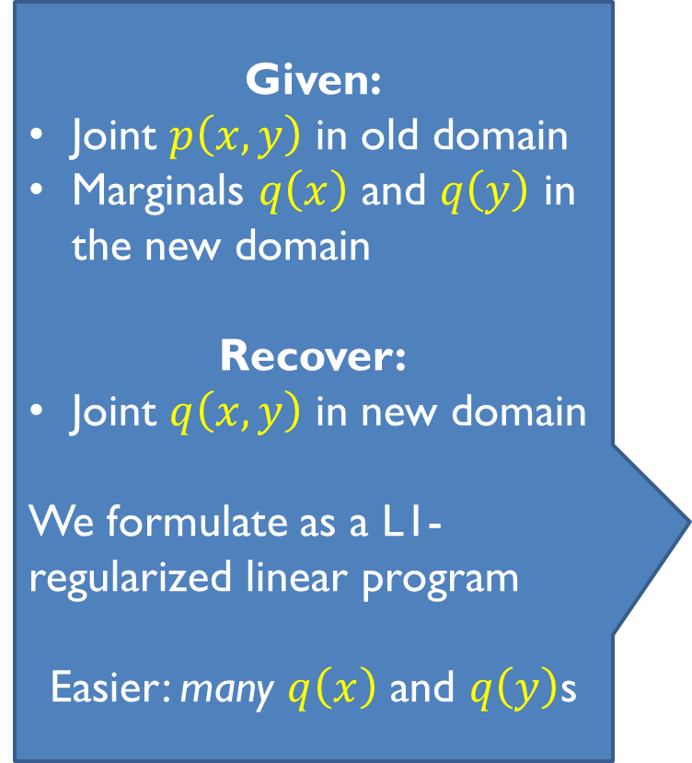
Marginal matching for “sense” errors
Given:
Joint $p\left(x,y\right)$ in old domain
Marginals $q\left(x\right)$ and $q\left(y\right)$ in the new domain
Recover:
Joint $q\left(x,y\right)$ in new domain
We formulate as a L1-regularized linear program
Easier: many $q\left(x\right)$ and $q\left(y\right)$s
 | grant | tune | … | $$Σ$$
accorder | 9 | 1 | … | 10+…
… | … | … | … | …
$$Σ$$ | 9+… | 1+… | …
 | grant | tune | … | $$Σ$$
accorder | ??? | ??? | ??? | 5
… | ??? | ??? | ??? | …
$$Σ$$ | 1 | 5 | …

Slide 53
Additional features
Sparsity: # of non-zero entries should be small
Distributional: document co-occurrence ⬄ translation pair
Spelling: Low edit dist
⬄ translation pair
Frequency: Rare words align to rare words;
common words align to common words
c-aractérisation
characterization
E
the
…
spiders
…
F
le
…
araignées
…

Slide 54
Example learned translations (Science)
French | Correct English | Learned Translations
cisaillement | shear | viscous crack shear
chromosomes | chromosomes | chromosomes chromosome chromosomal
caractérisation | characterization | characterization characteristic
araignées | spiders | spiders ant spider
tiges | stems | usda centimeters flowering

Slide 55
BLEU Scores

Slide 56
Case 2: Add NEW domain parallel data
Say we have a NEW domain translation memory
How can we leverage our OLD domain to achieve the greatest benefit?

Slide 57
Initial adaptation baselines
OLD
NEW
1. Do nothing
OLD
2. Ignore old data
NEW
3. Concatenate the two
OLD
+
NEW

Slide 58
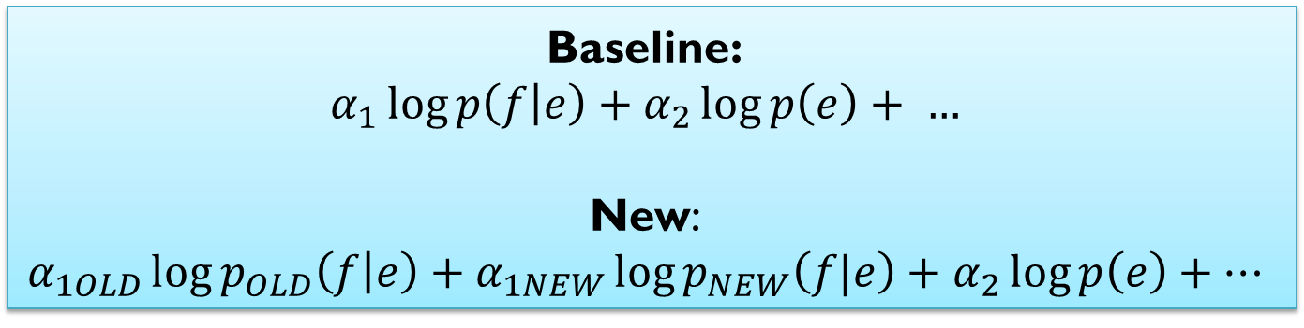
Use both models (log-linear mixture)
OLD
NEW
Engine
Baseline:
$$α_{1}\log{p\left(f | e\right)}+α_{2}\log{p\left(e\right)}+ …$$
New:
$$α_{1OLD}\log{p_{OLD}\left(f | e\right)}+α_{1NEW}\log{p_{NEW}\left(f|e\right)}+α_{2}\log{p\left(e\right)}+…$$
Notes:
Easy to use – just retrain weights on dev set
But not ideal – paths compete

Slide 59
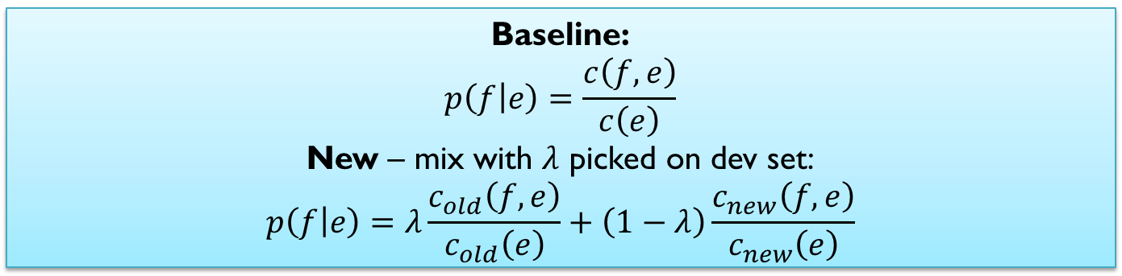
Combine models (linear mixture)
OLD
NEW
Old counts
New counts
Baseline:
$$p\left(f | e\right)=\frac{c\left(f,e\right)}{c\left(e\right)}$$
New – mix with $λ$ picked on dev set:
$$p\left(f | e\right)=λ\frac{c_{old}\left(f,e\right)}{c_{old}\left(e\right)}+\left(1−λ\right)\frac{c_{new}\left(f,e\right)}{c_{new}\left(e\right)}$$

Slide 60
BLEU results
 | OLD | NEW | OLD+ NEW | Use both models | Combine models
News | 23.8 | 21.7 | 22.0 | 16.4 | 21.4
EMEA | 28.7 | 34.8 | 34.8 | 32.9 | 36.6
Science | 26.1 | 32.3 | 27.5 | 30.9 | 32.2
Subtitles | 15.1 | 20.6 | 20.5 | 18.4 | 18.5

Slide 61
Next steps
These mixtures are simple but coarse
More fine-grained approaches:
  Data selection: pick OLD data most like NEW
  Data reweighting: use fractional counts on OLD data; greater weight to sentence pairs more like NEW
  Can reweight at the word or phrase level rather than sentence pair [Foster et al., 2010]
Similar in spirit to statistical domain adaptation
  but existing machine learning algorithms can’t be applied
  because SMT is not a classification task

Slide 62
Phrase Sense Disambiguation (PSD)
Proposed solution: Phrase Sense Disambiguation
  [Carpuat & Wu 2007]
  Incorporate context in lexical choice
    Yields P(e|f, context) features for phrase pairs
    Unlike usual P(e|f) relative frequencies
  Turns phrase translation into discriminative classification
    Just like standard machine learning tasks
  [Chan et al. 2007, Stroppa et al. 2007, Gimenez & Màrquez 2008, Jeong et al. 2010, Patry & Langlais 2011, ...]

Slide 63
Why PSD for domain adaptation?
Disambiguating English senses of rapport
report Il a rédigé un rapport .
relationship Quel est le rapport ?
ratio le rapport longueur / largeur
balance le rapport bénéfique / risque
…
Highest P(e|f) in Science!
P(e|f) in Hansard
New sense in medical domain!
Occurs in new domains but not as often as in Hansard!
Source context can prevent translation errors when shifting domain

Slide 64
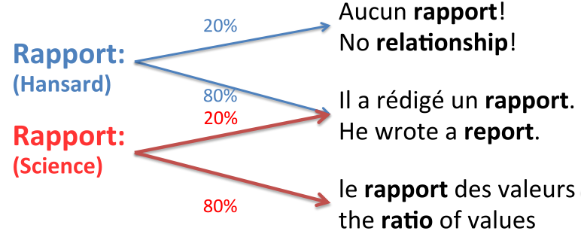
Phrase Sense Disambiguation
PSD = phrase translation as classification
PSD at test time
  use context to predict correct English translation of French phrase
  local lexical and POS context , global sentence and document context
PSD at train time
  extract French phrases with English translations from word alignment
  throw into off-the-shelf classifier + adaptation techniques
  [Blitzer & Daumé 2010]

Slide 65
Domain adaptation in PSD
Train a classifier over OLD and NEW data
Allow classifier to:
  share some features
  {rédigé …} rapport $→$ report
  keep others domain specific
  rapport {… valeurs} $→$ ratio

Slide 66
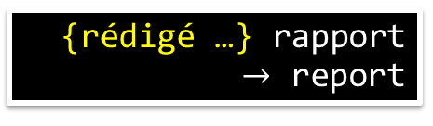
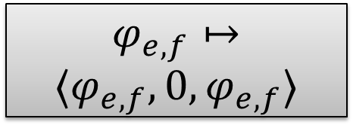
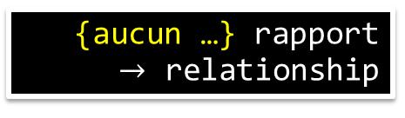


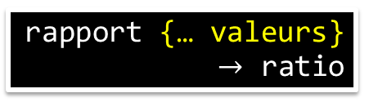

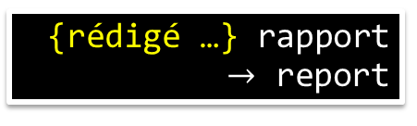
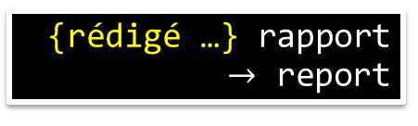

Feature augmentation I
OLD
NEW
$$φ_{e,f}↦$$
$$〈φ_{e,f},φ_{e,f},0〉$$
$$φ_{e,f}↦$$
$$〈φ_{e,f},0,φ_{e,f}〉$$
{rédigé …} rapport
$→$ report
{rédigé …} rapport
$→$ report
Original
features
{aucun …} rapport
$→$ relationship
rapport {… valeurs}
  $→$ ratio
OLD
features
{rédigé …} rapport
$→$ report
{aucun …} rapport
$→$ relationship
NEW
features
{rédigé …} rapport
$→$ report
rapport {… valeurs}
  $→$ ratio

Slide 67
Feature augmentation II
Feature augmentation is a very simple way to carry out domain adaptation
For more details on the basic approach (applicable to any feature-based classifier), see the paper:
Frustratingly Easy Domain Adaptation
Hal Daumé III
ACL 2007

Slide 68
PSD in Moses: VW-Moses integration
First general purpose classifier in Moses
Tight integration
  Can be built and run out-of-the-box, extended with new features, etc
  Fast!
    180% run time of standard Moses, fully parallelized in training (multiple processes) and decoding (multithreading)

Slide 69
Other areas of investigation
PSD for Hierarchical phrase-based translation
Discovering latent topics from parallel data
Spotting new senses: determining when a source word gains a new sense (needs a new translation)

Slide 70
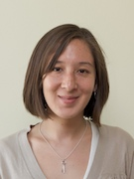

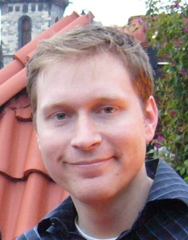
Discussion
Introduced taxonomy and measurement tools for adaptation effects in MT
“Score” errors – target of prior work – only a part of what goes wrong in translation
Marginal matching introduced as a model for addressing all S⁴ issues simultaneously: +2.4 BLEU
Data and outputs released for you to use (both in MT and as a stand-alone lexical selection task)
Feature-rich approaches integrated into Moses via VW library, applied to adaptation
Range of other problems to work on: identifying new senses, cross-domain topic models, etc.
Marine Carpuat
NRC-CNRC
Hal Daume
U Maryland
Chris Quirk
MSR

Slide 71
Summary
Defined structured prediction
  And presented a very simple approach
Presented the abstract problem of domain adaptation
Talked about domain adaptation in statistical machine translation
  Raised lots of questions about how to define the problem, data and modeling
  Parallel questions will come up throughout the semester

Slide 72
Reminder: Getting a Grade
You will make a presentation in English for 25 minutes on the paper
  Using latex, powerpoint, etc
  Include slide numbers (useful for discussion)
  Send me the slides after class
  Important technical note: this room only has *VGA*
This will be followed by 20 minutes of discussion by everyone
Three weeks after your presentation, a 6-page Hausarbeit is due
  Written prose version of your slides
  With inline citations, looking just like a standard scientific article!
    References in a standard format!!!
  If you need a review of how to do this, please check my slides on this in a previous seminar I have taught
    (Or the new slides in the Informationsextraktion seminar, to be presented on Wednesday and Thursday this week)

Slide 73
Outlook
In the seminar, we will start by reading a number of recent but classic papers on structured prediction
  Using neural networks
  These are all deep networks, in the sense that they are deep over time
  Nearly all of the papers we look at will model sequences (even the parsing paper)
Then we will begin to look at domain adaptation papers applied to structured prediction
  We'll see that very basic approaches work well, advanced work in this area is in its infancy
  So now is a good time to acquire a basic understanding!
Please read the two papers that will be discussed next time
  They are important papers to understand, setting much of the groundwork on structured prediction using neural networks
But don't forget that Tuesday next week is a holiday!

Slide 74
Thank you for your attention!

