Slide 1
Two Level Morphology
Alexander Fraser
fraser@cis.uni-muenchen.de
CIS, Ludwig-Maximilians-Universität München
Computational Morphology
SoSe 2017
2017-06-21

Slide 2
Outline
Today we will briefly discuss two-level morphology
Then Luisa will present an exercise showing how to use these concepts

Slide 3
Credits
Adapted from a lecture by Ching-Long Yeh, Tatung University
Which was adapted from:
Chapter 3 Morphology and Finite-State Transducers
Speech and Language Processing
An Introduction to Natural Language Processing, Computational Linguistics, and Speech Recognition
Daniel Jurafsky and James H. Martin

Slide 4
Two-Level Morphology
Two-level morphology is a key idea for dealing with morphology in a finite state framework
The critical generalization is that it is difficult to deal with things like orthographic rules in English with a single transducer
The key to making this work will be to use two transducers
Recall that we can compose transducers
  Composing intuitively means we feed the output of the first transducer as the input to the second transducer

Slide 5
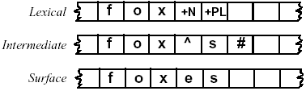
Why two levels?
Let's talk about generation: going from lexical to surface levels
The intermediate level captures morpheme segmentation
  ^ means morpheme segmentation. # means end of word
Working with an intermediate representation is powerful, it lets us deal with variation in a compact way
  We will handle orthographic generation of the English plural
  For instance, dog -> dogs, but fox -> foxes

Slide 6
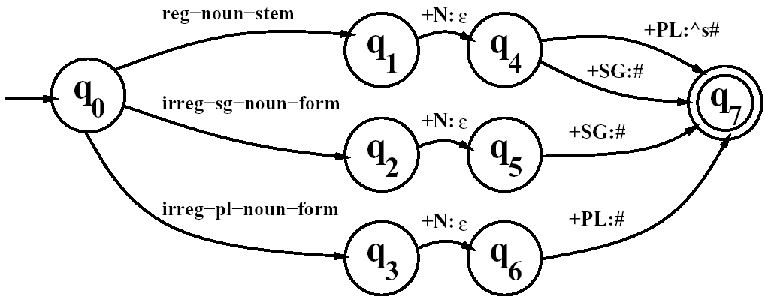
3.2 Finite-State Morphological Parsing
Morphological Parsing with FST
Inversion is useful because it makes it easy to convert a FST-as-parser into an FST-as-generator.
Composition is useful because it allows us to take two transducers than run in series and replace them with one complex transducer.
  T₁。T₂(S) = T₂(T₁(S) )
Reg-noun | Irreg-pl-noun | Irreg-sg-noun
fox fat fog aardvark | g o:e o:e s e sheep m o:i u:εs:c e | goose sheep mouse
A transducer for English nominal
number inflection T_{num}

Slide 7
3.2 Finite-State Morphological Parsing
Morphological Parsing with FST
Composition is useful because it allows us to take two transducers than run in series and replace them with one complex transducer.
  T₁。T₂(S) = T₂(T₁(S) )
Reg-noun | Irreg-pl-noun | Irreg-sg-noun
fox cat fog aardvark | g o:e o:e s e sheep m o:i u:εs:c e | goose sheep mouse
A transducer for English nominal
number inflection T_{num}

Slide 8
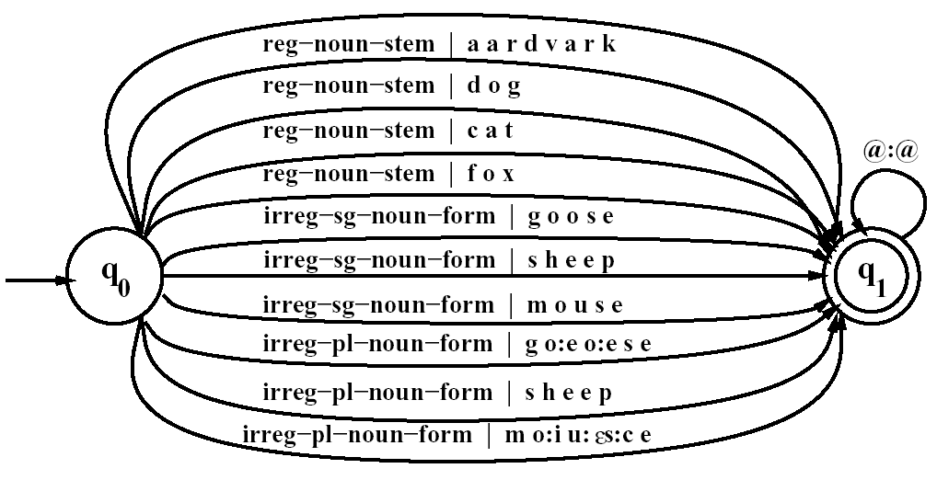
3.2 Finite-State Morphological Parsing
Morphological Parsing with FST
The transducer T_{stems}, which maps roots to their root-class

Slide 9
3.2 Finite-State Morphological Parsing
Morphological Parsing with FST
The transducer T_{stems}, which maps roots to their root-class

Slide 10
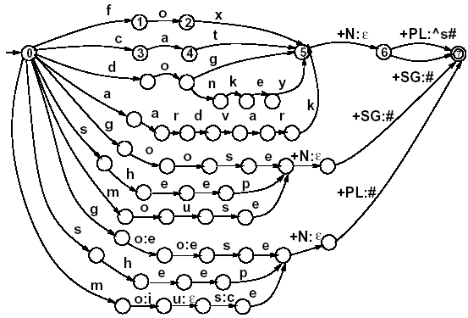
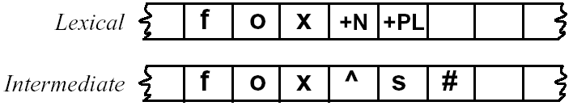
3.2 Finite-State Morphological Parsing
Morphological Parsing with FST
^: morpheme boundary
#: word boundary
A fleshed-out English nominal inflection FST
T_{lex} = T_{num}。T_{stems}

Slide 11
3.2 Finite-State Morphological Parsing
Orthographic Rules and FSTs
Spelling rules (or orthographic rules)
Name | Description of Rule | Example
Consonant doubling E deletion E insertion Y replacement K insertion | 1-letter consonant doubled before -ing/-ed Silent e dropped before -ing and -ed e added after -s, -z, -x, -ch, -sh, before -s -y changes to -ie before -s, -i before -ed Verb ending with vowel + -c add -k | beg/begging make/making watch/watches try/tries panic/panicked
  These spelling changes can be thought as taking as input a simple concatenation of morphemes and producing as output a slightly-modified concatenation of morphemes.

Slide 12
3.2 Finite-State Morphological Parsing
Orthographic Rules and FSTs
“insert an e on the surface tape just when the lexical tape has a morpheme ending in x (or z, etc) and the next morphemes is –s”
x
ε→ e/ s ^ s#
z
“rewrite a as b when it occurs between c and d”
a→ b / c d
This syntax is from the seminar paper of Chomsky and Halle (1968)
Note that ^ is used as a morpheme boundary, and # means that we talking about a word-final "-s"

Slide 13
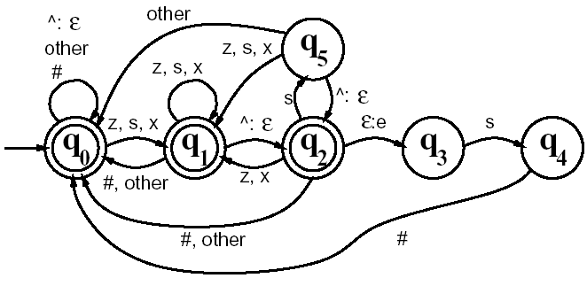
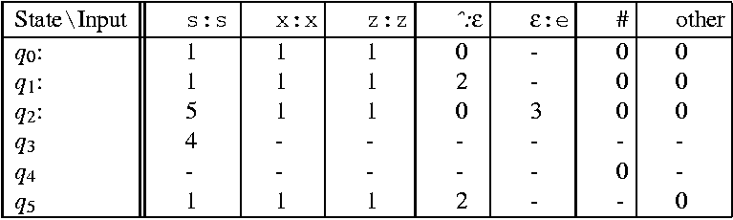
3.2 Finite-State Morphological Parsing
Orthographic Rules and FSTs
The transducer for the E-insertion rule

Slide 14
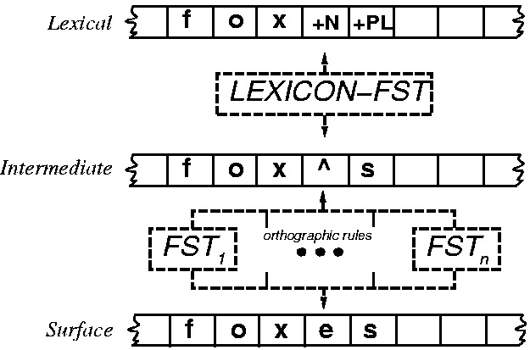
3.3 Combining FST Lexicon and Rules

Slide 15
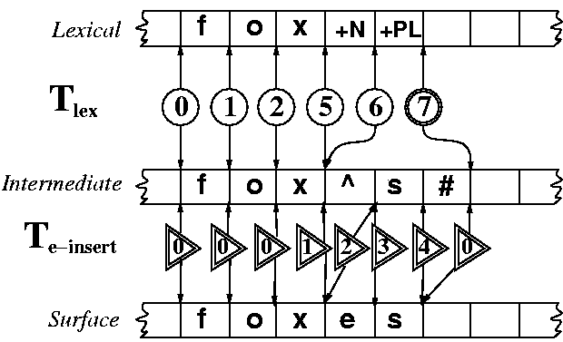
3.3 Combining FST Lexicon and Rules

Slide 16
3.3 Combining FST Lexicon and Rules
The power of FSTs is that the exact same cascade with the same state sequences is used
  When the machine is generating the surface form from the lexical tape, or
  When it is parsing the lexical tape from the surface tape.
Parsing can be slightly more complicated than generation, because of the problem of ambiguity
  For example, foxes could be fox +V +3SG as well as fox +N +PL
This shows that thinking about implementing generation might be easier than thinking about implementing parsing
  We can use our composed transducers in both directions

Slide 17
3.4 Lexicon-Free FSTs: the Porter Stemmer
Information retrieval
One of the mostly widely used stemming algorithms is the simple and efficient Porter (1980) algorithm, which is based on a series of simple cascaded rewrite rules.
  ATIONAL → ATE (e.g., relational → relate)
  ING → εif stem contains vowel (e.g., motoring → motor)
Problem:
  Not perfect: error of commision, omission
Experiments have been made
  Some improvement with smaller documents
  Any improvement is quite small

Slide 18
Summary
Two-level morphology depends on using two composed transducers to capture complex morphological phenomena
The example we looked at involved the orthography of realizing the plural morpheme "-s" in English
Two-level morphology is the technology behind most morphological analysis systems

Slide 19
Thank you for your attention

