Slide 1
Review of Basic Perl and Perl Regular Expressions
Alexander Fraser & Liane Guillou
{fraser,liane}@cis.uni-muenchen.de
CIS, Ludwig-Maximilians-Universität München
Computational Morphology and Electronic Dictionaries
SoSe 2016
2016-05-02

Slide 2
Outline
Today will start with a review of Perl
Followed by Perl regular expressions
  Regular expressions are closely tied to the Finite State Acceptors (and Transducers) we saw last time

Slide 3
Credits
Adapted from Perl Tutorial - Bioinformatics Orientation 2008
By Eric Bishop
which was:
Adapted from slides found at:
www.csd.uoc.gr/~hy439/Perl.ppt
(original author is not indicated)

Slide 4
Why Perl?
Perl is built around regular expressions
  REs are good for string processing
  Therefore Perl is a good scripting language
  Perl is especially popular for CGI scripts
Perl makes full use of the power of UNIX
Short Perl programs can be very short
  “Perl is designed to make the easy jobs easy, without making the difficult jobs impossible.” -- Larry Wall, Programming Perl

Slide 5
Why not Perl?
Perl is very UNIX-oriented
  Perl is available on other platforms...
  ...but isn’t always fully implemented there
  However, Perl is often the best way to get some UNIX capabilities on less capable platforms
Perl does not scale well to large programs
  Weak subroutines, heavy use of global variables
Perl’s syntax is not particularly appealing

Slide 6
Perl Example 1
#!/usr/bin/perl -w
#
# Program to do the obvious
#
print 'Hello world.'; # Print a message

Slide 7
Understanding “Hello World”
Comments are # to end of line
  But the first line, #!/usr/bin/perl, tells where to find the Perl compiler on your system
  I use the modifier "-w" to get extra warnings, highly recommended
Perl statements end with semicolons
Perl is case-sensitive

Slide 8
Running your program
Two ways to run your program:
  perl hello.pl
  chmod 700 hello.pl
  ./hello.pl

Slide 9
Scalar variables
Scalar variables start with $
Scalar variables hold strings or numbers, and they are interchangeable
When you first use (declare) a variable use the my keyword to indicate the variable’s scope
  Without "use strict;", this is not necessary but good programming practice
  With "use strict;", won't compile (highly recommended!)
Example:
  use strict;
  my $priority = 9;

Slide 10
Arithmetic in Perl
$a = 1 + 2; # Add 1 and 2 and store in $a
$a = 3 - 4; # Subtract 4 from 3 and store in $a
$a = 5 * 6; # Multiply 5 and 6
$a = 7 / 8; # Divide 7 by 8 to give 0.875
$a = 9 ** 10; # Nine to the power of 10, that is, 9¹⁰
$a = 5 % 2; # Remainder of 5 divided by 2
++$a; # Increment $a and then return it
$a++; # Return $a and then increment it
--$a; # Decrement $a and then return it
$a--; # Return $a and then decrement it

Slide 11
Arithmetic in Perl cont’d
You sometimes may need to group terms
  Use parentheses ()
  (5-6)*2 is not 5-(6*2)

Slide 12
String and assignment operators
$a = $b . $c; # Concatenate $b and $c
$a = $b x $c; # $b repeated $c times
$a = $b; # Assign $b to $a
$a += $b; # Add $b to $a
$a -= $b; # Subtract $b from $a
$a .= $b; # Append $b onto $a

Slide 13
Single and double quotes
$a = 'apples';
$b = 'bananas';
print $a . ' and ' . $b;
  prints: apples and bananas
print '$a and $b';
  prints: $a and $b
print "$a and $b";
  prints: apples and bananas

Slide 14
Perl Example 2
#!/usr/bin/perl -w
# program to add two numbers
use strict;
my $a = 3;
my $b = 5;
my $c = “the sum of $a and $b and 9 is: ”;
my $d = $a + $b + 9;
print “$c $d\n”;

Slide 15
Exercise 1
Modify example 2 to print (12 -9 )*3
(don’t do it in your head!)

Slide 16
if statements
if ($a eq “”)
{
print "The string is empty\n";
}
else
{
print "The string is not empty\n";
}

Slide 17
Tests
All of the following are false:
0, '0', "0", '', "”, “Zero”
Anything not false is true
Use == and != for numbers, eq and ne for strings
&&, ||, and ! are and, or, and not, respectively.

Slide 18
if - elsif statements
if ($a eq “”)
{ print "The string is empty\n"; }
elsif (length($a) == 1)
{ print "The string has one character\n"; }
elsif (length($a) == 2)
{ print "The string has two characters\n"; }
else
{ print "The string has many characters\n"; }

Slide 19
while loops
#!/usr/bin/perl –w
use strict;
my $i = 5;
while ($i < 15)
{
print ”$i";
$i++;
}

Slide 20
do..while loops
#!/usr/local/bin/perl
my $i = 5;
do
{
print ”$i\n";
$i++;
}
while ($i < 15” && $i != 5);

Slide 21
for loops
for (my $i = 5; $i < 15; $i++)
{
print "$i\n";
}

Slide 22
last
The last statement can be used to exit a loop before it would otherwise end
for (my $i = 5; $i < 15; $i++)
{
print "$i,";
if($i == 10)
{
last;
}
}
print “\n”;
when run, this prints 5,6,7,8,9,10

Slide 23
next
The next statement can be used to end the current loop iteration early
for (my $i = 5; $i < 15; $i++)
{
if($i == 10)
{
next;
}
print "$i,";
}
print “\n”
when run, this prints 5,6,7,8,9,11,12,13,14

Slide 24
Standard I/O
On the UNIX command line;
  < filename means to get input from this file
  > filename means to send output to this file
STDIN is standard input
  To read a line from standard input use:
  my $line = <STDIN>;
STDOUT is standard output
  Print will output to STDOUT by default
  You can also use :
  print STDOUT “my output goes here”;

Slide 25
File I/O
Often we want to read/write from specific files
In perl, we use file handles to manipulate files
The syntax to open a handle to read to a file for reading is different than opening a handle for writing
  To open a file handle for reading:
  open IN, “<fileName”;
  To open a file handle for writing:
  open OUT, “>fileName”;
File handles must be closed when we are finished with them -- this syntax is the same for all file handles
  close IN;

Slide 26
File I/O cont’d
Once a file handle is open, you may use it just like you would use STDIN or STDOUT
To read from an open file handle:
  my $line = <IN>;
To write to an open file handle:
  print OUT “my output data\n”;

Slide 27
Perl Example 3
#!/usr/bin/perl -w
# singlespace.pl: remove blank lines from a file
# Usage: perl singlespace.pl < oldfile > newfile
use strict;
while (my $line = <STDIN>)
{
if ($line eq "\n")
{
next;
}
print "$line";
}

Slide 28
Exercise 2
Modify Example 3 so that blank lines are removed ONLY if they occur in first 10 lines of original file

Slide 29
Arrays
my @food = ("apples", "bananas", "cherries");
But…
print $food[1];
  prints "bananas"
my @morefood = ("meat", @food);
  @morefood now contains:
  ("meat", "apples", "bananas", "cherries");

Slide 30
push and pop
push adds one or more things to the end of a list
  push (@food, "eggs", "bread");
  push returns the new length of the list
pop removes and returns the last element
  $sandwich = pop(@food);
$len = @food; # $len gets length of @food
$#food # returns index of last element

Slide 31
@ARGV: a special array
A special array, @ARGV, contains the parameters you pass to a program on the command line
If you run “perl test.pl a b c”, then within test.pl @ARGV will contain (“a”, “b”, “c”)

Slide 32
foreach
# Visit each item in turn and call it $morsel
foreach my $morsel (@food)
{
print "$morsel\n";
print "Yum yum\n";
}

Slide 33
Hashes / Associative arrays
Associative arrays allow lookup by name rather than by index
Associative array names begin with %
Example:
  my %fruit = ("apples”=>"red", "bananas”=>"yellow", "cherries”=>"red");
  Now, $fruit{"bananas"} returns "yellow”
  To set value of a hash element:
  $fruit{“bananas”} = “green”;

Slide 34
Hashes / Associative Arrays II
To remove a hash element use delete
  delete $fruit{“bananas”};
You cannot index an associative array, but you can use the keys and values functions:
foreach my $f (keys %fruit)
{
print ("The color of $f is " . $fruit{$f} . "\n");
}

Slide 35
Example 4
#!/usr/bin/perl –w
use strict;
my @names = ( "bob", "sara", "joe" );
my %likesHash = ( "bob"=>"steak", "sara"=>"chocolate", "joe"=>"rasberries" );
foreach my $name (@names)
{
my $nextLike = $likesHash{$name};
print "$name likes $nextLike\n";
}

Slide 36
Exercise 3
Modify Example 4 in the following way:
  Suppose we want to keep track of books that these people like as well as food
    Bob likes The Lord of the Rings
    Sara likes Hitchhiker’s Guide to the Galaxy
    Joe likes Thud!
  Modify Example 4 to print each person’s book preference as well as food preference

Slide 37
Regular Expressions
$sentence =~ /the/
  True if $sentence contains "the"
$sentence = "The dog bites.";
if ($sentence =~ /the/) # is false
  …because Perl is case-sensitive
!~ is "does not contain"

Slide 38
RE special characters
. # Any single character except a newline
^ # The beginning of the line or string
$ # The end of the line or string
* # Zero or more of the last character
+ # One or more of the last character
? # Zero or one of the last character

Slide 39
RE examples
^.*$ # matches the entire string
hi.*bye # matches from "hi" to "bye" inclusive
x +y # matches x, one or more blanks, and y
^Dear # matches "Dear" only at beginning
bags? # matches "bag" or "bags"
hiss+ # matches "hiss", "hisss", "hissss", etc.

Slide 40
Square brackets
[qjk] # Either q or j or k
[^qjk] # Neither q nor j nor k
[a-z] # Anything from a to z inclusive
[^a-z] # No lower case letters
[a-zA-Z] # Any letter
[a-z]+ # Any non-zero sequence of
# lower case letters

Slide 41
More examples
[aeiou]+ # matches one or more vowels
[^aeiou]+ # matches one or more nonvowels
[0-9]+ # matches an unsigned integer
[0-9A-F] # matches a single hex digit
[a-zA-Z] # matches any letter
[a-zA-Z0-9_]+ # matches identifiers

Slide 42
More special characters
\n # A newline
\t # A tab
\w # Any alphanumeric; same as [a-zA-Z0-9_]
\W # Any non-word char; same as [^a-zA-Z0-9_]
\d # Any digit. The same as [0-9]
\D # Any non-digit. The same as [^0-9]
\s # Any whitespace character
\S # Any non-whitespace character
\b # A word boundary, outside [] only
\B # No word boundary

Slide 43
Quoting special characters
\| # Vertical bar
\[ # An open square bracket
\) # A closing parenthesis
\* # An asterisk
\^ # A carat symbol
\/ # A slash
\\ # A backslash

Slide 44
Alternatives and parentheses
jelly|cream # Either jelly or cream
(eg|le)gs # Either eggs or legs
(da)+ # Either da or dada or
# dadada or...

Slide 45
The $_ variable
Often we want to process one string repeatedly
The $_ variable holds the current string
If a subject is omitted, $_ is assumed
Hence, the following are equivalent:
  if ($sentence =~ /under/) …
  $_ = $sentence; if (/under/) ...

Slide 46
Case-insensitive substitutions
s/london/London/i
  case-insensitive substitution; will replace london, LONDON, London, LoNDoN, etc.
You can combine global substitution with case-insensitive substitution
  s/london/London/gi

Slide 47
split
split breaks a string into parts
$info = "Caine:Michael:Actor:14, Leafy Drive";
@personal = split(/:/, $info);
@personal =
("Caine", "Michael", "Actor", "14, Leafy Drive");

Slide 48
Example 5
#!/usr/bin/perl –w
use strict;
my @lines = ( "Boston is cold.",
"I like the Boston Red Sox.",
"Boston drivers make me see red!" );
foreach my $line (@lines)
{
if ($line =~ /Boston.*red/i )
{
print "$line\n";
}
}

Slide 49
Exercise 4
Add the following to @lines in Example 5: “In Boston, there is a big Citgo sign that is red and white.”
Now modify Example 5 to print out only the same two lines as before

Slide 50
Calling subroutines
Assume you have a subroutine printargs that just prints out its arguments
Subroutine calls:
  printargs("perly", "king");
    Prints: "perly king"
  printargs("frog", "and", "toad");
    Prints: "frog and toad"

Slide 51
Defining subroutines
Here's the definition of printargs:
  sub printargs
  { print join(“ “, @_) . ”\n"; }
  Parameters for subroutines are in an array called @_
  The join() function is the opposite of split()
    Joins the strings in an array together into one string
    The string specified by first argument is put between the strings in the arrray

Slide 52
Returning a result
The value of a subroutine is the value of the last expression that was evaluated
sub maximum
{
if ($_[0] > $_[1])
{ $_[0]; }
else
{ $_[1]; }
}
$biggest = maximum(37, 24);

Slide 53
Returning a result (cont’d)
You can also use the “return” keyword to return a value from a subroutine
  This is better programming practice
sub maximum
{
my $max = $_[0];
if ($_[1] > $_[0])
{ max = $_[1]; }
return $max;
}
$biggest = maximum(37, 24);

Slide 54
Example 6
#!/usr/bin/perl -w
use strict;
sub inside
{
my $a = shift @_;
my $b = shift @_;
$a =~ s/ //g;
$b =~ s/ //g;
return ($a =~ /$b/ || $b =~ /$a/);
}
if( inside("lemon", "dole money") )
{
print "\"lemon\" is in \"dole money\"\n";
}

Slide 55
Exercise 5
Create a new subroutine, doesnotstart which, given 2 strings, tests that neither string starts with the other one
  doesnotstart(abc, abcdef) will be false
  doesnotstart(doggy, dog) will be false
  doesnotstart(bad dog, dog) will be true

Slide 56
Engineering Regular Expressions
There are some nice online packages and websites that can help with this.
Let's look at a regular expression for recognizing simple floating point numbers like:
1
-1
-1.56
+200000.5
(Credit for basic idea to TCL manual, version 8.5)

Slide 57
/[-+]?([0-9])*\.?([0-9]*)/
Does this seem reasonable?
We can go to regexper.com, and put in this regular expression and visualize it

Slide 58
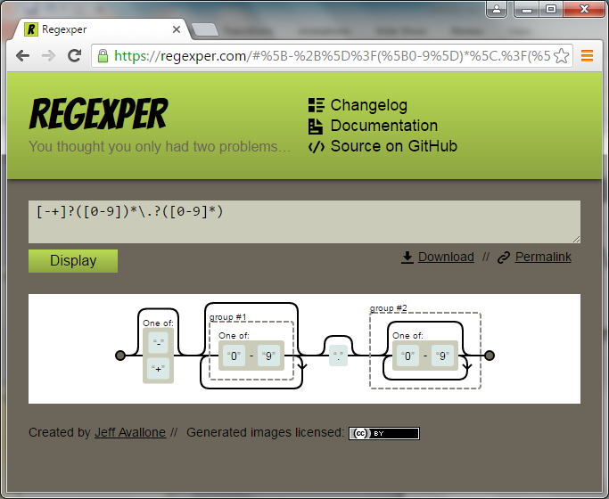

Slide 59
We can test our regular expression against strings at regex101.com

Slide 60
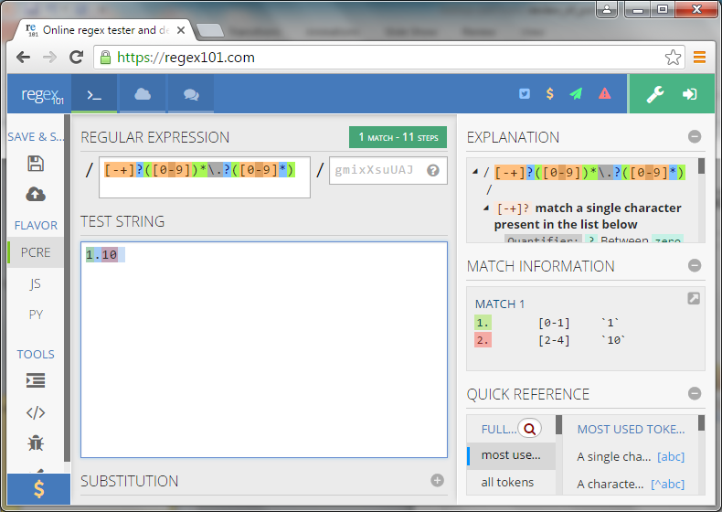

Slide 61
Looks good, right?
But... What is up with match 1 on the next slide?
  Credit here to Veronika Hintzen for noticing and explaining this bug in class!

Slide 62
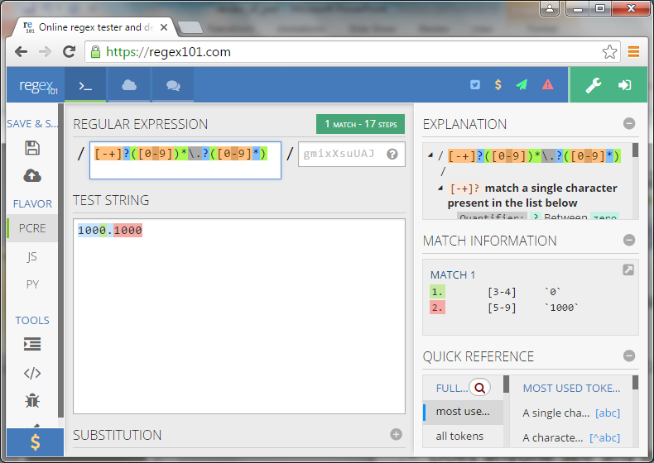

Slide 63
Let's go back to the regexper.com graphic (back a few slides)
Look at the first group. It looks different from the second group
We can fix this by changing the regular expression to be like this (we move the first star inside the parenthesis):
/[-+]?([0-9]*)\.?([0-9]*)/

Slide 64
regex101.com allows us to test our new regular expression
  Now it works as expected!

Slide 65
perlretut
Final word: if you really want to master regular expressions, take a look at:
perlretut
The perl regular expressions tutorial

Slide 66
Thank you for your attention

