Slide 1
Information Extraction
Lecture 4 – Named Entity Recognition II
CIS, LMU München
Winter Semester 2020-2021
Prof. Dr. Alexander Fraser, CIS

Slide 2
Administravia
Seminar
  Dates are up. PLEASE CHECK YOUR NAME, TOPIC AND PRESENTATION LANGUAGE!
Speaking times:
  *10 minutes* per speaker for groups of 3
  *13 minutes* per speaker for groups of 2
Tips
    Presentations should have slide numbers to facilitate the discussion
  And, as you know, the Hausarbeit is due 3 weeks after your presentation!

Slide 3
Reading
Please read Sarawagi Chapter 3 for next time
  Sarawagi talks about classifier based IE in Chapter 3
  Unfortunately, the discussion is very technical. I would recommend reading it, but not worrying too much about the math (yet), just get the basic idea
  Please plan to reread Chapter 3 again after we discuss machine learning

Slide 4
Outline
Topics from last time
  Evaluation metrics in more detail
  Quick review of Rule-Based NER
Evaluations and gold standards in IE
  Issues in Evaluation of IE
  Human Annotation for NER
IE end-to-end
Introduction: named entity detection as a classification problem

Slide 5
Recall
Measure of how much relevant information the system has extracted (coverage of system).
Exact definition:
Recall = 1 if no possible correct answers
else:
# of correct answers given by system
total # of possible correct answers in text
Slide modified from Butt/Jurafsky/Martin

Slide 6
Precision
Measure of how much of the information the system returned is correct (accuracy).
Exact definition:
Precision = 1 if no answers given by system
else:
# of correct answers given by system
# of answers given by system
Slide modified from Butt/Jurafsky/Martin

Slide 7
Evaluation
Every system, algorithm or theory should be evaluated, i.e. its output should be compared to the gold standard (i.e. the ideal output). Suppose we try to find scientists…
Algorithm output:
O = {Einstein, Bohr, Planck, Clinton, Obama}
✓
✓
✓
✗
✗
Gold standard:
G = {Einstein, Bohr, Planck, Heisenberg}
✓
✓
✓
✗
Precision:
What proportion of the
output is correct?
| O ∧ G |
|O|
Recall:
What proportion of the
gold standard did we get?
| O ∧ G |
|G|
Slide modified from Suchanek

Slide 8
Evaluation
Why Evaluate?
What to Evaluate?
How to Evaluate?
Slide from Giles

Slide 9
Why Evaluate?
Determine if the system is useful
Make comparative assessments with other methods/systems
  Who’s the best?
Test and improve systems
Others: Marketing, …
Slide modified from Giles

Slide 10
What to Evaluate?
In Information Extraction, we try to match a pre-annotated gold standard
But the evaluation methodology is mostly taken from Information Retrieval
  So let's consider relevant documents to a search engine query for now
  We will return to IE evaluation later

Slide 11
Relevant vs. Retrieved Documents
Retrieved
Relevant
All docs available
Set approach
Slide from Giles

Slide 12
Contingency table of relevant and retrieved documents
relevant
Rel
NotRel
Ret_{Rel}
Ret_{NotRel}
Ret
Ret = Ret_{Rel} + Ret_{NotRel}
retrieved
NotRet_{Rel}
NotRet_{NotRel}
NotRet = NotRet_{Rel} + NotRet_{NotRel}
NotRet
Relevant = Ret_{Rel} + NotRet_{Rel}
Not Relevant = Ret_{NotRel} + NotRet_{NotRel}
Total # of documents available N = Ret_{Rel} + NotRet_{Rel} + Ret_{NotRel} + NotRet_{NotRel}
Precision: P= Ret_{Rel} / Retrieved
Recall: R = Ret_{Rel} / Relevant
P = [0,1]
R = [0,1]
Slide from Giles

Slide 13
Contingency table of classification of documents
Actual Condition
Present
Absent
tp
fp
type1
fp type 1 error
Positive
Test result
fn
type2
tn
Negative
fn type 2 error
present = tp + fn
positives = tp + fp
negatives = fn + tn
Total # of cases N = tp + fp + fn + tn
Slide modified from Giles

Slide 14
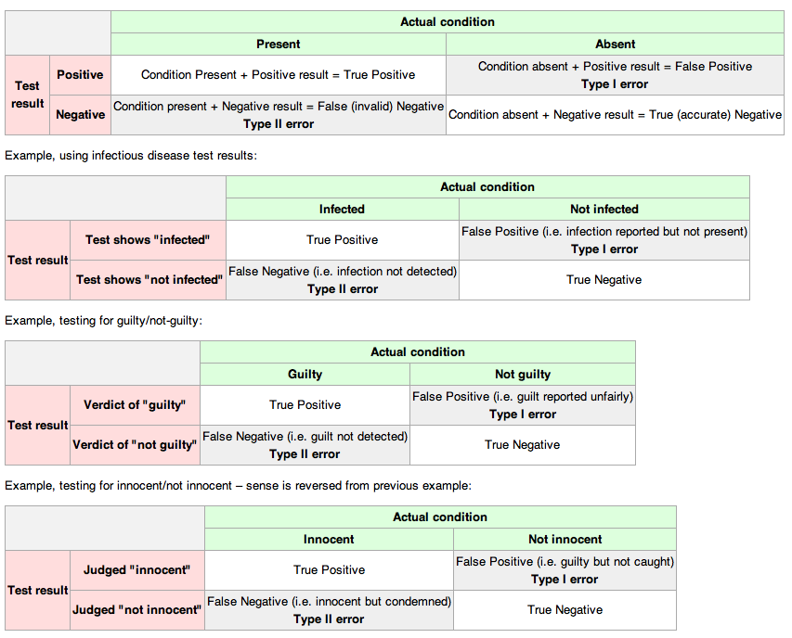
Slide from Giles

Slide 15
Retrieval example
Documents available: D1,D2,D3,D4,D5,D6,D7,D8,D9,D10
Relevant: D1, D4, D5, D8, D10
Query to search engine retrieves: D2, D4, D5, D6, D8, D9
 | relevant | not relevant
retrieved
not retrieved
Slide from Giles

Slide 16
Retrieval example
Documents available: D1,D2,D3,D4,D5,D6,D7,D8,D9,D10
Relevant: D1, D4, D5, D8, D10
Query to search engine retrieves: D2, D4, D5, D6, D8, D9
 | relevant | not relevant
retrieved | D4,D5,D8 | D2,D6,D9
not retrieved | D1,D10 | D3,D7
Slide from Giles

Slide 17
Precision and Recall – Contingency Table
Retrieved
Not retrieved
w=3
x=2
Relevant
Relevant = w+x= 5
y=3
z=2
Not relevant
Not Relevant = y+z = 5
Retrieved = w+y = 6
Not Retrieved = x+z = 4
Total documents N = w+x+y+z = 10
Precision: P= w / w+y =3/6 =.5
Recall: R = w / w+x = 3/5 =.6
Slide from Giles

Slide 18
Contingency table of relevant and retrieved documents
relevant
Rel
NotRel
Ret_{Rel}=3
Ret_{NotRel}=3
Ret
Ret = Ret_{Rel} + Ret_{NotRel}
= 3 + 3 = 6
retrieved
NotRet_{Rel}=2
NotRet_{NotRel}=2
NotRet
NotRet = NotRet_{Rel} + NotRet_{NotRe}
= 2 + 2 = 4
Relevant = Ret_{Rel} + NotRet_{Rel}
= 3 + 2 = 5
Not Relevant = Ret_{NotRel} + NotRet_{NotRel}
= 2 + 2 = 4
Total # of docs N = Ret_{Rel} + NotRet_{Rel} + Ret_{NotRel} + NotRet_{NotRel}= 10
Precision: P= Ret_{Rel} / Retrieved = 3/6 = .5
Recall: R = Ret_{Rel} / Relevant = 3/5 = .6
Slide modified from Giles

Slide 19
What do we want
Find everything relevant – high recall
Only retrieve what is relevant – high precision
Slide from Giles

Slide 20
Relevant vs. Retrieved
All docs
Retrieved
Relevant
Slide from Giles

Slide 21
Precision vs. Recall
All docs
Retrieved
Relevant
Slide from Giles

Slide 22
Retrieved vs. Relevant Documents
Very high precision, very low recall
retrieved
Relevant
Slide from Giles

Slide 23
Retrieved vs. Relevant Documents
High recall, but low precision
Relevant
retrieved
Slide from Giles

Slide 24
Retrieved vs. Relevant Documents
Very low precision, very low recall (0 for both)
retrieved
Relevant
Slide from Giles

Slide 25
Retrieved vs. Relevant Documents
High precision, high recall (at last!)
retrieved
Relevant
Slide from Giles

Slide 26
Why Precision and Recall?
Slide modified from Giles
Get as much of what we want while at the same time getting as little junk as possible.
Recall is the percentage of relevant documents returned compared to everything that is available!
Precision is the percentage of relevant documents compared to what is returned!
The desired trade-off between precision and recall is specific to the scenario we are in

Slide 27
Relation to Contingency Table
 | Doc is Relevant | Doc is NOT relevant
Doc is retrieved | a | b
Doc is NOT retrieved | c | d
Accuracy: (a+d) / (a+b+c+d)
Precision: a/(a+b)
Recall: a/(a+c)
Why don’t we use Accuracy for IR?
  (Assuming a large collection)
    Most docs aren’t relevant
    Most docs aren’t retrieved
    Inflates the accuracy value
Slide from Giles

Slide 28
CMU Seminars task
Given an email about a seminar
Annotate
  Speaker
  Start time
  End time
  Location

Slide 29
CMU Seminars - Example
<0.24.4.93.20.59.10.jgc+@NL.CS.CMU.EDU (Jaime Carbonell).0>
Type: cmu.cs.proj.mt
Topic: <speaker>Nagao</speaker> Talk
Dates: 26-Apr-93
Time: <stime>10:00</stime> - <etime>11:00 AM</etime>
PostedBy: jgc+ on 24-Apr-93 at 20:59 from NL.CS.CMU.EDU (Jaime Carbonell)
Abstract:
<paragraph><sentence>This Monday, 4/26, <speaker>Prof. Makoto Nagao</speaker> will give a seminar in the <location>CMT red conference room</location> <stime>10</stime>-<etime>11am</etime> on recent MT research results</sentence>.</paragraph>

Slide 30
Creating Rules
Suppose we observe "the seminar at <stime>4 pm</stime> will [...]" in a training document
The processed representation will have access to the words and to additional knowledge
We can create a very specific rule for <stime>
  And then generalize this by dropping constraints (as discussed previously)

Slide 31
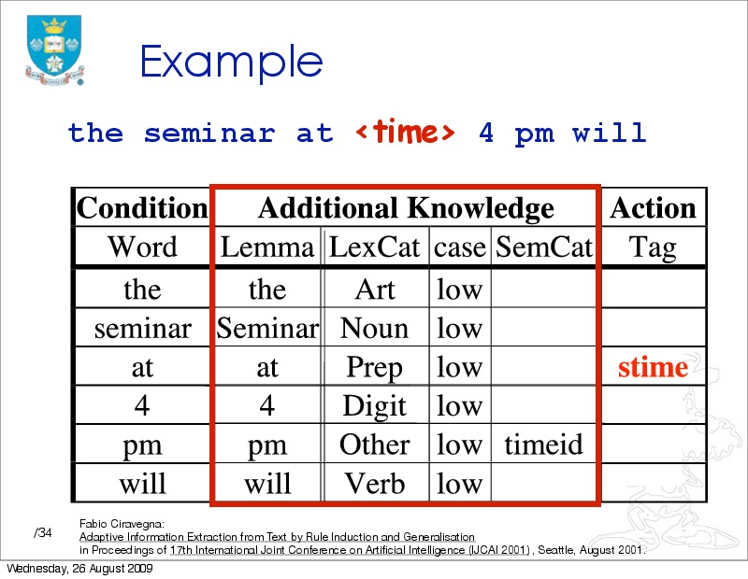

Slide 32
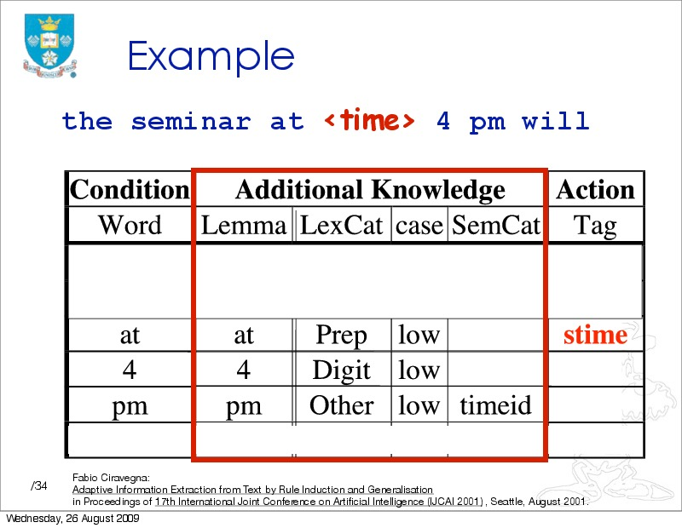

Slide 33
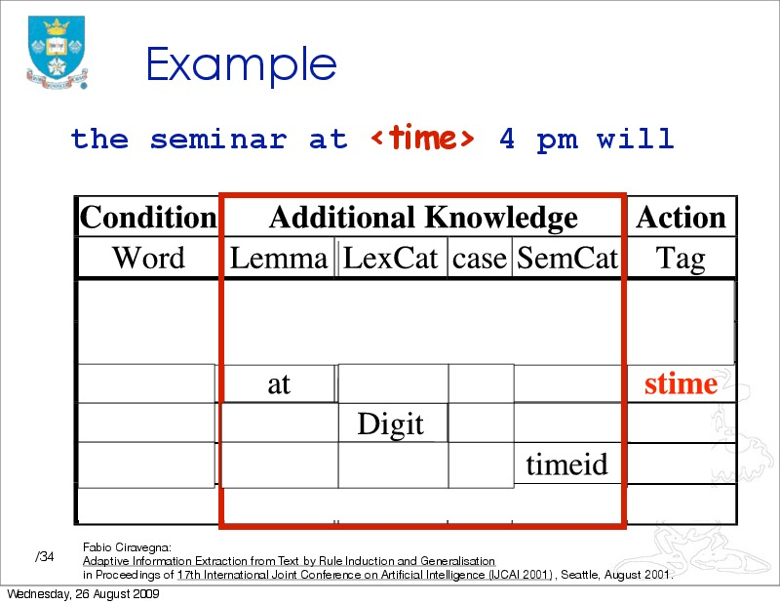

Slide 34
For each rule, we look for:
  Support (training examples that match this pattern)
  Conflicts (training examples that match this pattern with no annotation, or a different annotation)
Suppose we see:
"tomorrow at <stime>9 am</stime>"
  The rule in our example applies!
  If there are no conflicts, we have a more general rule
Overall: we try to take the most general rules which don't have conflicts

Slide 35
Returning to Evaluation
This time, evaluation specifically for IE

Slide 36
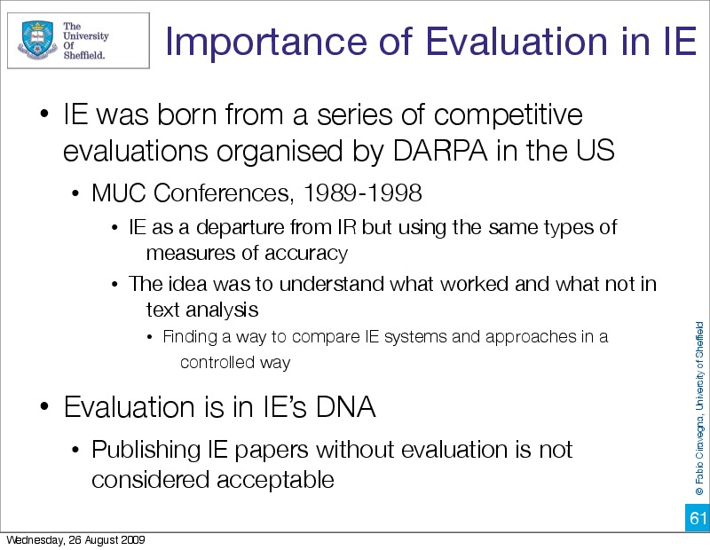

Slide 37
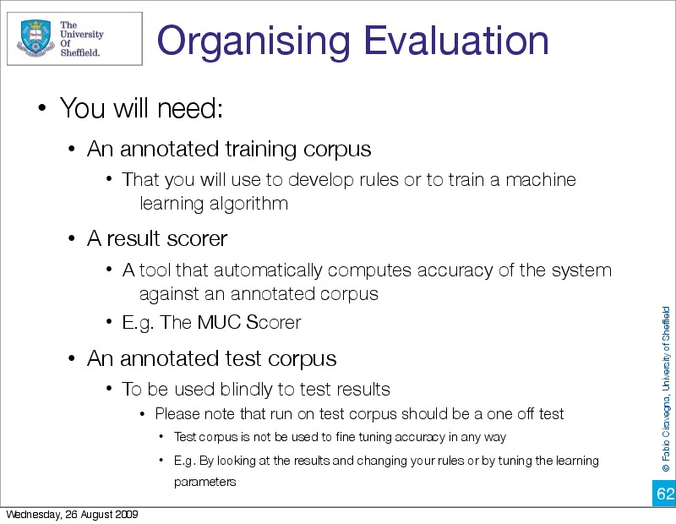

Slide 38
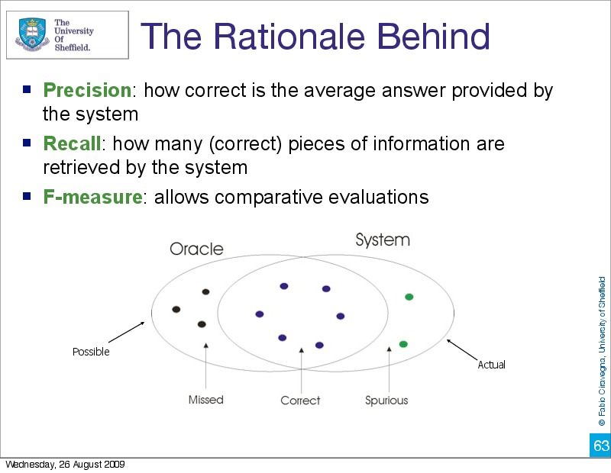

Slide 39
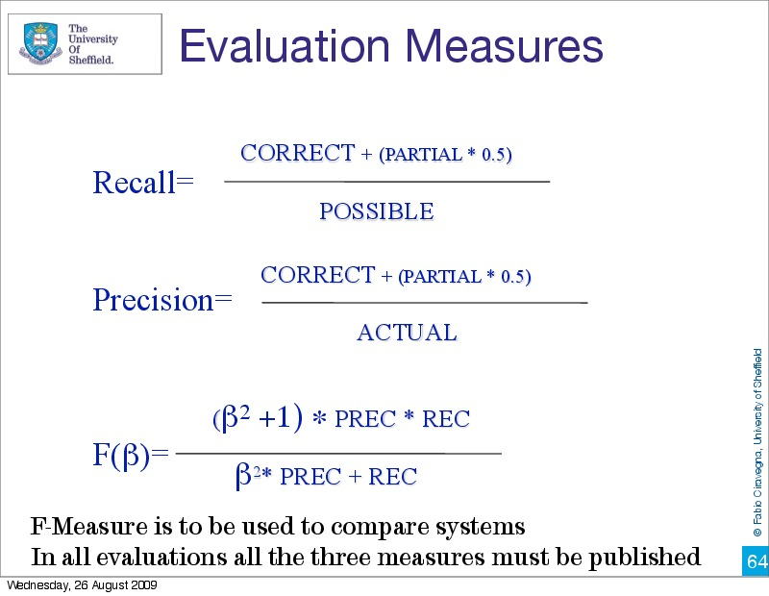

Slide 40
False Negative in CMU Seminars
Gold standard test set:
  Starting from <stime>11 am</stime>
System marks nothing:
  Starting from 11 am
False negative (which measure does this hurt?)

Slide 41
False Positive in CMU Seminars
Gold standard test set:
  ... Followed by lunch at 11:30 am , and meetings
System marks:
  ... at <stime>11:30 am</stime>
False positive (which measure does this hurt?)

Slide 42
Mislabeled in CMU Seminars
Gold standard test set:
  at a different time - <stime>6 pm</stime>
System marks:
  ... - <etime>6 pm</etime>
What sort of error do we have here?
Which measures are affected?
Note that this is different from Information Retrieval!

Slide 43
Partial Matches in CMU Seminars
Gold standard test set:
  ... at <stime>5 pm</stime>
System marks:
  ... at <stime>5</stime> pm
Then I get a partial match (worth 0.5)
Also different from Information Retrieval

Slide 44


Slide 45
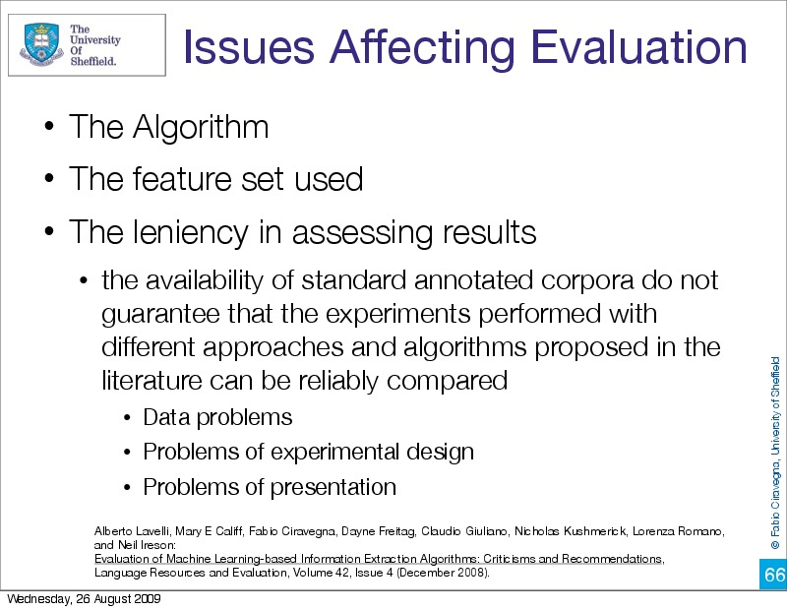

Slide 46
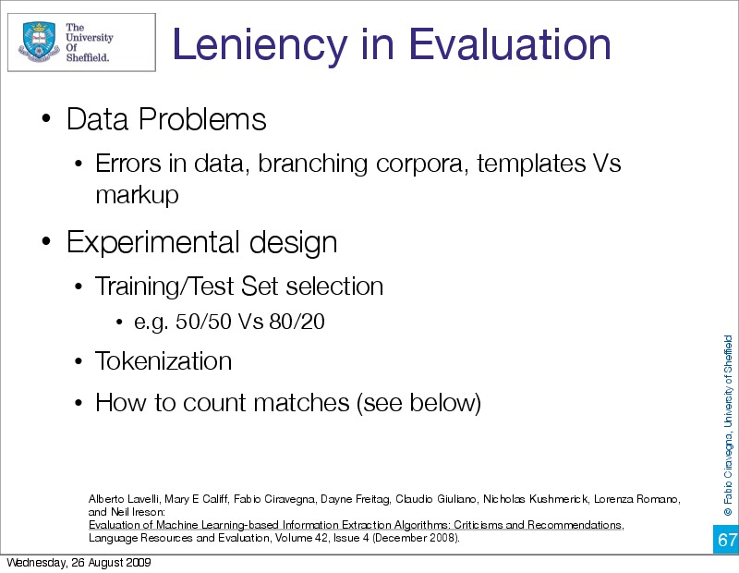

Slide 47
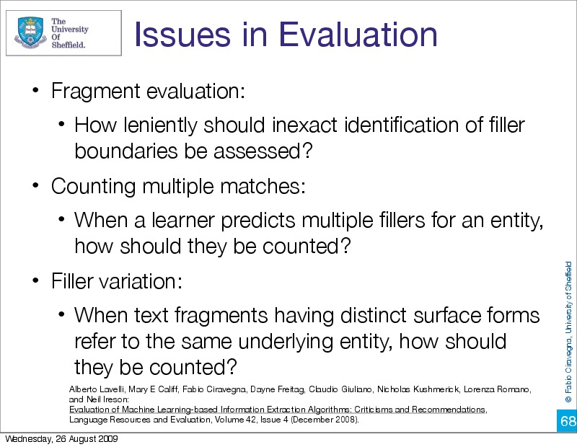

Slide 48
Evaluation is a critical issue where there is still much work to be done
But before we can evaluate, we need a gold standard
Training IE systems
  Critical component for "learning" statistical classifiers
  The more data, the better the classifier
Can also be used for developing a handcrafted NER system
  Constant rescoring and coverage checks are very helpful
Necessary in both cases for evaluation

Slide 49


Slide 50
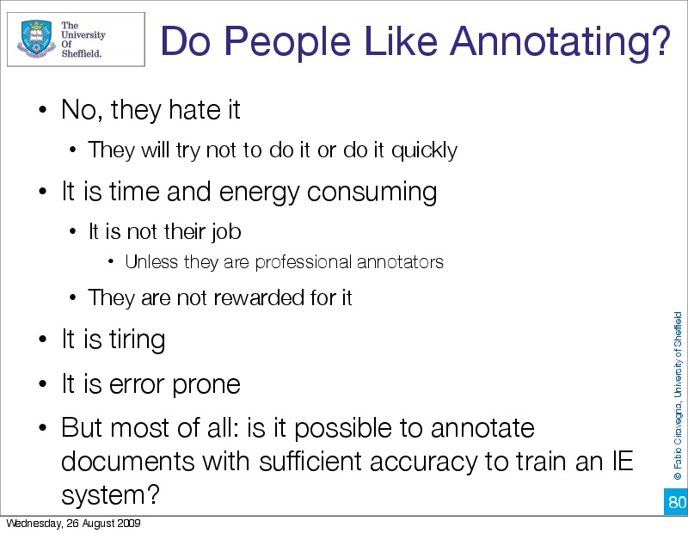

Slide 51
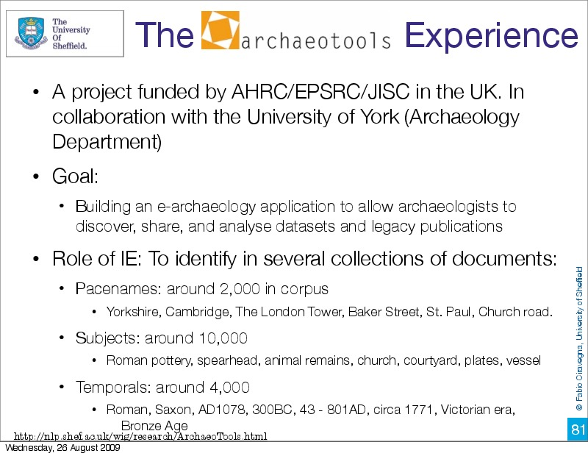

Slide 52
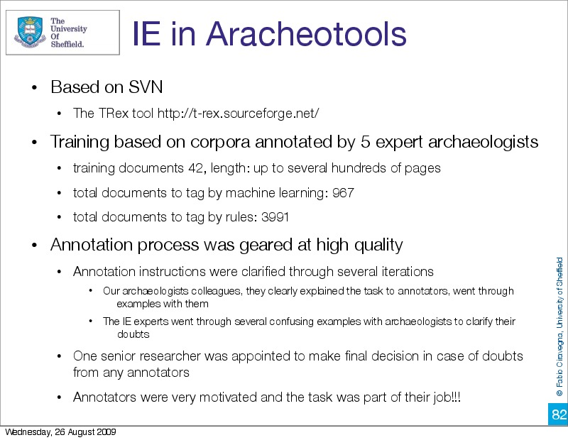

Slide 53
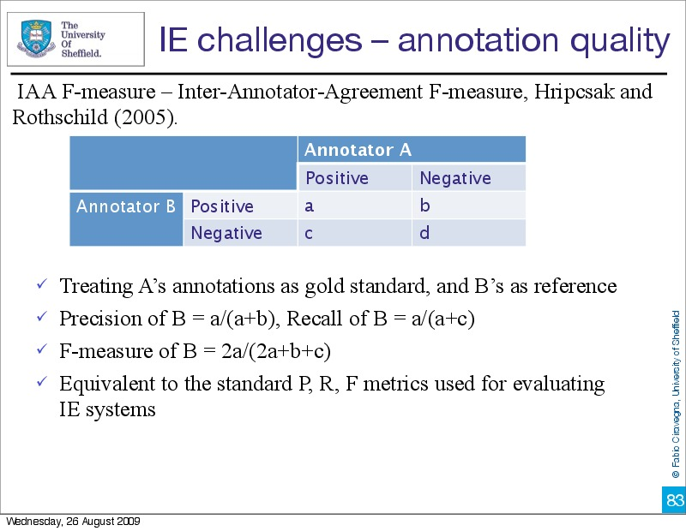

Slide 54
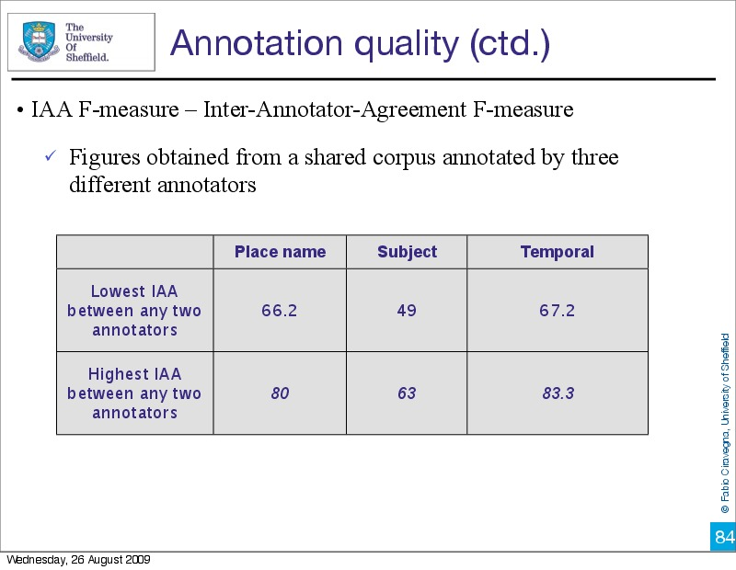

Slide 55
Annotator Variability
Differences in annotation are a significant problem
  Only some people are good at annotation
  Practice helps
Even good annotators can have different understanding of the task
  For instance, in doubt, annotate? Or not?
  (~ precision/recall tradeoffs)
Effect of using gold standard corpora that are not well annotated
  Evaluations can return inaccurate results
  Systems trained on inconsistent data can develop problems which are worse than if the training examples are eliminated
Crowd-sourcing, which we will talk about later, has all of these same problems even more strongly!

Slide 56
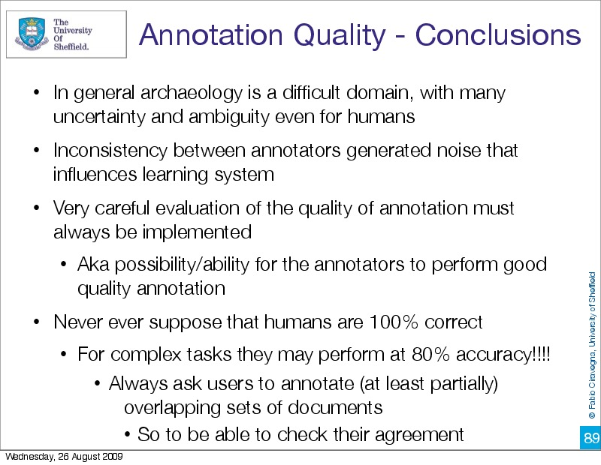

Slide 57
CMU Seminars task
Given an email about a seminar…
Annotate mentions of:
  Speaker
  Start time
  End time
  Location

Slide 58
CMU Seminars - Example
<0.24.4.93.20.59.10.jgc+@NL.CS.CMU.EDU (Jaime Carbonell).0>
Type: cmu.cs.proj.mt
Topic: <speaker>Nagao</speaker> Talk
Dates: 26-Apr-93
Time: <stime>10:00</stime> - <etime>11:00 AM</etime>
PostedBy: jgc+ on 24-Apr-93 at 20:59 from NL.CS.CMU.EDU (Jaime Carbonell)
Abstract:
<paragraph><sentence>This Monday, 4/26, <speaker>Prof. Makoto Nagao</speaker> will give a seminar in the <location>CMT red conference room</location> <stime>10</stime>-<etime>11am</etime> on recent MT research results</sentence>.</paragraph>

Slide 59
IE Template
Slot Name | Value
Speaker | Prof. Makoto Nagao
Start time | 1993-04-26 10:00
End time | 1993-04-26 11:00
Location | CMT red conference room
Message Identifier (Filename) | 0.24.4.93.20.59.10.jgc+@NL.CS.CMU.EDU (Jaime Carbonell).0
Template contains *canonical* version of information
  There are several "mentions" of speaker, start time and end-time in the email (see previous slide)
  Only one value for each slot
  Location could probably also be canonicalized
  Important: also keep link back to original text

Slide 60
How many database entries?
In the CMU seminars task, one message generally results in one database entry
  Or no database entry if you process an email that is not about a seminar
In other IE tasks, can get multiple database entries from a single document or web page
  A page of concert listings -> database entries
  Entries in timeline -> database entries

Slide 61
Summary
IR: end-user
  Start with information need
  Gets relevant documents, hopefully information need is solved
  Important difference: Traditional IR vs. Web R
IE: analyst (you)
  Start with template design and corpus
  Get database of filled out templates
    Followed by subsequent processing (e.g., data mining, or user browsing, etc.)

Slide 62
IE: what we've seen so far
So far we have looked at:
Source issues (selection, tokenization, etc)
Extracting regular entities
Rule-based extraction of named entities
Learning rules for rule-based extraction of named entities
We also jumped ahead and looked briefly at end-to-end IE for the CMU Seminars task

Slide 63
Information Extraction
and beyond
Information Extraction (IE) is the process
of extracting structured information
from unstructured machine-readable documents
Ontological
Information
Extraction
Fact
Extraction
Instance
Extraction
Named Entity
Recognition
✓
Elvis Presley | singer
Angela Merkel | politician
✓
Tokenization&
Normalization
...married Elvis
on 1967-05-01
Source
Selection
05/01/67
→
1967-05-01
?

Slide 64
Where we are going
We will stay with the named entity recognition (NER) topic for a while
  How to formulate this as a machine learning problem (later in these slides)
  Next time: brief introduction to machine learning

Slide 65
Named Entity Recognition
Named Entity Recognition (NER) is the process of finding entities (people, cities, organizations, dates, ...) in a text.
Elvis Presley was born in 1935 in East Tupelo, Mississippi.

Slide 66
Extracting Named Entities
Person: Mr. Hubert J. Smith, Adm. McInnes, Grace Chan
Title: Chairman, Vice President of Technology, Secretary of State
Country: USSR, France, Haiti, Haitian Republic
City: New York, Rome, Paris, Birmingham, Seneca Falls
Province: Kansas, Yorkshire, Uttar Pradesh
Business: GTE Corporation, FreeMarkets Inc., Acme
University: Bryn Mawr College, University of Iowa
Organization: Red Cross, Boys and Girls Club
Slide from J. Lin

Slide 67
More Named Entities
Currency: 400 yen, $100, DM 450,000
Linear: 10 feet, 100 miles, 15 centimeters
Area: a square foot, 15 acres
Volume: 6 cubic feet, 100 gallons
Weight: 10 pounds, half a ton, 100 kilos
Duration: 10 day, five minutes, 3 years, a millennium
Frequency: daily, biannually, 5 times, 3 times a day
Speed: 6 miles per hour, 15 feet per second, 5 kph
Age: 3 weeks old, 10-year-old, 50 years of age
Slide from J. Lin

Slide 68
IE Posed as a Machine Learning Task
Training data: documents marked up with ground truth
Extract features around words/information
Pose as a classification problem
…
00 : pm Place : Wean Hall Rm 5409 Speaker : Sebastian Thrun
…
prefix
contents
suffix
Slide from Kauchak

Slide 69
Sliding Windows
Information Extraction: Tuesday 10:00 am, Rm 407b
For each position, ask: Is the current window a named entity?
Window size = 1
Slide from Suchanek

Slide 70
Sliding Windows
Information Extraction: Tuesday 10:00 am, Rm 407b
For each position, ask: Is the current window a named entity?
Window size = 2
Slide from Suchanek

Slide 71
Features
Information Extraction: Tuesday 10:00 am, Rm 407b
Prefix
window
Content
window
Postfix
window
Choose certain features (properties) of windows
that could be important:
window contains colon, comma, or digits
window contains week day, or certain other words
window starts with lowercase letter
window contains only lowercase letters
...
Slide from Suchanek

Slide 72
Feature Vectors
Information Extraction: Tuesday 10:00 am, Rm 407b
Prefix
window
Content
window
Postfix
window
Prefix colon 1
Prefix comma 0
... …
Content colon 1
Content comma 0
... …
Postfix colon 0
Postfix comma 1
The feature vector represents the presence or absence of features of one content window (and its prefix window and postfix window)
Features
Feature Vector
Slide from Suchanek

Slide 73
Sliding Windows Corpus
Now, we need a corpus (set of documents) in which the
entities of interest have been manually labeled.
time
location
NLP class: Wednesday, 7:30am and Thursday all day, rm 667
From this corpus, compute the feature vectors with labels:
1
0
0
0
1
1
1
0
0
0
1
0
1
1
1
1
0
0
0
1
1
0
1
0
1
...
...
...
...
Nothing
Nothing
Time
Nothing
Location
Slide from Suchanek

Slide 74

Machine Learning
Information Extraction: Tuesday 10:00 am, Rm 407b
Use the labeled feature vectors as
training data for Machine Learning
1
0
0
1
1
1
1
1
1
0
0
1
0
1
1
0
0
0
0
Result
classify
Time
Machine
Learning
Nothing
Time
Slide from Suchanek

Slide 75
Sliding Windows Exercise
What features would you use to recognize person names?
Elvis Presley married Ms. Priscilla at the Aladin Hotel.
UpperCase
hasDigit
…
1
0
0
0
1
1
1
0
1
1
1
1
1
0
1
0
1
0
...
Slide from Suchanek

Slide 76
Good Features for Information Extraction
begins-with-number
begins-with-ordinal
begins-with-punctuation
begins-with-question-word
begins-with-subject
blank
contains-alphanum
contains-bracketed-number
contains-http
contains-non-space
contains-number
contains-pipe
Example word features:
  identity of word
  is in all caps
  ends in “-ski”
  is part of a noun phrase
  is in a list of city names
  is under node X in WordNet or Cyc
  is in bold font
  is in hyperlink anchor
  features of past & future
  last person name was female
  next two words are “and Associates”
contains-question-mark
contains-question-word
ends-with-question-mark
first-alpha-is-capitalized
indented
indented-1-to-4
indented-5-to-10
more-than-one-third-space
only-punctuation
prev-is-blank
prev-begins-with-ordinal
shorter-than-30
Slide from Kauchak

Slide 77
Good Features for Information Extraction
Is Capitalized
Is Mixed Caps
Is All Caps
Initial Cap
Contains Digit
All lowercase
Is Initial
Punctuation
Period
Comma
Apostrophe
Dash
Preceded by HTML tag
Character n-gram classifier
says string is a person
name (80% accurate)
In stopword list
(the, of, their, etc)
In honorific list
(Mr, Mrs, Dr, Sen, etc)
In person suffix list
(Jr, Sr, PhD, etc)
In name particle list
(de, la, van, der, etc)
In Census lastname list;
segmented by P(name)
In Census firstname list;
segmented by P(name)
In locations lists
(states, cities, countries)
In company name list
(“J. C. Penny”)
In list of company suffixes
(Inc, & Associates, Foundation)
Word Features
  lists of job titles,
  Lists of prefixes
  Lists of suffixes
  350 informative phrases
HTML/Formatting Features
  {begin, end, in} x
  {<b>, <i>, <a>, <hN>} x
  {lengths 1, 2, 3, 4, or longer}
  {begin, end} of line
Slide from Kauchak

Slide 78
Slide sources
  A number of slides were taken from a wide variety of sources (see the attribution at the bottom right of each slide)
  Some of the slide authors:
    C. Lee Giles, Penn State
    Fabio Ciravegna/Zhang Zhiqi, Sheffield
    Dave Kauchak, Pomona College
    Fabian Suchanek, Telecom ParisTech
  CMU Seminars task: Dayne Freitag, see also his PhD thesis (Machine Learning for Information Extraction in Informal Domains, CMU, Nov 1998)

Slide 79
Conclusion
Last two lectures
  Manually coded rules for NER
  Learning rules for NER
  Evaluation
  Annotation
  Introduction to classification
    Sliding windows and features
Please read Sarawagi Chapter 3!

Slide 80
Questions?

Slide 81
Thank you for your attention!

