Slide 1
Information Extraction
Lecture 09 – Sentiment Analysis
CIS, LMU München
Winter Semester 2019-2020
Dario Stojanovski, CIS

Slide 2
Today
Today we will take a tangent and look at another problem in information extraction: sentiment analysis

Slide 3
Sentiment Analysis
Determine if a sentence/document expresses positive/negative/neutral sentiment towards some object
Slide from Koppel/Wilson

Slide 4
Some Applications
Review classification: Is a review positive or negative toward the movie?
Product review mining: What features of the ThinkPad T43 do customers like/dislike?
Tracking sentiments toward topics over time: Is anger ratcheting up or cooling down?
Prediction (election outcomes, market trends): Will Romney or Obama win?
Slide from Koppel/Wilson

Slide 5
Social media
Twitter most popular
Short (140 characters) and very informal text
Abbreviations, slang, spelling mistakes
500 million tweets per day
Tons of applications

Slide 6
Level of Analysis
We can inquire about sentiment at various linguistic levels:
Words – objective, positive, negative, neutral
Clauses – “going out of my mind”
Sentences – possibly multiple sentiments
Documents
Slide from Koppel/Wilson

Slide 7
Words
Adjectives
  objective: red, metallic
  positive: honest important mature large patient
  negative: harmful hypocritical inefficient
  subjective (but not positive or negative): curious, peculiar, odd, likely, probable
Slide from Koppel/Wilson

Slide 8
Words
  Verbs
    positive: praise, love
    negative: blame, criticize
    subjective: predict
  Nouns
    positive: pleasure, enjoyment
    negative: pain, criticism
    subjective: prediction, feeling
Slide from Koppel/Wilson

Slide 9
Clauses
Might flip word sentiment
  “not good at all”
  “not all good”
Might express sentiment not in any word
  “convinced my watch had stopped”
  “got up and walked out”
Slide from Koppel/Wilson

Slide 10
Sentences/Documents
Might express multiple sentiments
  “The acting was great but the story was a bore”
Problem even more severe at document level
Slide from Koppel/Wilson

Slide 11
Some Special Issues
Whose opinion?
(Writer)
(writer, Xirao-Nima, US)
(writer, Xirao-Nima)
“The US fears a spill-over’’, said Xirao-Nima, a professor of foreign affairs at the Central University for Nationalities.
Slide from Koppel/Wilson

Slide 12
Some Special Issues
Whose opinion?
Opinion about what?
Slide from Koppel/Wilson

Slide 13
Laptop Review
I should say that I am a normal user and this laptop satisfied all my expectations, the screen size is perfect, its very light, powerful, bright, lighter, elegant, delicate... But the only think that I regret is the Battery life, barely 2 hours... some times less... it is too short... this laptop for a flight trip is not good companion...
Even the short battery life I can say that I am very happy with my Laptop VAIO and I consider that I did the best decision. I am sure that I did the best decision buying the SONY VAIO
Slide from Koppel/Wilson

Slide 14
Some Special Issues
Identify expressed sentiment towards several aspects of the text
  Different features of a laptop
Sentiment towards a specific entity
  Person, product, company
Emotion Analysis
  Identify emotions in text (love, joy, anger…)
Sarcasm

Slide 15
Two Approaches to Classifying Documents
Bottom-Up
  Assign sentiment to words
  Derive clause sentiment from word sentiment
  Derive document sentiment from clause sentiment
Top-Down
  Get labeled documents
  Use text categorization methods to learn models
  Derive word/clause sentiment from models
Slide modified from Koppel/Wilson

Slide 16
Word Sentiment
Let’s try something simple
Choose a few seeds with known sentiment
Mark synonyms of good seeds: good
Mark synonyms of bad seeds: bad
Iterate
Slide from Koppel/Wilson

Slide 17
Word Sentiment
Let’s try something simple
Choose a few seeds with known sentiment
Mark synonyms of good seeds: good
Mark synonyms of bad seeds: bad
Iterate
Not quite.
exceptional -> unusual -> weird
Slide from Koppel/Wilson

Slide 18
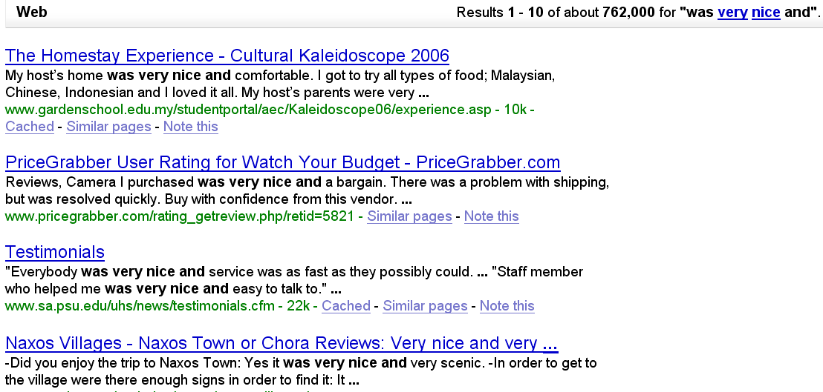
Better Idea
Hatzivassiloglou & McKeown 1997
Build training set: label all adj. with frequency > 20; test agreement with human annotators
Extract all conjoined adjectives
nice and comfortable
nice and scenic
Slide from Koppel/Wilson

Slide 19
Hatzivassiloglou & McKeown 1997
3. A supervised learning algorithm builds a graph of adjectives linked by the same or different semantic orientation
scenic
nice
terrible
painful
handsome
fun
expensive
comfortable
Slide from Koppel/Wilson

Slide 20
Hatzivassiloglou & McKeown 1997
4. A clustering algorithm partitions the adjectives into two subsets
+
slow
scenic
nice
terrible
handsome
painful
fun
expensive
comfortable
Slide from Koppel/Wilson

Slide 21
Even Better Idea Turney 2001
Pointwise Mutual Information (Church and Hanks, 1989):
Slide from Koppel/Wilson

Slide 22
Even Better Idea Turney 2001
Pointwise Mutual Information (Church and Hanks, 1989):
Semantic Orientation:
Slide from Koppel/Wilson

Slide 23
Even Better Idea Turney 2001
Pointwise Mutual Information (Church and Hanks, 1989):
Semantic Orientation:
PMI-IR estimates PMI by issuing queries to a search engine
Slide from Koppel/Wilson

Slide 24
Resources
These -- and related -- methods have been used to generate sentiment dictionaries
Sentinet
General Enquirer
…
Slide from Koppel/Wilson

Slide 25
Bottom-Up: Words to Clauses
Assume we know the “polarity” of a word
Does its context flip its polarity?
Slide from Koppel/Wilson

Slide 26
Prior Polarity versus Contextual Polarity
Wilson et al 2005
Prior polarity: out of context, positive or negative
  beautiful → positive
  horrid → negative
A word may appear in a phrase that expresses a different polarity in context
Contextual polarity
“Cheers to Timothy Whitfield for the wonderfully horrid visuals.”
Slide from Koppel/Wilson

Slide 27
Example
Philip Clap, President of the National Environment Trust, sums up well the general thrust of the reaction of environmental movements: there is no reason at all to believe that the polluters are suddenly going to become reasonable.
Slide from Koppel/Wilson

Slide 28
Example
Philip Clap, President of the National Environment Trust, sums up well the general thrust of the reaction of environmental movements: there is no reason at all to believe that the polluters are suddenly going to become reasonable.
Slide from Koppel/Wilson

Slide 29
Example
Philip Clap, President of the National Environment Trust, sums up well the general thrust of the reaction of environmental movements: there is no reason at all to believe that the polluters are suddenly going to become reasonable.
Contextual polarity
prior polarity
Slide from Koppel/Wilson

Slide 30
Lexicon
Step 1
Step 2
All
Instances
Neutral
or
Polar?
Polar
Instances
Contextual
Polarity?
Corpus
Word token
Word prior polarity
Negated
Negated subject
Modifies polarity
Modified by polarity
Conjunction polarity
General polarity shifter
Negative polarity shifter
Positive polarity shifter
Slide from Koppel/Wilson

Slide 31
Lexicon
Step 1
Step 2
All
Instances
Neutral
or
Polar?
Polar
Instances
Contextual
Polarity?
Corpus
Word token
Word prior polarity
Negated
Negated subject
Modifies polarity
Modified by polarity
Conjunction polarity
General polarity shifter
Negative polarity shifter
Positive polarity shifter
Word token
terrifies
Word prior polarity
negative
Slide from Koppel/Wilson

Slide 32
Lexicon
Step 1
Step 2
All
Instances
Neutral
or
Polar?
Polar
Instances
Contextual
Polarity?
Corpus
Word token
Word prior polarity
Negated
Negated subject
Modifies polarity
Modified by polarity
Conjunction polarity
General polarity shifter
Negative polarity shifter
Positive polarity shifter
Binary features:
Negated
  For example:
  not good
  does not look very good
  not only good but amazing
Negated subject
No politically prudent Israeli could support either of them.
Slide from Koppel/Wilson

Slide 33
Lexicon
Step 1
Step 2
All
Instances
Neutral
or
Polar?
Polar
Instances
Contextual
Polarity?
Corpus
Modifies polarity
  5 values: positive, negative, neutral, both, not mod
  substantial: negative
Modified by polarity
  5 values: positive, negative, neutral, both, not mod
    challenge: positive
Word token
Word prior polarity
Negated
Negated subject
Modifies polarity
Modified by polarity
Conjunction polarity
General polarity shifter
Negative polarity shifter
Positive polarity shifter
substantial (pos) challenge (neg)
Slide from Koppel/Wilson

Slide 34
Lexicon
Step 1
Step 2
All
Instances
Neutral
or
Polar?
Polar
Instances
Contextual
Polarity?
Corpus
Word token
Word prior polarity
Negated
Negated subject
Modifies polarity
Modified by polarity
Conjunction polarity
General polarity shifter
Negative polarity shifter
Positive polarity shifter
Conjunction polarity
  5 values: positive, negative, neutral, both, not mod
  good: negative
good (pos) and evil (neg)
Slide from Koppel/Wilson

Slide 35
Lexicon
Step 1
Step 2
All
Instances
Neutral
or
Polar?
Polar
Instances
Contextual
Polarity?
Corpus
Word token
Word prior polarity
Negated
Negated subject
Modifies polarity
Modified by polarity
Conjunction polarity
General polarity shifter
Negative polarity shifter
Positive polarity shifter
General polarity shifter
pose little threat
contains little truth
Negative polarity shifter
lack of understanding
Positive polarity shifter
abate the damage

Slide 36
Lexicon
Step 1
Step 2
All
Instances
Neutral
or
Polar?
Polar
Instances
Contextual
Polarity?
Corpus
Results 2a
Slide from Koppel/Wilson

Slide 37
Lexicon
Step 1
Step 2
All
Instances
Neutral
or
Polar?
Polar
Instances
Contextual
Polarity?
Corpus
Results 2b
Slide from Koppel/Wilson

Slide 38
Top-Down Sentiment Analysis
So far we’ve seen attempts to determine document sentiment from word/clause sentiment
Now we’ll look at the old-fashioned supervised method: get labeled documents and learn models
Slide from Koppel/Pang/Gamon

Slide 39
Finding Labeled Data
Online reviews accompanied by star ratings provide a ready source of labeled data
  movie reviews
  book reviews
  product reviews
Slide from Koppel/Pang/Gamon

Slide 40
Movie Reviews (Pang, Lee and V. 2002)
Source: Internet Movie Database (IMDb)
4 or 5 stars = positive; 1 or 2 stars = negative
  700 negative reviews
  700 positive reviews
Slide from Koppel/Pang/Gamon

Slide 41
Evaluation
Initial feature set:
  16,165 unigrams appearing at least 4 times in the 1400-document corpus
  16,165 most often occurring bigrams in the same data
  Negated unigrams (when "not" appears to the left of a word)
Test method: 3-fold cross-validation
(so about 933 training examples)
Slide from Koppel/Pang/Gamon

Slide 42
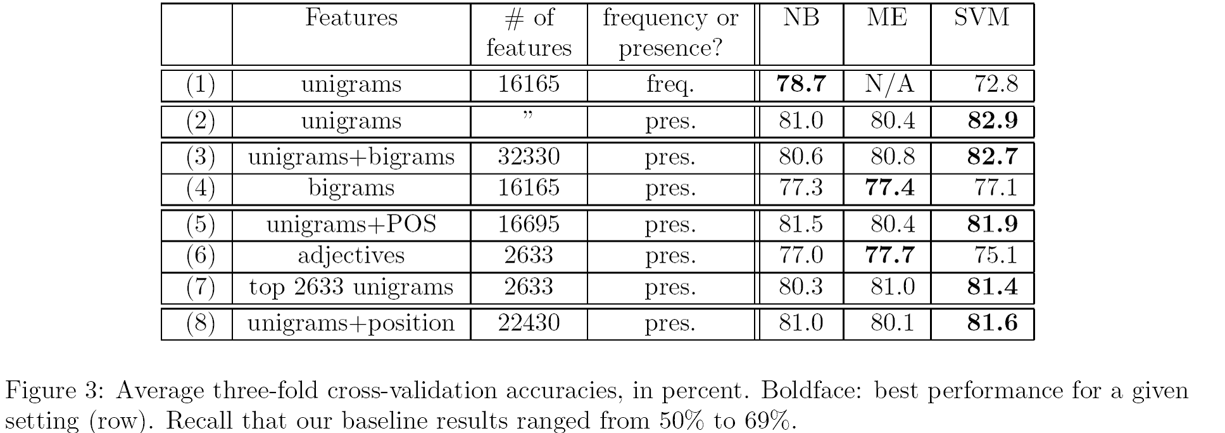
Results
Slide from Koppel/Pang/Gamon

Slide 43
Observations
In most cases, SVM slightly better than NB
Binary features good enough
Drastic feature filtering doesn’t hurt much
Bigrams don’t help (others have found them useful)
POS tagging doesn’t help
Benchmark for future work: 80%+
Slide from Koppel/Pang/Gamon

Slide 44
Looking at Useful Features
Many top features are unsurprising (e.g. boring)
Some are very unexpected
  tv is a negative word
  flaws is a positive word
That’s why bottom-up methods are fighting an uphill battle
Slide from Koppel/Pang/Gamon

Slide 45
Other Genres
The same method has been used in a variety of genres
Results are better than using bottom-up methods
Using a model learned on one genre for another genre does not work well

Slide 46
Cheating (Ignoring Neutrals)
One nasty trick that researchers use is to ignore neutral data (e.g. movies with three stars)
Models learned this way won’t work in the real world where many documents are neutral
The optimistic view is that neutral documents will lie near the negative/positive boundary in a learned model.
Slide modified from Koppel/Pang/Gamon

Slide 47
A Perfect World
Slide from Koppel/Pang/Gamon

Slide 48
A Perfect World

Slide 49
The Real World
Slide from Koppel/Pang/Gamon

Slide 50
Some Obvious Tricks
Learn separate models for each category or
Use regression to score documents
But maybe with some ingenuity we can do even better.
Slide from Koppel/Pang/Gamon

Slide 51
Corpus
We have a corpus of 1974 reviews of TV shows,
manually labeled as positive, negative or neutral
Note: neutrals means either no sentiment (most) or mixed (just a few)
For the time being, let’s do what most people do and ignore the neutrals (both for training and for testing).
Slide from Koppel/Pang/Gamon

Slide 52
Basic Learning
Feature set: 500 highest infogain unigrams
Learning algorithm: SMO
5-fold CV Results: 67.3% correctly classed as positive/negative
OK, but bear in mind that this model won’t class any neutral test documents as neutral – that’s not one of its options.
Slide from Koppel/Pang/Gamon

Slide 53
So Far We Have Seen..
… that you need neutral training examples to classify neutral test examples
In fact, it turns out that neutral training examples are useful even when you know that all your test examples are positive or negative (not neutral).
Slide from Koppel/Pang/Gamon

Slide 54
Multiclass Results
OK, so let’s consider the three class (positive, negative, neutral) sentiment classification problem.
On the same corpus as above (but this time not ignoring neutral examples in training and testing), we obtain accuracy (5-fold CV) of:
56.4% using multi-class SVM
69.0% using linear regression
Slide from Koppel/Pang/Gamon

Slide 55
Can We Do Better?
But actually we can do much better by combining pairwise (pos/neg, pos/neut, neg/neut) classifiers in clever ways.
When we do this, we discover that pos/neg is the least useful of these classifiers (even when all test examples are known to not be neutral).
Let’s go to the videotape…
Slide from Koppel/Pang/Gamon

Slide 56
Optimal Stack
Slide from Koppel/Pang/Gamon

Slide 57
Optimal Stack
Slide from Koppel/Pang/Gamon
Here’s the best way to combine pairwise classifiers for the 3-class problem:
IF positive > neutral > negative THEN class is positive
IF negative > neutral > positive THEN class is negative
ELSE class is neutral
Using this rule, we get accuracy of 74.9%
(OK, so we cheated a bit by using test data to find the best rule. If, we hold out some training data to find the best rule, we get accuracy of 74.1%)

Slide 58
Key Point
Best method does not use the positive/negative model at all – only the positive/neutral and negative/neutral models.
This suggests that we might even be better off learning to distinguish positives from negatives by comparing each to neutrals rather than by comparing each to each other.
Slide from Koppel/Pang/Gamon

Slide 59
Positive /Negative models
So now let’s address our original question. Suppose I know that all test examples are not neutral. Am I still better off using neutral training examples?
Yes.
Above we saw that using (equally distributed) positive and negative training examples, we got 67.3%
Using our optimal stack method with (equally distributed) positive, negative and neutral training examples we get 74.3%
(The total number of training examples is equal in each case.)
Slide from Koppel/Pang/Gamon

Slide 60
Can Sentiment Analysis Make Me Rich?
Slide from Koppel/Pang/Gamon

Slide 61
Can Sentiment Analysis Make Me Rich?
NEWSWIRE 4:08PM 10/12/04
STARBUCKS SAYS CEO ORIN SMITH TO RETIRE IN MARCH 2005
How will these messages affect Starbucks stock prices?
Slide from Koppel/Pang/Gamon

Slide 62
Impact of Story on Stock Price
Are price moves such as these predictable?
What are the critical text features?
What is the relevant time scale?
Slide from Koppel/Pang/Gamon

Slide 63
General Idea
Gather news stories
Gather historical stock prices
Match stories about company X with price movements of stock X
Learn which story features have positive/negative impact on stock price
Slide from Koppel/Pang/Gamon

Slide 64
Experiment
MSN corpus
  5000 headlines for 500 leading stocks September 2004 – March 2005.
Price data
  Stock prices in 5 minute intervals
Slide from Koppel/Pang/Gamon

Slide 65
Feature set
Word unigrams and bigrams.
800 features with highest infogain
Binary vector
Slide from Koppel/Pang/Gamon

Slide 66
Defining a headline as positive/negative
If stock price rises more than Δ during interval T, message classified as positive.
If stock price declines more than Δ during interval T, message is classified as negative.
Otherwise it is classified as neutral.
With larger delta, the number of positive and negative messages is smaller but classification is more robust.
Slide from Koppel/Pang/Gamon

Slide 67
Trading Strategy
Assume we buy a stock upon appearance of “positive” news story about company.
Assume we short a stock upon appearance of “negative” news story about company.
Slide from Koppel/Pang/Gamon

Slide 68
Do we earn a profit?
Slide from Koppel/Pang/Gamon

Slide 69
Do we earn a profit?
If this worked, I’d be driving a red convertible. (I’m not.)
Slide from Koppel/Pang/Gamon

Slide 70
Predicting the Future
If you are interested in this problem in general, take a look at:
Nate Silver
The Signal and the Noise: Why So
Many Predictions Fail - but
Some Don't
2012
(Penguin Publishers)

Slide 71
Text Categorization
Deep Learning

Slide 72
Machine learning
Hand crafted features
  In addition to unigrams: number of uppercase words, number of exclamation marks, number of positive and negative words …
In social media domain:
  emoticons, hashtags (#happy), elongated words (haaaapy)

Slide 73
Deep learning
Automatic feature extraction
  Learn feature representation jointly
Little to no preprocessing required
Takes into account word order
General approaches:
  Recursive Neural Networks
  Convolutional Neural Networks
  Recurrent Neural Networks
  Self attention (Transformer)

Slide 74
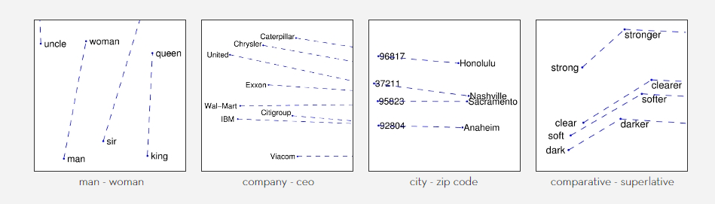
Word embeddings
Word embeddings capture syntactic and semantic regularities – no sentiment information encoded
Good and bad are neighboring words
Pennington et al. 2014. GloVe: Global Vectors for Word Representation

Slide 75
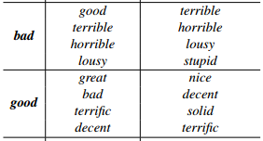
Word embeddings
Update word embeddings by back-propagation
Most similar words before (column 2) and after training (column 3)
Kim (2014)

Slide 76
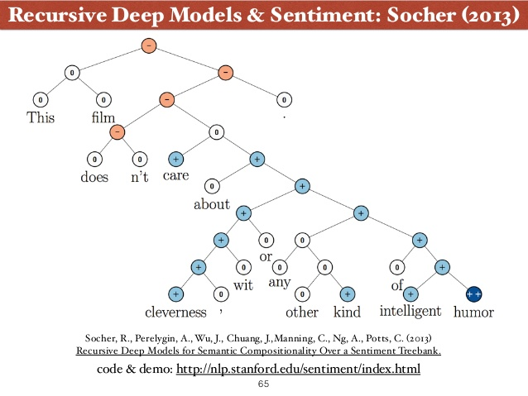
Recursive Neural Networks

Slide 77
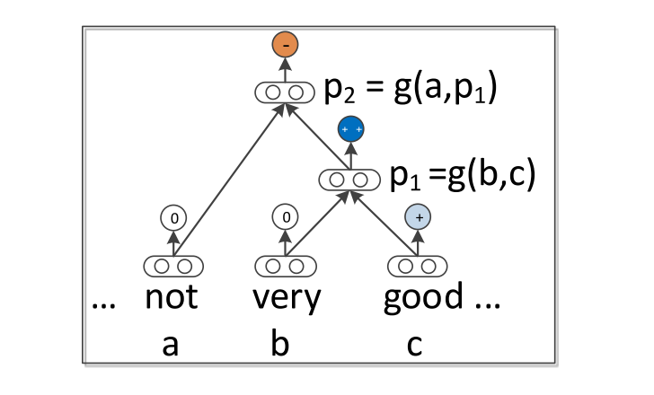
Recursive Neural Networks

Slide 78
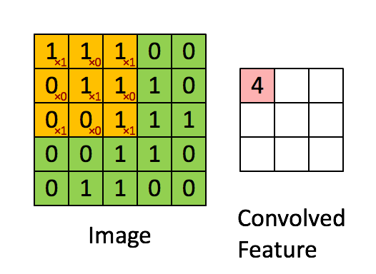
Convolutional Neural Networks
Each row represents a word given by a word embedding with dimensionality d
For a 10 word sentence, our “image” is a matrix of 10xd

Slide 79
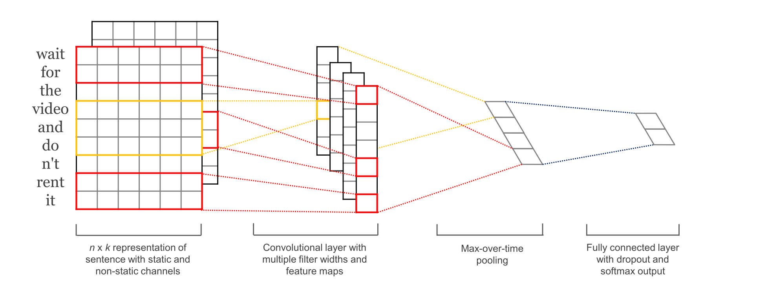
Convolutional Neural Networks
Kim (2014)

Slide 80
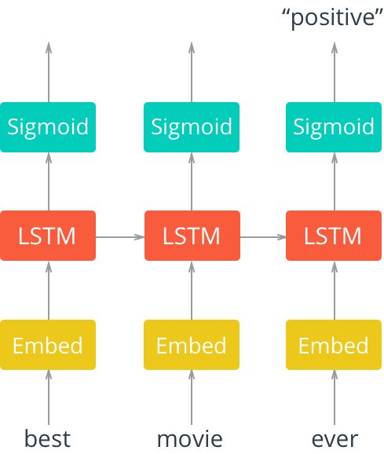
Recurrent Neural Networks
https://towardsdatascience.com/sentiment-analysis-using-rnns-lstm-60871fa6aeba

Slide 81
Aspect-based Sentiment
What about aspect-based SA?
  Interested in opinions towards multiple aspects
  E.g. laptop: battery life, performance, screen …
  We need a fine-grained way of getting the sentiment
Attention-based models

Slide 82
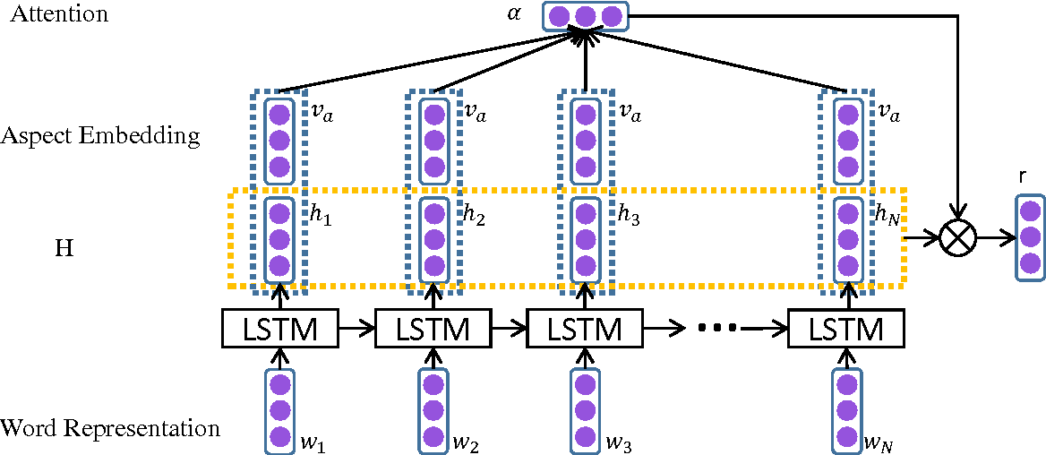
Aspect-based model
Wang et al. (2016)

Slide 83
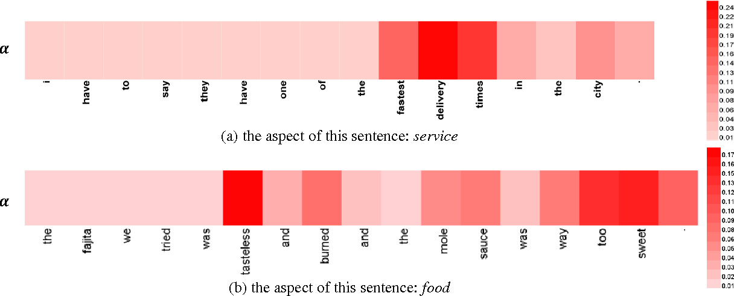
Aspect-based model
Wang et al. (2016)

Slide 84
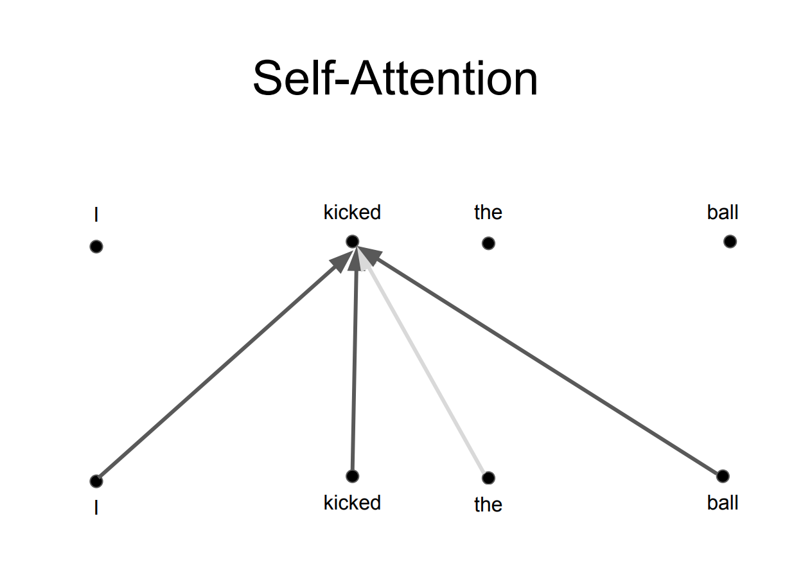
Transformer
Self-attention model
  Attention is all you need (Vaswani et al. 2017)
Most work on NLP uses Transformer nowadays
Taken and modified from https://towardsdatascience.com/transformers-141e32e69591

Slide 85
Sentiment Analysis in Keras
Keras is a high-level neural networks API
written in Python
model = Sequential()
model.add(Embedding(vocab_size, emb_dim))
model.add(LSTM(lstm_dim))
model.add(Dense(3, activation=“softmax”))

Slide 86
Sentiment neuron
Character-level language model trained on Amazon reviews
Linear model on this representation achieves state-of-the-art on Stanford Sentiment Treebank using 30-100x fewer labeled examples
Representation contains a distinct “sentiment neuron” which contains almost all of the sentiment signal
Radford et al. (2017).

Slide 87
BERT Pretraining
Use very large monolingual data and train a Transformer language model
Fine-tune your language model on sentiment analysis
Takes advantage of huge monolingual data
Probably all future work on sentiment analysis will use BERT (or variants of BERT) in one way or another

Slide 88
Sentiment - Other Issues
Somehow exploit NLP to improve accuracy
Identify which specific product features sentiment refers to (fine-grained)
“Transfer” sentiment classifiers from one domain to another (domain adaptation)
Summarize individual reviews and also collections of reviews
Slide modified from Koppel/Pang/Gamon

Slide 89
Slide sources
  Nearly all of the slides today are from Prof. Moshe Koppel (Bar-Ilan University)
Further reading on traditional sentiment approaches
  2011 AAAI tutorial on sentiment analysis from Bing Liu (quite technical)
Deep learning for sentiment
  See Stanford Deep Learning Sentiment Demo page
  Kim, Yoon. "Convolutional neural networks for sentence classification." EMNLP 2014.
  Socher, Richard, et al. "Recursive deep models for semantic compositionality over a sentiment treebank." EMNLP 2013.
  Radford, Alec, Rafal Jozefowicz, and Ilya Sutskever. "Learning to generate reviews and discovering sentiment." arXiv preprint arXiv:1704.01444 (2017).
  Wang, Yequan, Minlie Huang, and Li Zhao. "Attention-based lstm for aspect-level sentiment classification." EMNLP 2016.

Slide 90
Thank you for your attention!

