Slide 1
Information Extraction
CIS, LMU München
Winter Semester 2019-2020
Prof. Dr. Alexander Fraser, CIS

Slide 2
Information Extraction – Administravia - I
Vorlesung
  Learn the basics of Information Extraction (IE)
Seminar
  Each student will present a Referat on IE (Powerpoint, LaTeX, Mac)
    The group will discuss it
  Also: three or so practical sessions in the computer lab (hopefully we have time)
  There are two seminars! You come to just one of the two sessions, either Mondays 16:00 (Group 01) or Thursdays 10:00 (Group 02)

Slide 3
Information Extraction – Administravia - II
Registration:
  If you are a CIS Student: check whether you are registered for *both* the Vorlesung and the Seminar (these are two things in LSF!)
    Please ignore the Modulteilprüfung entries, make sure you are registered for the Seminar and the Vorlesung
  There are a good number of people only in the Vorlesung
  There are just a couple of people only in the Seminar

Slide 4
Information Extraction – Administravia - III
Vorlesung and Seminar are two separate courses (in same module for CIS people)
  However, there may be some shifting around of slots depending on time constraints
Vorlesung (Grade):
  Klausur on Feb 12th entirely determines the Vorlesung grade
Seminar (Grade):
  Referat
  Hausarbeit (write-up of the Referat) (6 pages, due 3 weeks after you hold your Referat)
  The Hausarbeit can also include the practical exercises (optional, extra points)
CIS-ler: No Notenverbesserung

Slide 5
Information Extraction – Administravia - IV
Syllabus: updated dynamically on my web page (see also WS last year, but there will be some differences)
  Brief idea at end of this slide deck (if we finish, then today)
List of Referatsthemen
  This will be presented soon in the Seminar, next week
Literature:
  Required: Sunita Sarawagi. Information Extraction. Foundations and Trends in Databases, 1(3):261–377, 2008. (good survey paper, somewhat brief)
    Please read the introduction for next week (it is available on the web page!)
  Optional: Christopher D. Manning, Prabhakar Raghavan and Hinrich Schuetze, Introduction to Information Retrieval, Cambridge University Press. 2008. (good information retrieval textbook, preview copies available from the book website: http://nlp.stanford.edu/IR-book/)

Slide 6
Information Extraction - Administravia - V
There will also be guest lectures from Viktor Hangya, Dr. Matthias Huck, Dario Stojanovski
Our tutor, Tobias Eder, will help with the exercises and be available to help you with any questions

Slide 7
Questions?

Slide 8
Information Extraction
An introduction to the course
  The topic "Information Extraction" means different things to different people
  In this course we will look at several different perspectives
  There is unfortunately no comprehensive textbook that includes all of these perspectives

Slide 9
My Biases
As you may have noticed by now: I am from the US (PhD in Computer Science from USC/ISI, Artifical Intelligence division)
I am a professor here at CIS
I do research in the broad area of statistical NLP
  I mostly work on machine translation, and related structured prediction problems (e.g., treebank-based syntactic parsing, generation using sequence (tagging) models)
  I also work on other multilingual problems such as cross-language information retrieval
With respect to rule-based NLP (with manually written rules), I'll try to be as fair as humanly possible
  I do use these techniques sometimes too

Slide 10
Outline for today
Motivation
  Problems requiring information extraction
  Basic idea of the output
Abstract idea of the core of an information extraction pipeline
Course topics

Slide 11
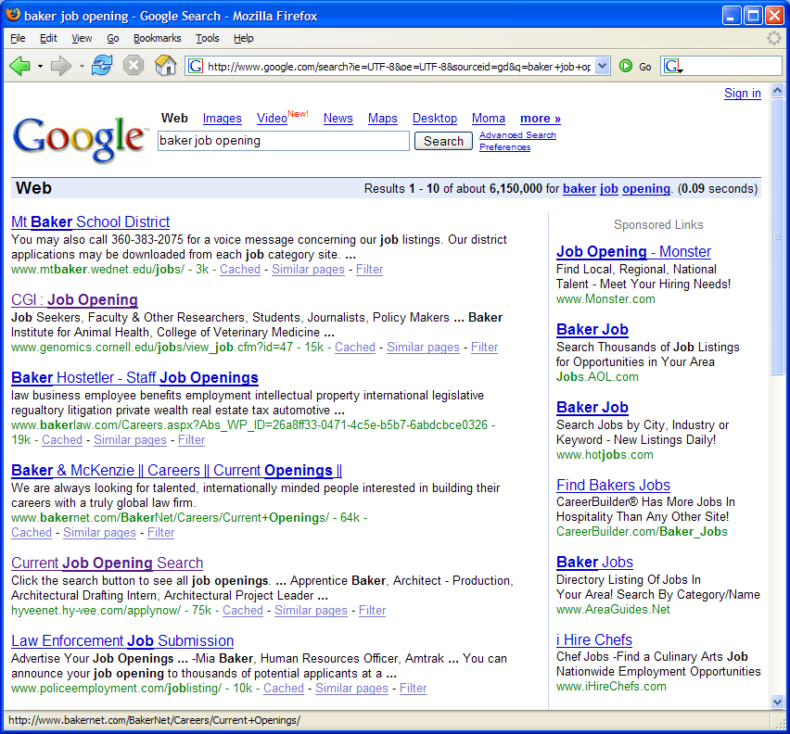
A problem
Mt. Baker, the school district
Baker Hostetler, the company
Baker, a job opening
Genomics job
Slide from Cohen/Mccallum

Slide 12
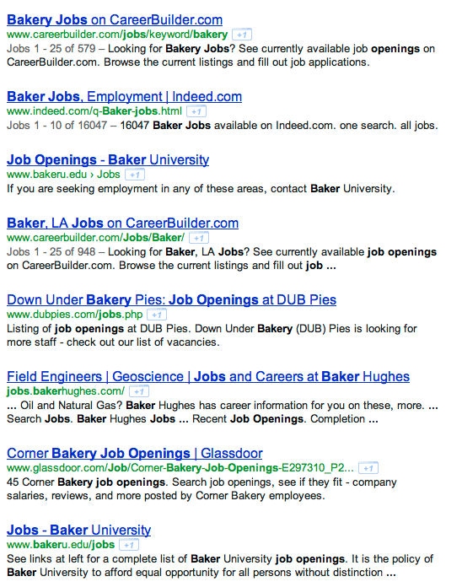
Slide from Kauchak

Slide 13
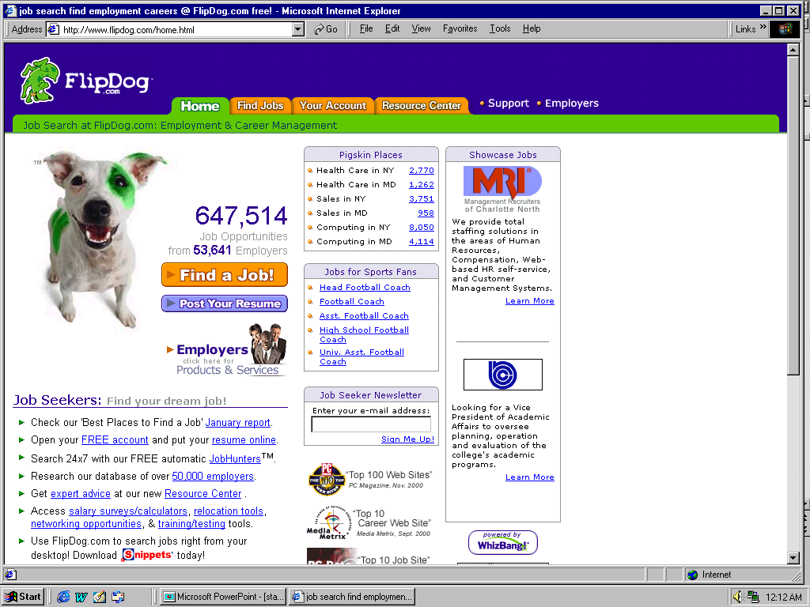
A solution
Slide from Cohen/McCallum

Slide 14
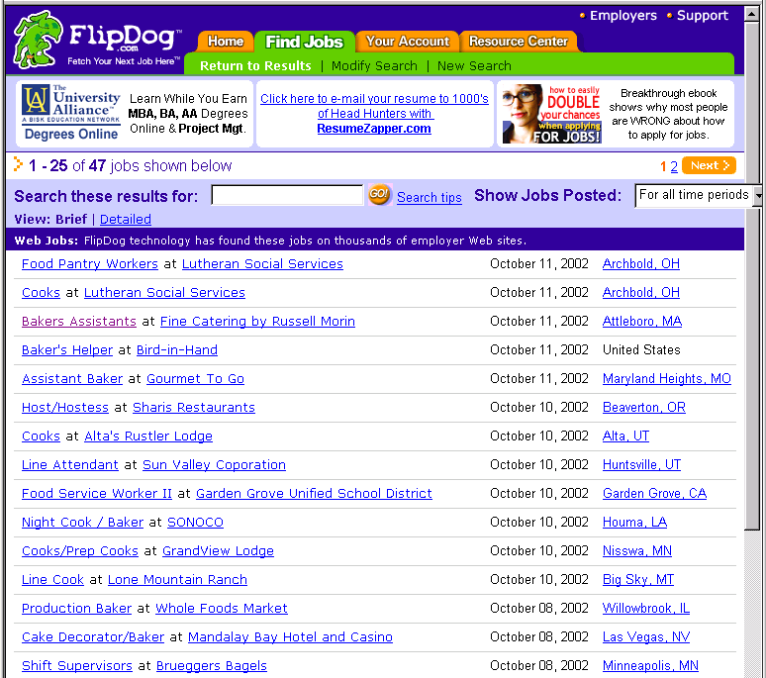
Job Openings:
Category = Food Services
Keyword = Baker
Location = Continental U.S.
Slide from Cohen/McCallum

Slide 15

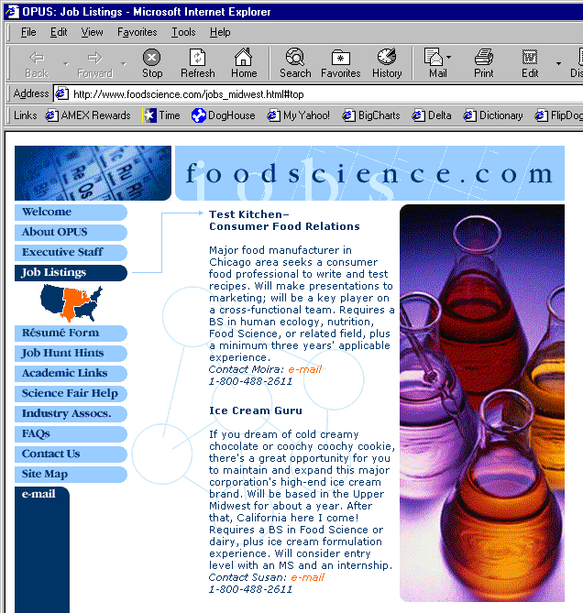
Extracting Job Openings from the Web
Title: Ice Cream Guru
Description: If you dream of cold creamy…
Contact: susan@foodscience.com
Category: Travel/Hospitality
Function: Food Services
Slide from Cohen/McCallum

Slide 16
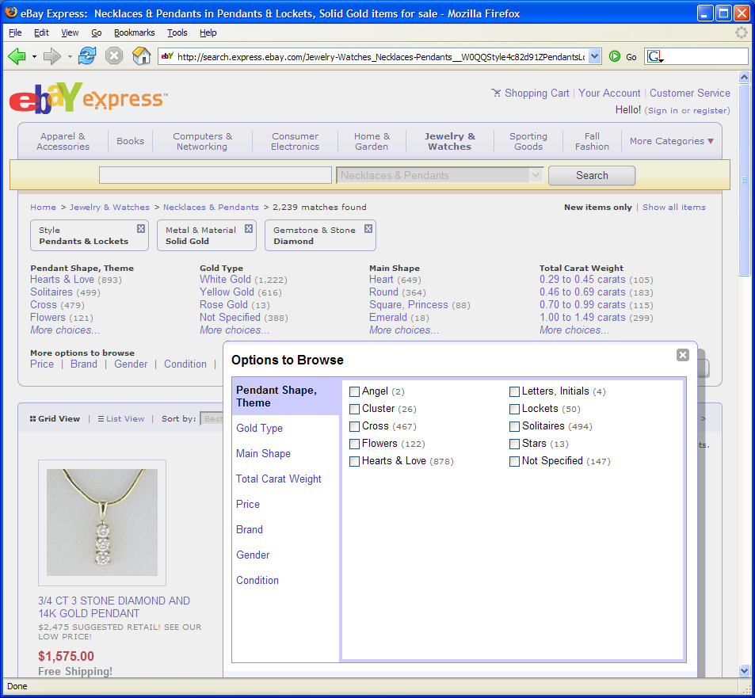
Another Problem
Slide from Cohen/McCallum

Slide 17
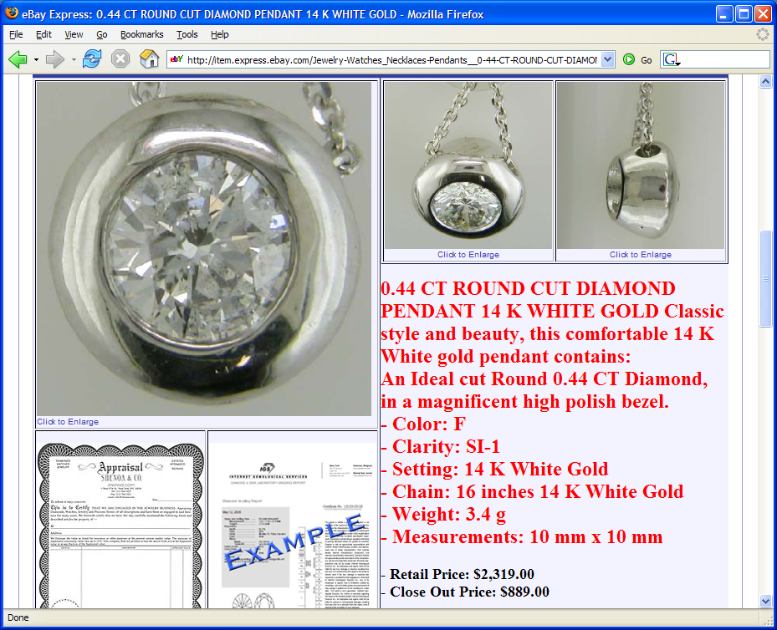
Often structured information in text
Slide from Cohen/McCallum

Slide 18
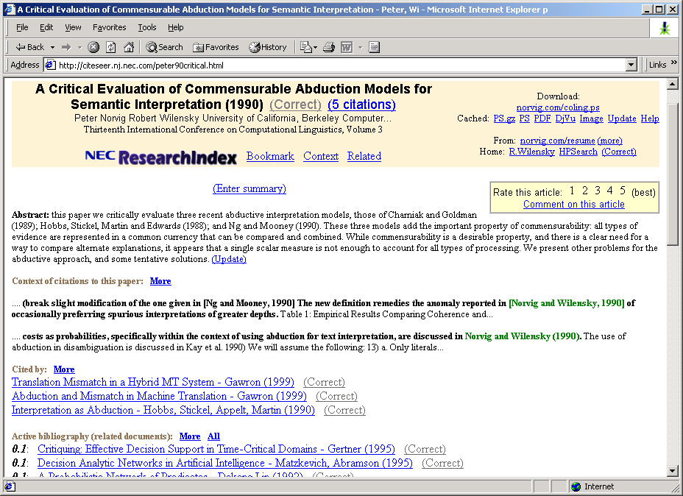
Another Problem
Slide from Cohen/McCallum

Slide 19
Definition of IE
Information Extraction (IE) is the process
of extracting structured information (e.g., database tables) from unstructured machine-readable documents
(e.g., Web documents).
Information
Extraction
GName | FName | Occupation
Elvis | Presley | singer
Elvis | Hunter | painter
... | ...
Elvis Presley was a famous rock singer.
...
Mary once remarked that the only attractive thing about the painter Elvis Hunter was his first name.
“Seeing the Web as a table”
Slide from Suchanek

Slide 20
Defining an IE problem
In what I will refer to as "classic" IE, we are converting documents to one or more table entries
  There are other kinds of IE, we will talk about those later
The design of these tables is usually determined by some business need
Let's look at the table entries for a similar set of examples to the ones we just saw

Slide 21
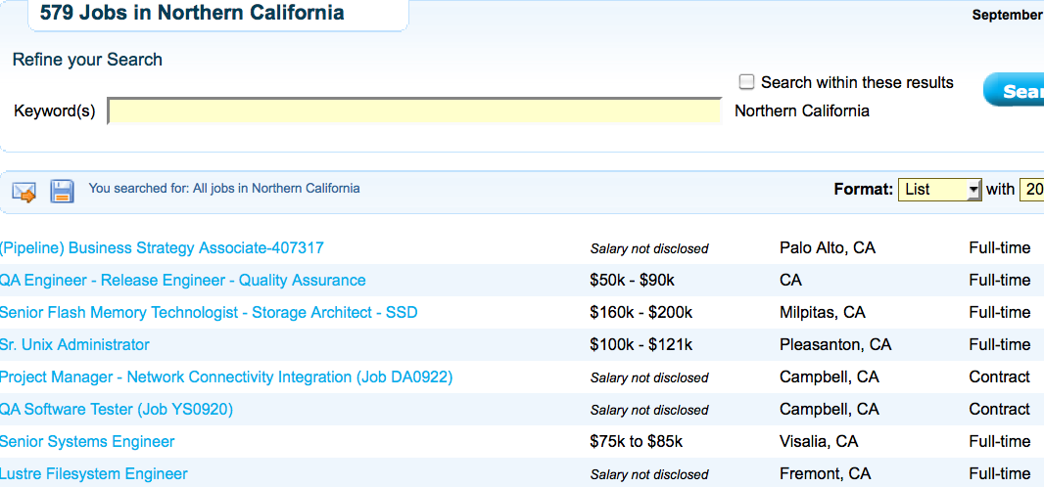
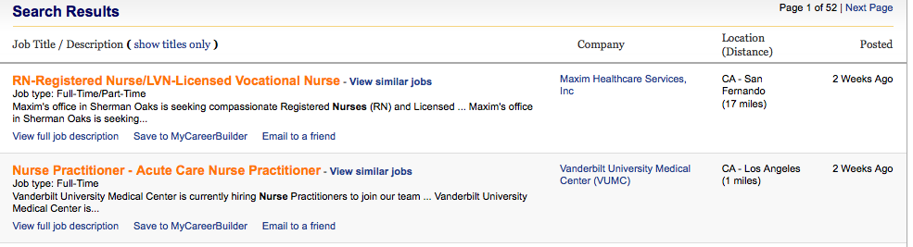
Motivating Examples
Title | Type | Location
Business strategy Associate | Part time | Palo Alto, CA
Registered Nurse | Full time | Los Angeles
... | ...
Slide from Suchanek

Slide 22
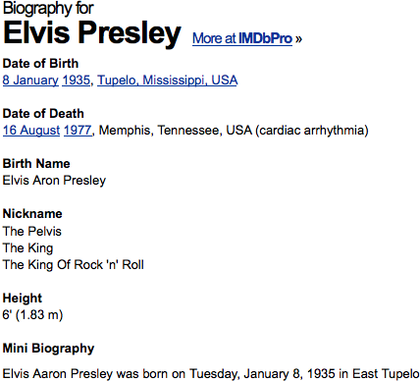
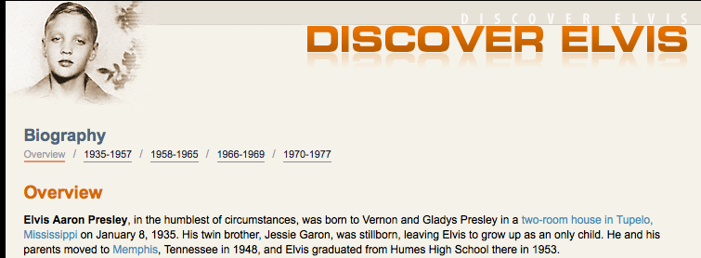
Motivating Examples
Name | Birthplace | Birthdate
Elvis Presley | Tupelo, MI | 1935-01-08
... | ...
Slide from Suchanek

Slide 23
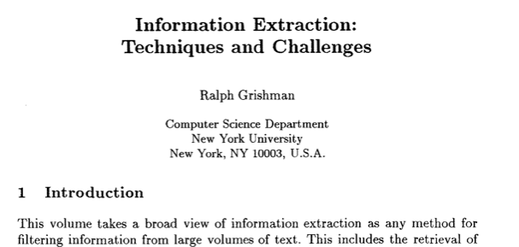
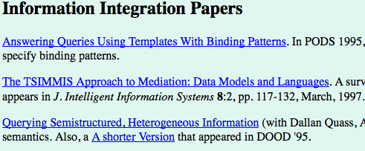
Motivating Examples
Author | Publication | Year
Grishman | Information Extraction... | 2006
... | ... | ...
Slide from Suchanek

Slide 24
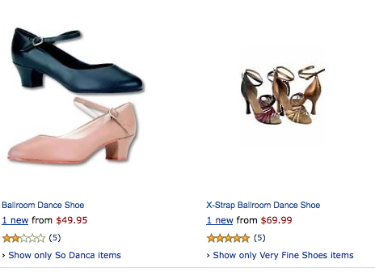
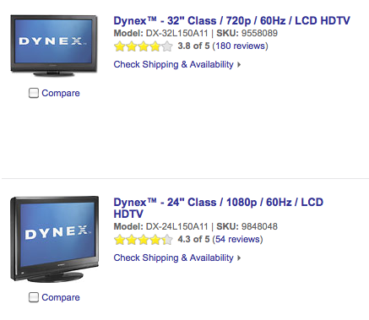
Motivating Examples
Product | Type | Price
Dynex 32” | LCD TV | $1000
... | ...
Slide from Suchanek

Slide 25
Information Extraction
Information Extraction (IE) is the process
of extracting structured information
from unstructured machine-readable documents
Source
Selection
?
Instance
Extraction
Person Name | Person Type
Elvis Presley | musician
Angela Merkel | politician
05/01/67
→
1967-05-01
Tokenization&
Normalization
Fact
Extraction
Relation | Entity1 | Entity2
Married | Elvis Presley | Priscilla Beaulieu
CEO | Tim Cook | Apple
Named Entity
Recognition
... married Elvis
on 1967-05-01
And Beyond!
Ontological
Information Extraction
Tip of the hat: Suchanek

Slide 26
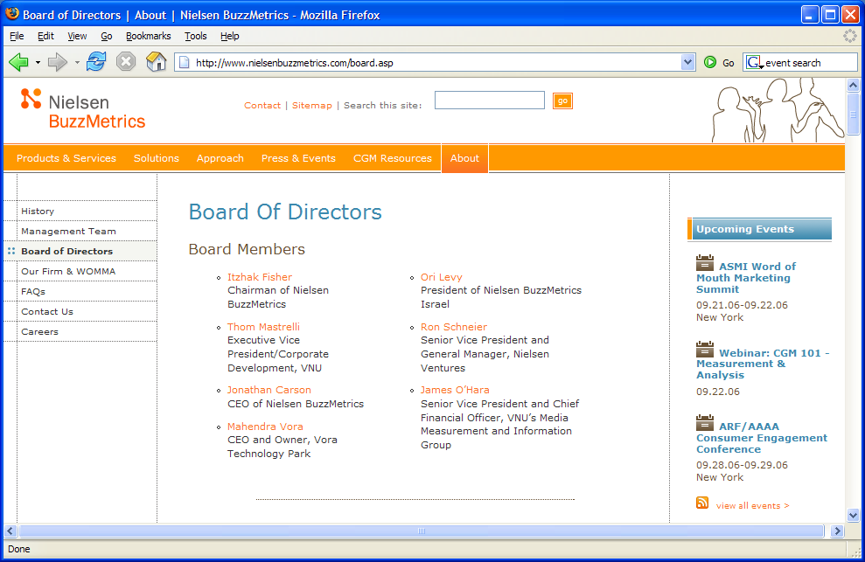
Information Extraction
Traditional definition: Recovering structured data from text
What are some of the sub-problems/challenges?
Slide from Nigam/Cohen/McCallum

Slide 27
Information Extraction?
Recovering structured data from text
  Identifying fields (e.g. named entity recognition)
Slide from Nigam/Cohen/McCallum

Slide 28
Information Extraction?
Recovering structured data from text
  Identifying fields (e.g. named entity recognition)
  Understanding relations between fields (e.g. record association)
Slide from Nigam/Cohen/McCallum

Slide 29
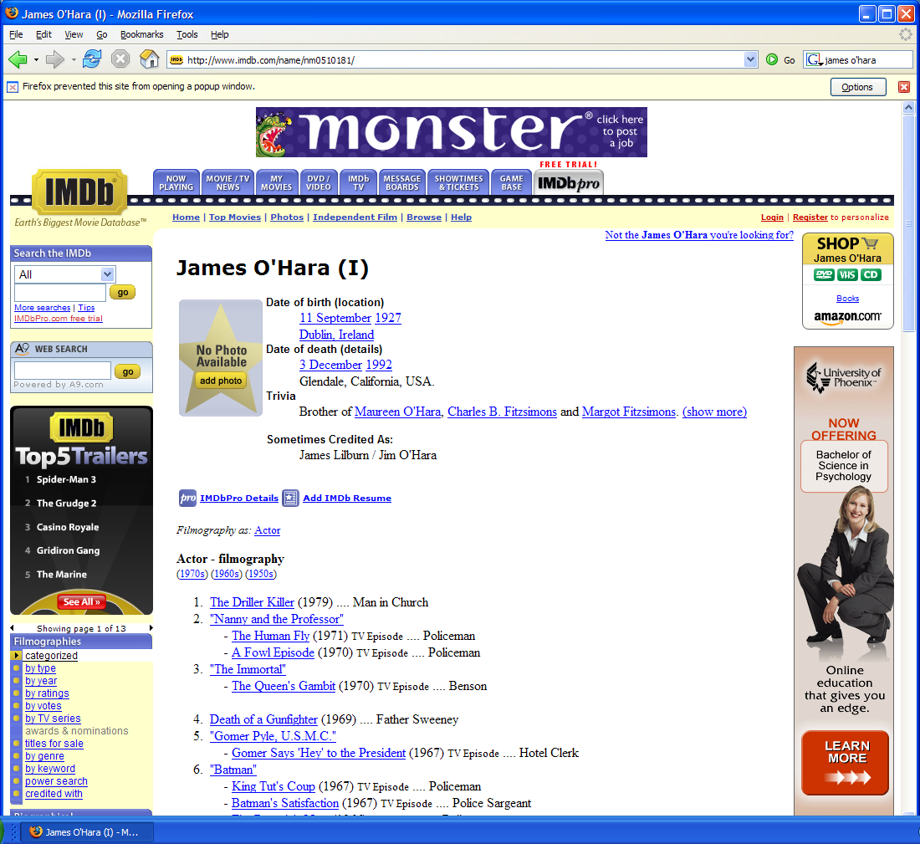
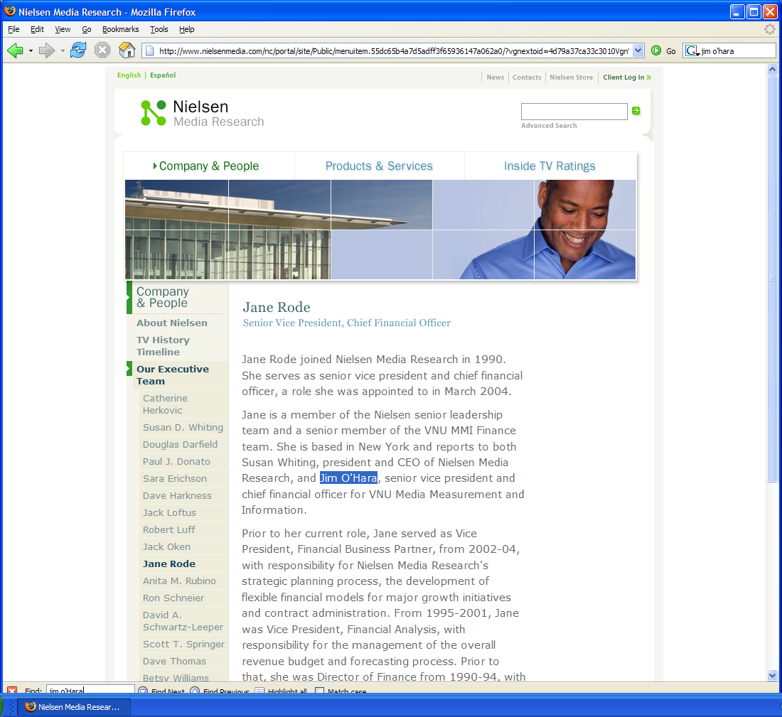
Information Extraction?
Recovering structured data from text
  Identifying fields (e.g. named entity recognition)
  Understanding relations between fields (e.g. record association)
  Normalization and deduplication
Slide from Nigam/Cohen/McCallum

Slide 30

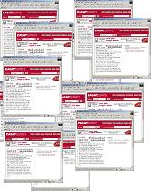
Information extraction
Input: Text Document
  Various sources: web, e-mail, journals, …
Output: Relevant fragments of text and relations possibly to be processed later in some automated way
IE
User Queries
Slide from McCallum

Slide 31
Not all documents are created equal…
Varying regularity in document collections
Natural or unstructured
  Little obvious structural information
Partially structured
  Contain some canonical formatting
Highly structured
  Often, automatically generated
Slide from McCallum

Slide 32
Natural Text: MEDLINE
Journal Abstracts
Extract number of subjects, type of study, conditions, etc.
BACKGROUND: The most challenging aspect of revision hip surgery is the management of bone loss. A reliable and valid measure of bone loss is important since it will aid in future studies of hip revisions and in preoperative planning. We developed a measure of femoral and acetabular bone loss associated with failed total hip arthroplasty. The purpose of the present study was to measure the reliability and the intraoperative validity of this measure and to determine how it may be useful in preoperative planning. METHODS: From July 1997 to December 1998, forty-five consecutive patients with a failed hip prosthesis in need of revision surgery were prospectively followed. Three general orthopaedic surgeons were taught the radiographic classification system, and two of them classified standardized preoperative anteroposterior and lateral hip radiographs with use of the system. Interobserver testing was carried out in a blinded fashion. These results were then compared with the intraoperative findings of the third surgeon, who was blinded to the preoperative ratings. Kappa statistics (unweighted and weighted) were used to assess correlation. Interobserver reliability was assessed by examining the agreement between the two preoperative raters. Prognostic validity was assessed by examining the agreement between the assessment by either Rater 1 or Rater 2 and the intraoperative assessment (reference standard). RESULTS: With regard to the assessments of both the femur and the acetabulum, there was significant agreement (p < 0.0001) between the preoperative raters (reliability), with weighted kappa values of >0.75. There was also significant agreement (p < 0.0001) between each rater's assessment and the intraoperative assessment (validity) of both the femur and the acetabulum, with weighted kappa values of >0.75. CONCLUSIONS: With use of the newly developed classification system, preoperative radiographs are reliable and valid for assessment of the severity of bone loss that will be found intraoperatively.
Slide from Kauchak

Slide 33
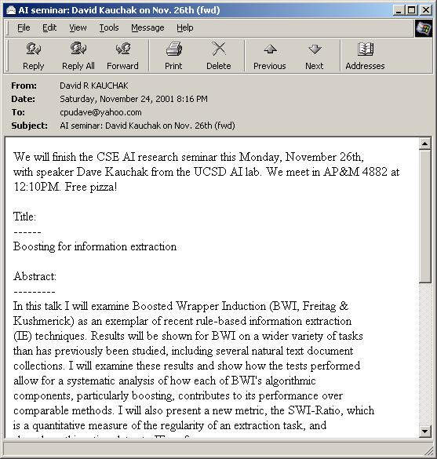
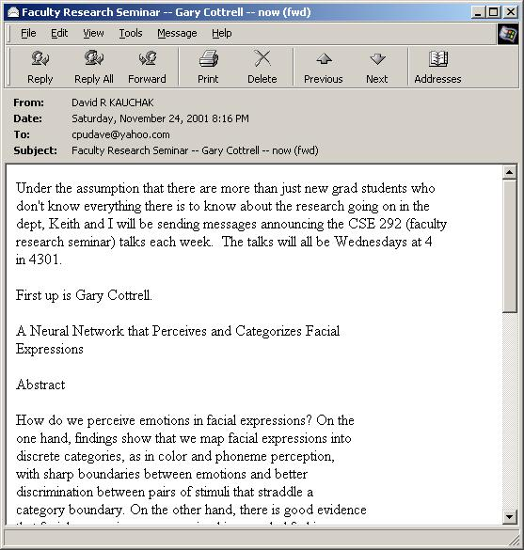
Partially Structured:
Seminar Announcements
Extract time, location, speaker, etc.
Slide from Kauchak

Slide 34
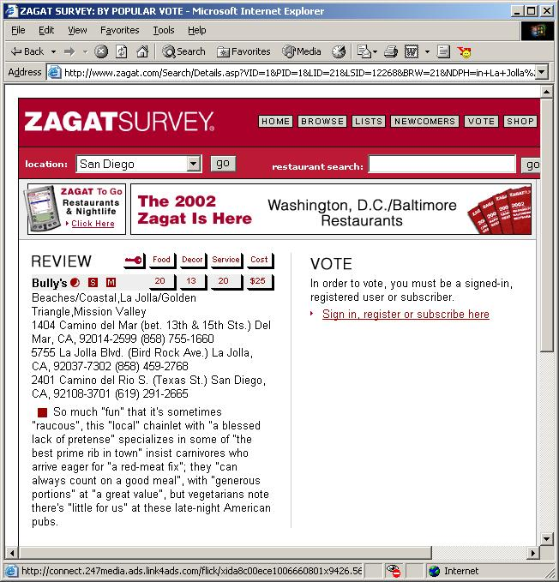
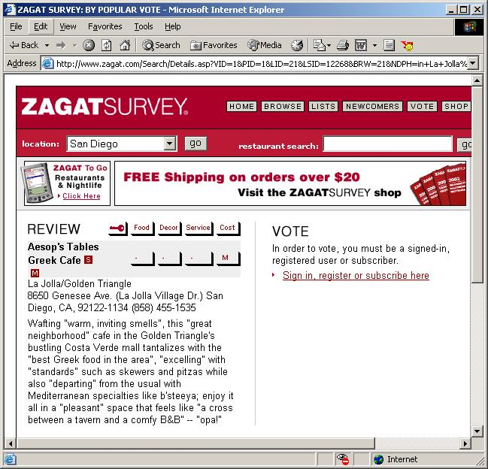
Highly Structured:
Zagat’s Reviews
Extract restaurant, location, cost, etc.
Slide from Kauchak

Slide 35
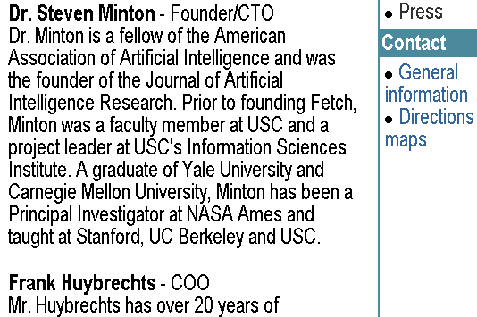
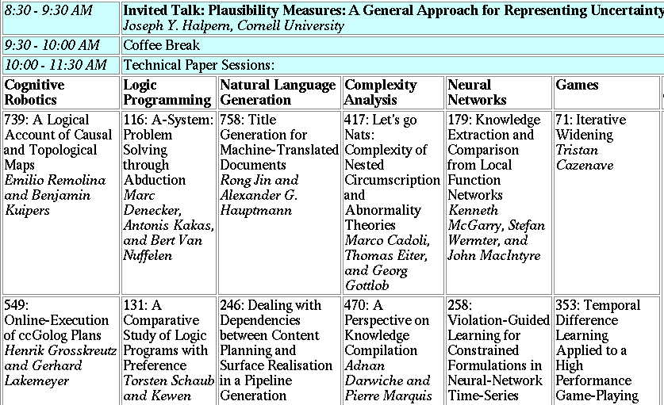
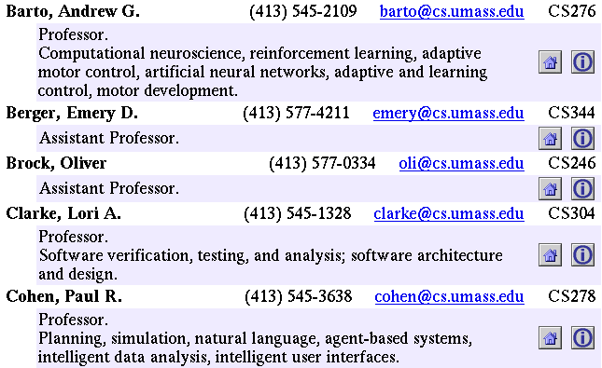
Landscape of IE Tasks:
Document Formatting
Text paragraphs
without formatting
Grammatical sentences
and some formatting & links
Astro Teller is the CEO and co-founder of BodyMedia. Astro holds a Ph.D. in Artificial Intelligence from Carnegie Mellon University, where he was inducted as a national Hertz fellow. His M.S. in symbolic and heuristic computation and B.S. in computer science are from Stanford University.
Tables
Non-grammatical snippets,
rich formatting & links
Slide from McCallum

Slide 36



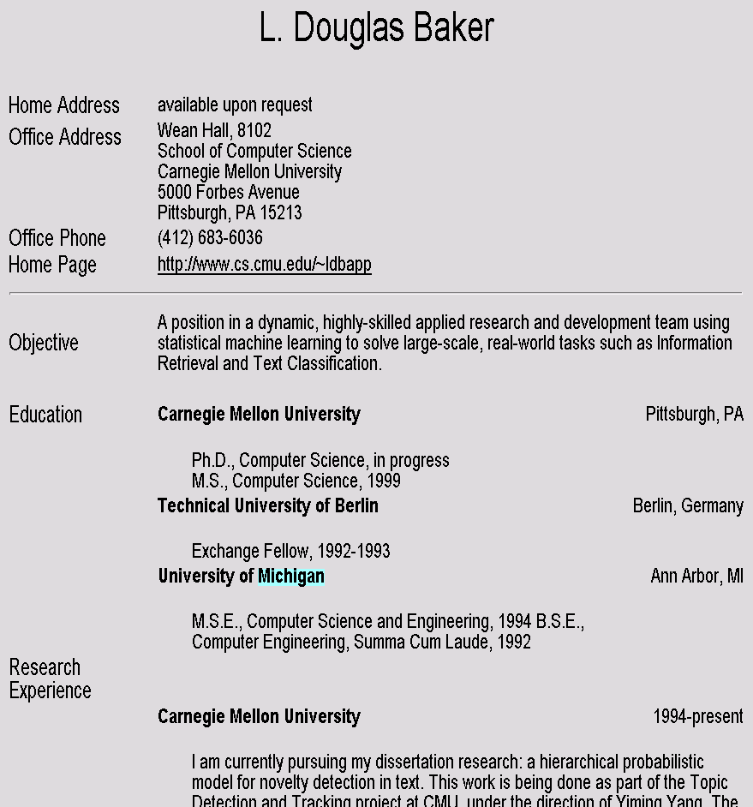
Landscape of IE Tasks
Intended Breadth of Coverage
Web site specific
Genre specific
Wide, non-specific
Formatting
Layout
Language
Amazon.com Book Pages
Resumes
University Names
Slide from McCallum

Slide 37
Landscape of IE Tasks :
Complexity of entities/relations
Closed set
Regular set
U.S. states
U.S. phone numbers
He was born in Alabama…
Phone: (413) 545-1323
The big Wyoming sky…
The CALD main office is 412-268-1299
Ambiguous patterns, needing context and many sources of evidence
Complex pattern
U.S. postal addresses
Person names
University of Arkansas
P.O. Box 140
Hope, AR 71802
…was among the six houses sold by Hope Feldman that year.
Headquarters:
1128 Main Street, 4th Floor
Cincinnati, Ohio 45210
Pawel Opalinski, Software
Engineer at WhizBang Labs.
Slide from McCallum

Slide 38
Landscape of IE Tasks:
Arity of relation
Jack Welch will retire as CEO of General Electric tomorrow. The top role
at the Connecticut company will be filled by Jeffrey Immelt.
Single entity
Binary relationship
N-ary record
Person: Jack Welch
Relation: Person-Title
Person: Jack Welch
Title: CEO
Relation: Succession
Company: General Electric
Title: CEO
Out: Jack Welsh
In: Jeffrey Immelt
Person: Jeffrey Immelt
Location: Connecticut
Relation: Company-Location
Company: General Electric
Location: Connecticut
"Named entity" extraction
Slide from McCallum

Slide 39
Association task = Relation Extraction
Checking if groupings of entities are instances of a relation
Manually engineered rules
  Rules defined over words/entities: “<company> located in <location>”
  Rules defined over parsed text:
    “((Subj<company>) (Verb located) (*) (Obj <location>))”
Machine Learning-based
  Supervised: Learn relation classifier from examples
  Partially-supervised: bootstrap rules/patterns from “seed” examples
Slide modified from Manning

Slide 40
Relation Extraction: Disease Outbreaks
May 19 1995, Atlanta -- The Centers for Disease Control
and Prevention, which is in the front line of the world's
response to the deadly Ebola epidemic in Zaire ,
is finding itself hard pressed to cope with the crisis…
Date | Disease Name | Location
Jan. 1995 | Malaria | Ethiopia
July 1995 | Mad Cow Disease | U.K.
Feb. 1995 | Pneumonia | U.S.
May 1995 | Ebola | Zaire
Information
Extraction System
Slide from Manning

Slide 41
Relation Extraction: Protein Interactions
“We show that CBF-A and CBF-C interact
with each other to form a CBF-A-CBF-C complex
and that CBF-B does not interact with CBF-A or
CBF-C individually but that it associates with the
CBF-A-CBF-C complex.“
interact
complex
CBF-A CBF-C
CBF-B CBF-A-CBF-C complex
associates
Slide from Manning

Slide 42
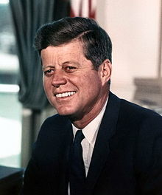
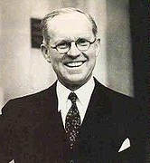
Resolving coreference
(both within and across documents)
John Fitzgerald Kennedy was born at 83 Beals Street in Brookline, Massachusetts on Tuesday, May 29, 1917, at 3:00 pm,[7] the second son of Joseph P. Kennedy, Sr., and Rose Fitzgerald; Rose, in turn, was the eldest child of John "Honey Fitz" Fitzgerald, a prominent Boston political figure who was the city's mayor and a three-term member of Congress. Kennedy lived in Brookline for ten years and attended Edward Devotion School, Noble and Greenough Lower School, and the Dexter School, through 4th grade. In 1927, the family moved to 5040 Independence Avenue in Riverdale, Bronx, New York City; two years later, they moved to 294 Pondfield Road in Bronxville, New York, where Kennedy was a member of Scout Troop 2 (and was the first Boy Scout to become President).[8] Kennedy spent summers with his family at their home in Hyannisport, Massachusetts, and Christmas and Easter holidays with his family at their winter home in Palm Beach, Florida. For the 5th through 7th grade, Kennedy attended Riverdale Country School, a private school for boys. For 8th grade in September 1930, the 13-year old Kennedy attended Canterbury School in New Milford, Connecticut.
Slide from Manning

Slide 43
Rough Accuracy of Information Extraction
Information type | Accuracy
Entities | 90-98%
Attributes | 80%
Relations | 60-70%
Events | 50-60%
Errors cascade (error in entity tag → error in relation extraction)
These are very rough, actually optimistic, numbers
  Hold for well-established tasks, but lower for many specific/novel IE tasks
Slide from Manning

Slide 44
What we will cover in this class (briefly)
PART I: basic information extraction (through Named Entity Recognition)
  History of IE, Related Fields
  Source Selection
  Tokenization and Normalization
  Named Entity Recognition (NER)

Slide 45
What we will cover in this class (briefly)
PART II: machine learning in depth (mostly tagging models used for named entities)
  Decision Trees and Overfitting
  Linear Models
  Feature Engineering
  Word Embeddings
  Deep Learning (Non-Linear Models)
  In the seminar: the practical exercises will be on practical classification (you are also invited to these even if you are not in the seminar!)

Slide 46
What we will cover in this class (briefly)
PART III: advanced information extraction
  Instance Extraction
  Fact/Event Extraction
  Ontological IE/Open IE
  Sentiment Analysis

Slide 47
Last words
The seminar tomorrow is cancelled, but I will be there in case you need to discuss something
  Topics will be presented next week (twice, once in each group)
Also, don't forget the reading for next week!
Sarawagi: Information Extraction (available from web page) Read the introduction!
These slides will be uploaded as well

Slide 48
Thank you for your attention!

