Slide 1
Information Extraction
Lecture 11 – Event Extraction and Multimodal Extraction
CIS, LMU München
Winter Semester 2016-2017
Dr. Alexander Fraser, CIS

Slide 2
Event Extraction
We'll now discuss event extraction, as defined in state-of-the-art statistical systems
  This is an extension of the ideas in relation extraction (as discussed by Matthias) to events
  Event extraction offers a good opportunity to think about cross-sentence and cross-document extraction
  The lecture on Ontologies and Open IE will be next week
Later in this lecture we'll briefly discuss multimodal extraction (speech, images, etc)
  Just to give a basic idea about what is possible

Slide 3
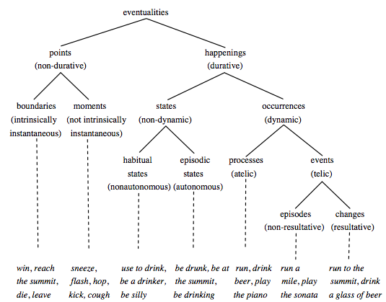
General Event Definition
  An Event is a specific occurrence involving participants.
  An Event is something that happens.
  An Event can frequently be described as a change of state.
Most of current NLP work focused on this
Chart from (Dölling, 2011)
Slide from Heng Ji
3
Notes:
Make this more pretty, put pictures; revise the next picture to reflect these steps
3

Slide 4
Event Mention Extraction: Task
An event is specific occurrence that implies a change of states
event trigger: the main word which most clearly expresses an event occurrence
event arguments: the mentions that are involved in an event (participants)
event mention: a phrase or sentence within which an event is described, including trigger and arguments
Automatic Content Extraction defined 8 types of events, with 33 subtypes
  ACE event type/subtype Event Mention Example
  Life/Die Kurt Schork died in Sierra Leone yesterday
  ^
  Transaction/Transfer GM sold the company in Nov 1998 to LLC
  Movement/Transport Homeless people have been moved to schools
  Business/Start-Org Schweitzer founded a hospital in 1913
  Conflict/Attack the attack on Gaza killed 13
  Contact/Meet Arafat’s cabinet met for 4 hours
  Personnel/Start-Position She later recruited the nursing student
  Justice/Arrest Faison was wrongly arrested on suspicion of murder
Argument, role=victim
trigger
Slide from Heng Ji

Slide 5
Supervised Event Mention Extraction: Methods
Staged classifiers
  Trigger Classifier
    to distinguish event instances from non-events, to classify event instances by type
  Argument Classifier
    to distinguish arguments from non-arguments
  Role Classifier
    to classify arguments by argument role
  Reportable-Event Classifier
    to determine whether there is a reportable event instance
Can choose any supervised learning methods such as MaxEnt and SVMs
(Ji and Grishman, 2008)
Slide from Heng Ji

Slide 6
Typical Event Mention Extraction Features
Trigger Labeling
  Lexical
    Tokens and POS tags of candidate trigger and context words
  Dictionaries
    Trigger list, synonym gazetteers
  Syntactic
    the depth of the trigger in the parse tree
    the path from the node of the trigger to the root in the parse tree
    the phrase structure expanded by the parent node of the trigger
    the phrase type of the trigger
  Entity
    the entity type of the syntactically nearest entity to the trigger in the parse tree
    the entity type of the physically nearest entity to the trigger in the sentence
Argument Labeling
  Event type and trigger
    Trigger tokens
    Event type and subtype
  Entity
    Entity type and subtype
    Head word of the entity mention
  Context
    Context words of the argument candidate
  Syntactic
    the phrase structure expanding the parent of the trigger
    the relative position of the entity regarding to the trigger (before or after)
    the minimal path from the entity to the trigger
    the shortest length from the entity to the trigger in the parse tree
(Chen and Ji, 2009)
Slide from Heng Ji
Notes:
IE’s application

Slide 7
Why Trigger Labeling is so Hard?
DT this “this is the largest pro-troops demonstration that has ever been in San Francisco”
RP forward “We've had an absolutely terrific story, pushing forward north toward Baghdad”
WP what “what happened in”
RB back “his men back to their compound”
IN over “his tenure at the United Nations is over”
IN out “the state department is ordering all non-essential diplomats”
CD nine eleven “nine eleven”
RB formerly “McCarthy was formerly a top civil servant at”
Slide from Heng Ji
Notes:
IE’s application

Slide 8
Why Trigger Labeling is so Hard?
A suicide bomber detonated explosives at the entrance to a crowded
medical teams carting away dozens of wounded victims
dozens of Israeli tanks advanced into thenorthern Gaza Strip
Many nouns such as “death”, “deaths”, “blast”, “injuries” are missing
Slide from Heng Ji
Notes:
IE’s application

Slide 9
Why Argument Labeling is so Hard?
Two 13-year-old children were among those killed in the Haifa bus bombing, Israeli public radio said, adding that most of the victims were youngsters
Israeli forces staged a bloody raid into a refugee camp in central Gaza targeting a founding member of Hamas
Israel's night-time raid in Gaza involving around 40 tanks and armoured vehicles
Eight people, including a pregnant woman and a 13-year-old child were killed in Monday's Gaza raid
At least 19 people were killed and 114 people were wounded in Tuesday's southern Philippines airport
Slide modified from Heng Ji
Notes:
IE’s application

Slide 10
Why Argument Labeling is so Hard?
Two 13-year-old children were among those killed in the Haifa bus bombing, Israeli public radio said, adding that most of the victims were youngsters
Fifteen people were killed and more than 30 wounded Wednesday as a suicide bomber blew himself up on a student bus in the northern town of Haifa
Two 13-year-old children were among those killed in the Haifa bus bombing
Slide from Heng Ji
Notes:
IE’s application

Slide 11
State-of-the-art and Remaining Challenges
State-of-the-art Performance (F-score)
  English: Trigger 70%, Argument 45%
  Chinese: Trigger 68%, Argument 52%
  Single human annotator: Trigger 72%, Argument 62%
Remaining Challenges
  Trigger Identification
    Generic verbs
    Support verbs such as “take” and “get” which can only represent an event mention together with other verbs or nouns
    Nouns and adjectives based triggers
  Trigger Classification
    “named” represents a “Personnel_Nominate” or “Personnel_Start-Position”?
    “hacked to death” represents a “Life_Die” or “Conflict_Attack”?
  Argument Identification
    Capture long contexts
  Argument Classification
    Capture long contexts
    Temporal roles
(Ji, 2009; Li et al., 2011)
Slide from Heng Ji
Notes:
IE’s application

Slide 12







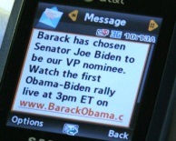
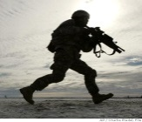

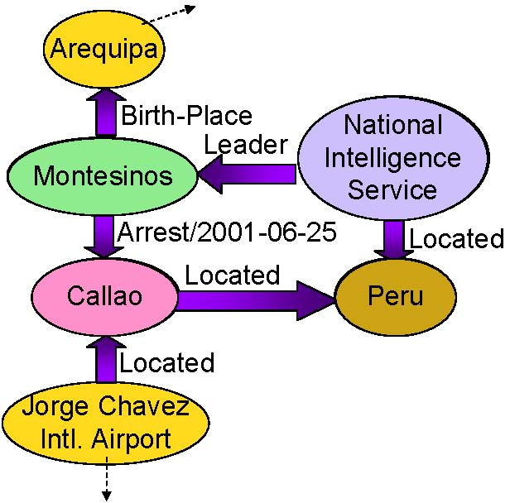
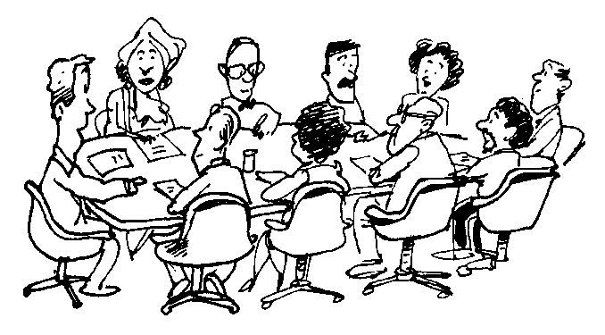
IE in Rich Contexts
Time/Location/
Cost Constraints
Texts
Authors
Venues
IE
Information Networks
Human Collaborative Learning
Slide from Heng Ji
Notes:
₁₂

Slide 13
Capture Information Redundancy
When the data grows beyond some certain size, IE task is naturally embedded in rich contexts; the extracted facts become inter-dependent
Leverage Information Redundancy from:
  Large Scale Data (Chen and Ji, 2011)
  Background Knowledge (Chan and Roth, 2010; Rahman and Ng, 2011)
  Inter-connected facts (Li and Ji, 2011; Li et al., 2011; e.g. Roth and Yih, 2004; Gupta and Ji, 2009; Liao and Grishman, 2010; Hong et al., 2011)
  Diverse Documents (Downey et al., 2005; Yangarber, 2006; Patwardhan and Riloff, 2009; Mann, 2007; Ji and Grishman, 2008)
  Diverse Systems (Tamang and Ji, 2011)
  Diverse Languages (Snover et al., 2011)
  Diverse Data Modalities (text, image, speech, video…)
But how? Such knowledge might be overwhelming…
Slide from Heng Ji
Notes:
However, if we take one step back by looking at human learning, we often see that students study in groups of two or more, mutually searching for the best understanding, solution or meaning; researchers gather together as a ``committee" or ``panel" to select the best paper/project proposal. Such activities are formalized as ``collaborative
. Events no longer exist on their own; they are connected to other topically-related documents, associated with authors (e.g., posters for blogs, reporters for news, speakers for conversation transcripts, authors for papers) and the publication venues (e.g., forums for blogs, agencies for news, conferences for papers), and linked to the geographical places where the documents are published. We call such heterogeneous contexts as the background ``information networks" for each candidate event in a test document, as depicted in Figure~\ref{overallframework}. However, it is not trivial to encode such contextual clues directly into the event extraction system because they are ubiquitously interrelated in various network structures.
learning"~\cite{Smith1992}.
In this paper we propose to directly incorporate multi-dimensional heterogeneous background information networks, through a new and uniformed biased propagation based topic modeling framework as described in our recent work~\cite{Deng2011}.
The underlying intuition is that multi-typed contextual information should be integrated but treated differently in the topic model. This method is designed to imitate human collaborative learning to seek topically-related events as ``collaborators" and enhance both training (portability) and testing (quality) an event extractor:
\begin{itemize}
\item \emph{training}: automatically select topically-related documents as for training data annotation; we shall demonstrate that this method can significantly reduce annotation cost.
%in this way using only 1/4 training data we can achieve comparable performance as passive learning;
%\vspace{-0.3cm}
\item \emph{testing}: conduct statistical cross-document inference within each topic cluster to favor consistency of interpretation across documents and achieve higher extraction quality; we shall demonstrate topic modeling provides a more effective way than information retrieval (IR)-based document clustering.
\end{itemize}

Slide 14
Cross-Sent/Cross-Doc Event Inference Architecture
Test
Doc
Within-Sent
Event
Tagger
UMASS
INDRI
IR
Cluster of Related
Docs
Within-Sent
Event
Tagger
Cross-Sent
Inference
Cross-Sent
Inference
Candidate
Events &
Confidence
Cross-Doc
Inference
Related
Events &
Confidence
Refined
Events
Slide from Heng Ji

Slide 15
Baseline Within-Sentence
Event Extraction
Pattern matching
  Build a pattern from each ACE training example of an event
    British and US forces reported gains in the advance on Baghdad
  → PER report gain in advance on LOC
MaxEnt models
  Trigger Classifier
    to distinguish event instances from non-events, to classify event instances by type
  Argument Classifier
    to distinguish arguments from non-arguments
  Role Classifier
    to classify arguments by argument role
  Reportable-Event Classifier
    to determine whether there is a reportable event instance
Slide from Heng Ji

Slide 16
Global Confidence Estimation
Within-Sentence IE system produces local confidence
IR engine returns a cluster of related docs for each test doc
Document-wide and Cluster-wide Confidence
  Frequency weighted by local confidence
  XDoc-Trigger-Freq(trigger, etype): The weighted frequency of string trigger appearing as the trigger of an event of type etype across all related documents
  XDoc-Arg-Freq(arg, etype): The weighted frequency of arg appearing as an argument of an event of type etype across all related documents
  XDoc-Role-Freq(arg, etype, role): The weighted frequency of arg appearing as an argument of an event of type etype with role role across all related documents
  Margin between the most frequent value and the second most frequent value, applied to resolve classification ambiguities
  ……
Slide from Heng Ji
Notes:
Uncertainty; delay the confidence estimation from the baseline,try to confirm or correct the results using global confidence; some examples are as follows.

Slide 17
Cross-Sent/Cross-Doc Event
Inference Procedure
Remove triggers and argument annotations with local or cross-doc confidence lower than thresholds
  Local-Remove: Remove annotations with low local confidence
  XDoc-Remove: Remove annotations with low cross-doc confidence
Adjust trigger and argument identification and classification to achieve document-wide and cluster-wide consistency
  XSent-Iden/XDoc-Iden: If the highest frequency is larger than a threshold, propagate the most frequent type to all unlabeled candidates with the same strings
  XSent-Class/XDoc-Class: If the margin value is higher than a threshold, propagate the most frequent type and role to replace
  low-confidence annotations
Slide from Heng Ji
Notes:
Two main operations…;

Slide 18
Experiments: Data and Setting
Within-Sentence baseline IE trained from 500 English ACE05 texts (from March – May of 2003)
Use 10 ACE05 newswire texts as development set to optimize the global confidence thresholds and apply them for blind test
Blind test on 40 ACE05 texts, for each test text, retrieved 25 related texts from TDT5 corpus (278,108 texts, from April-Sept. of 2003)
Slide from Heng Ji

Slide 19
Experiments: Trigger Labeling
Performance System/Human | Precision | Recall | F-Measure
Within-Sent IE (Baseline) | 67.6 | 53.5 | 59.7
After Cross-Sent Inference | 64.3 | 59.4 | 61.8
After Cross-Doc Inference | 60.2 | 76.4 | 67.3
Human Annotator 1 | 59.2 | 59.4 | 59.3
Human Annotator 2 | 69.2 | 75.0 | 72.0
Inter-Adjudicator Agreement | 83.2 | 74.8 | 78.8
Slide from Heng Ji
Notes:
In order to show how reliable of the key is, we try to count the inter-agreement of two keys prepared in parallel, and the agreement f-measure is about 78.8

Slide 20
Experiments: Argument Labeling
Performance System/Human | Argument Identification |  |  | Argument Classification Accuracy | Argument Identification +Classification
 | P | R | F |  | P | R | F
Within-Sent IE | 47.8 | 38.3 | 42.5 | 86.0 | 41.2 | 32.9 | 36.3
After Cross-Sent Inference | 54.6 | 38.5 | 45.1 | 90.2 | 49.2 | 34.7 | 40.7
After Cross-Doc Inference | 55.7 | 39.5 | 46.2 | 92.1 | 51.3 | 36.4 | 42.6
Human Annotator 1 | 60.0 | 69.4 | 64.4 | 85.8 | 51.6 | 59.5 | 55.3
Human Annotator 2 | 62.7 | 85.4 | 72.3 | 86.3 | 54.1 | 73.7 | 62.4
Inter-Adjudicator Agreement | 72.2 | 71.4 | 71.8 | 91.8 | 66.3 | 65.6 | 65.9
Slide from Heng Ji
Notes:
Our approach works much better than the baseline; for both identification and classification accuracy. There is a larger gap between system and human for argment labeling; argument identification is not a reasonable annotation. US news announced the news of invation into Iraq. Human has to remember everything said in the document.; maybe need arbitrary inference.

Slide 21
Summary
Event extraction is an interesting topic which has recently started to undergo significant changes
  In these slides we talked about cross-document reference
  One can go further and include the web and/or ontologies (next lecture)
It is a very difficult problem but clearly necessary if we want to reason about changes of state, rather than facts that hold over long periods of time

Slide 22
Multimodal Extraction
The purpose of these slides is to give a basic idea about what can be done in a multimodal setting
Details of how the systems work in detail is out of scope here (i.e., don't worry about this)

Slide 23
Extraction from Speech
Extraction from speech is typically addressed by adapting text-based NLP tools to ASR (Automatic Speech Recognition) output
  Neural systems are typically used for ASR
Some significant challenges using ASR output as input to NLP
  ASR errors (in recognizing speech)
  No or little punctuation in ASR output
  Disfluencies (e.g., when people, are, um, sp..., speaking)
Some new work tries to train end-to-end systems to do tasks like ASR and NER at the same time
  Make sense, because many names are likely to be out-of-vocabulary items to the ASR system
  Allow use of specialized ASR sub-model

Slide 24
Extraction from Images
Approaches for image classification and related problems have been dramatically changed by deep learning
Current explosion of new work and dramatically different problems being addressed
First let's look at accuracies on the ImageNet task (next slide)
The let's look at image captioning (just a brief look, do not worry about details!)

Slide 25
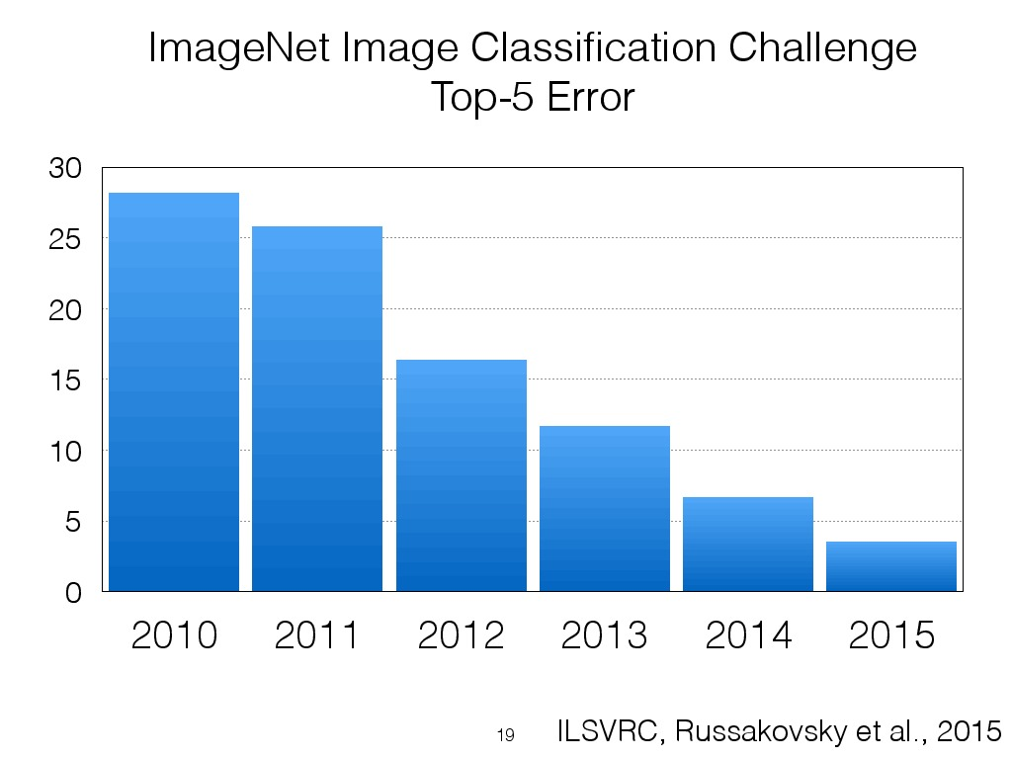
Slide from Andrej Karpathy, results from

Slide 26
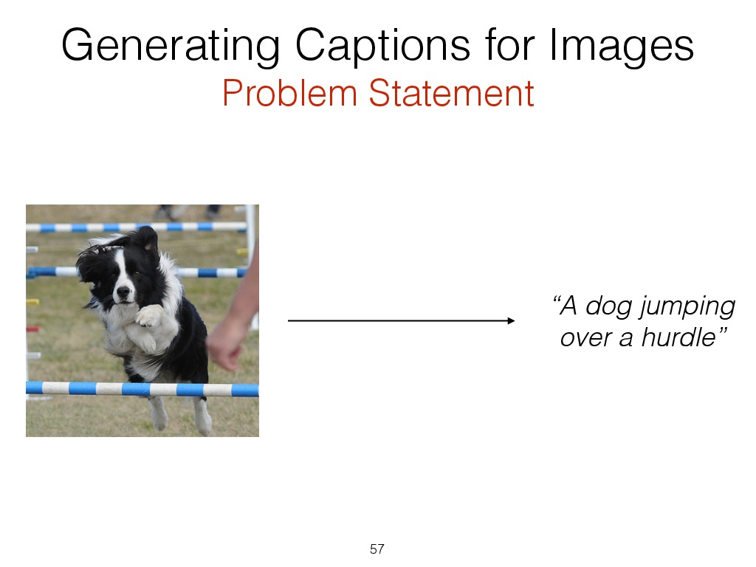
Slide from Andrej Karpathy

Slide 27
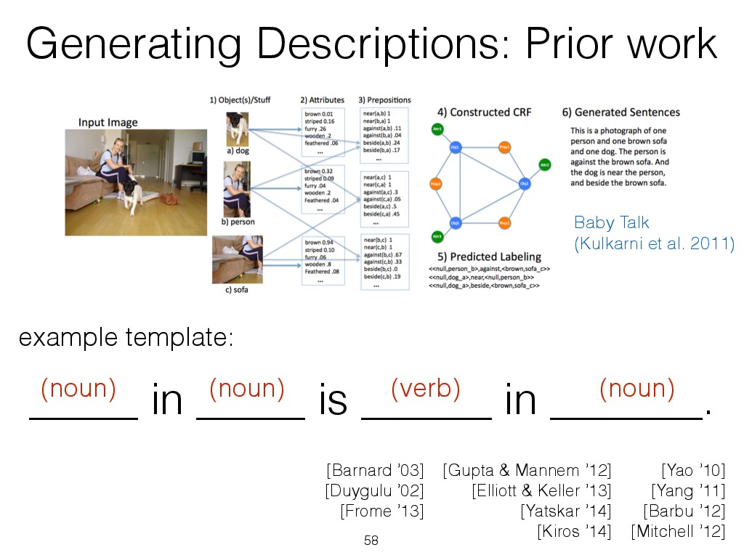
Slide from Andrej Karpathy

Slide 28
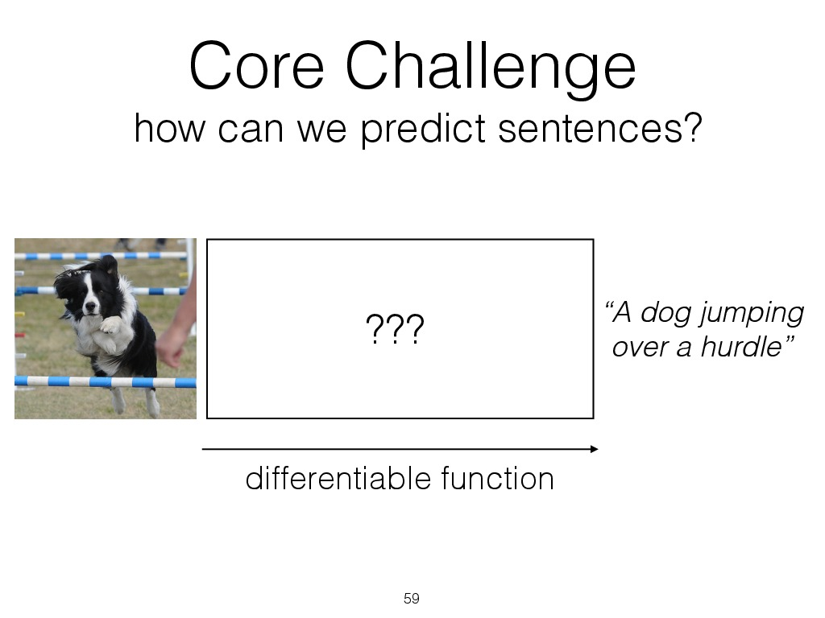
Slide from Andrej Karpathy

Slide 29
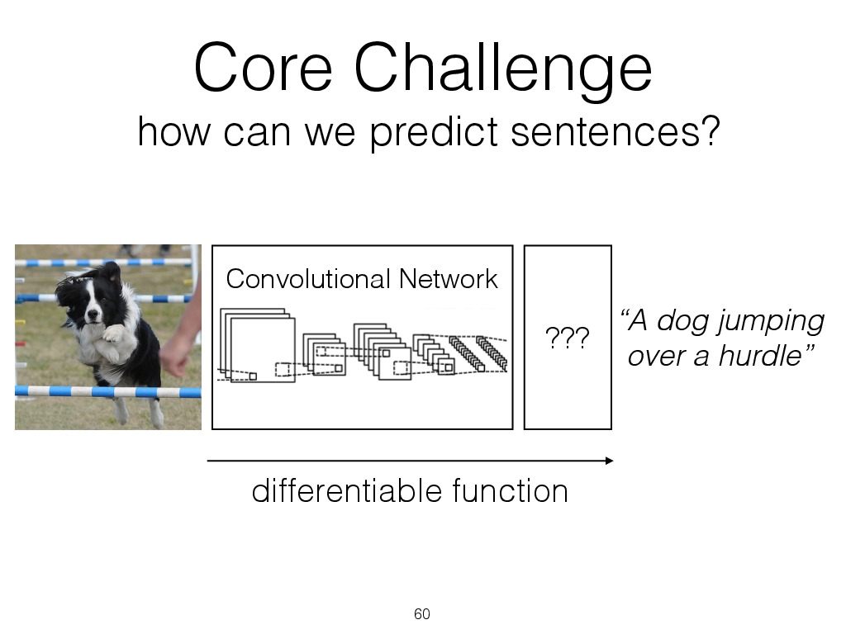
Slide from Andrej Karpathy

Slide 30
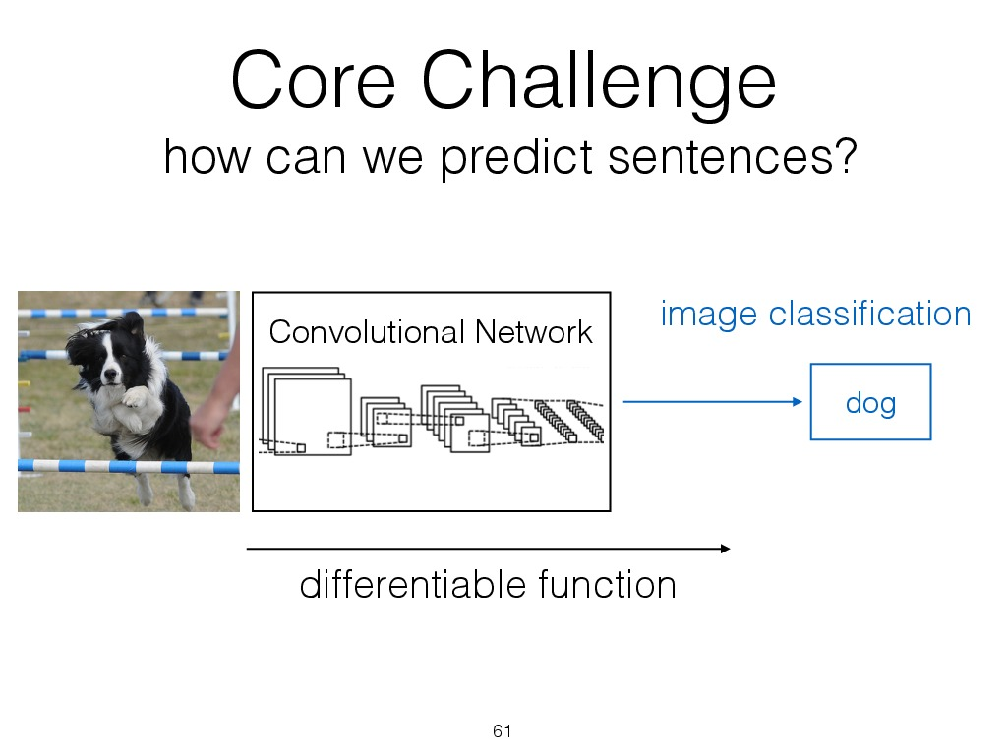
Slide from Andrej Karpathy

Slide 31
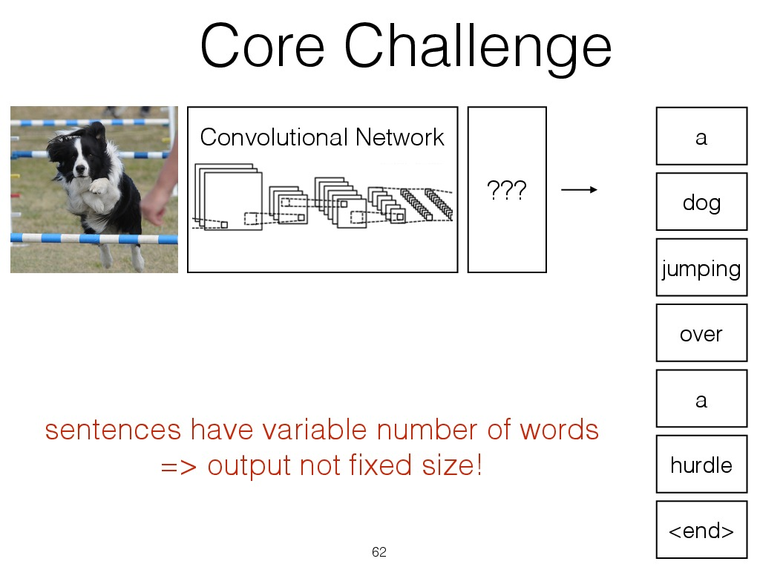
Slide from Andrej Karpathy

Slide 32
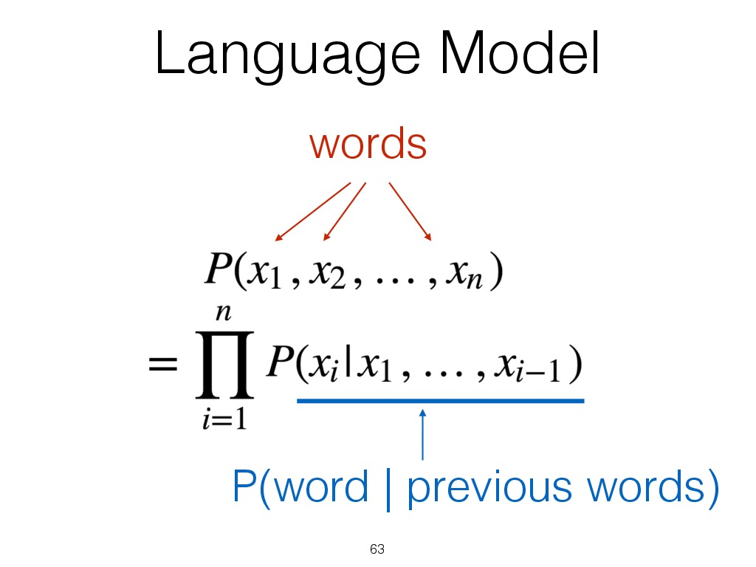
Slide from Andrej Karpathy

Slide 33
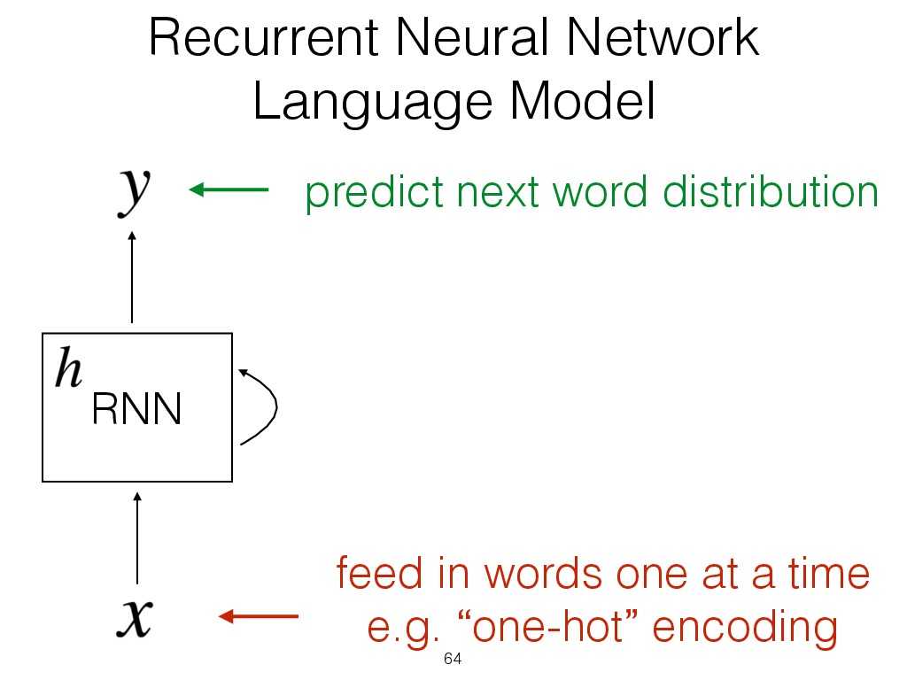
Slide from Andrej Karpathy

Slide 34
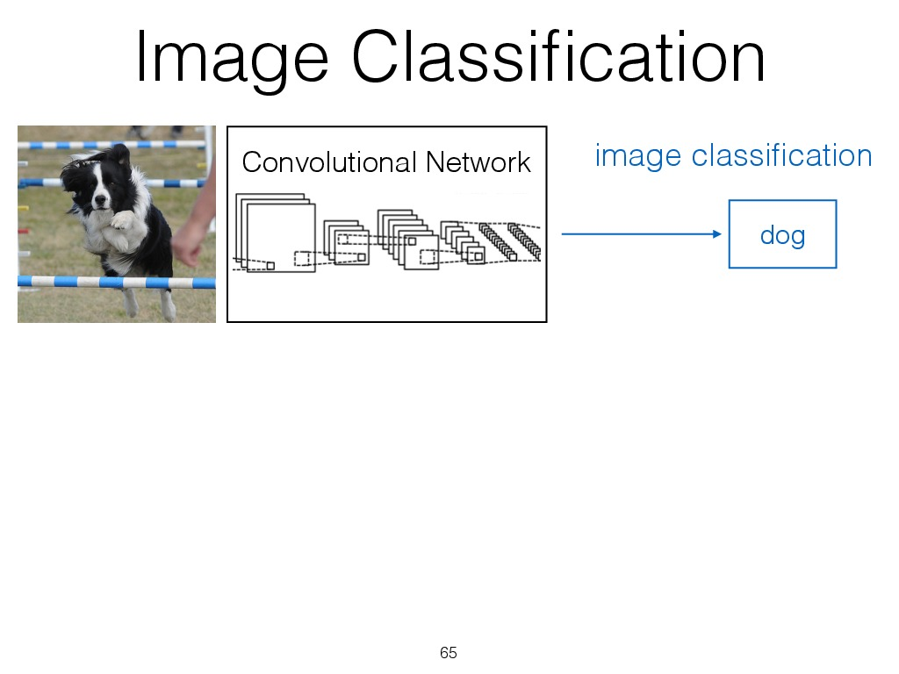
Slide from Andrej Karpathy

Slide 35
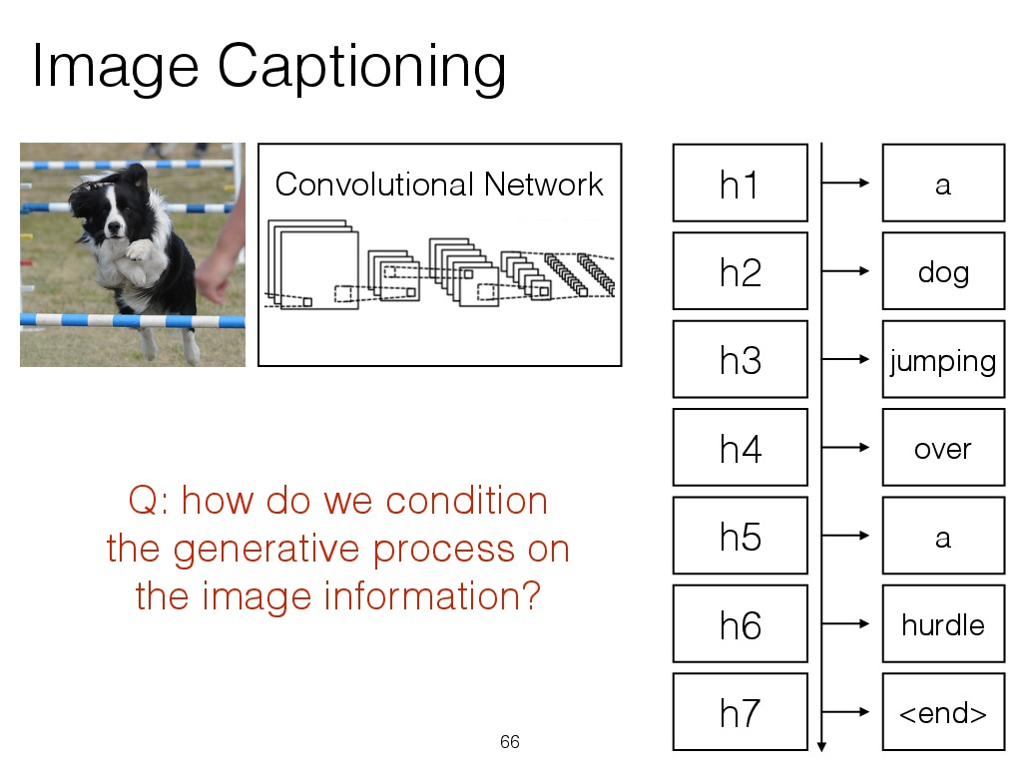
Slide from Andrej Karpathy

Slide 36
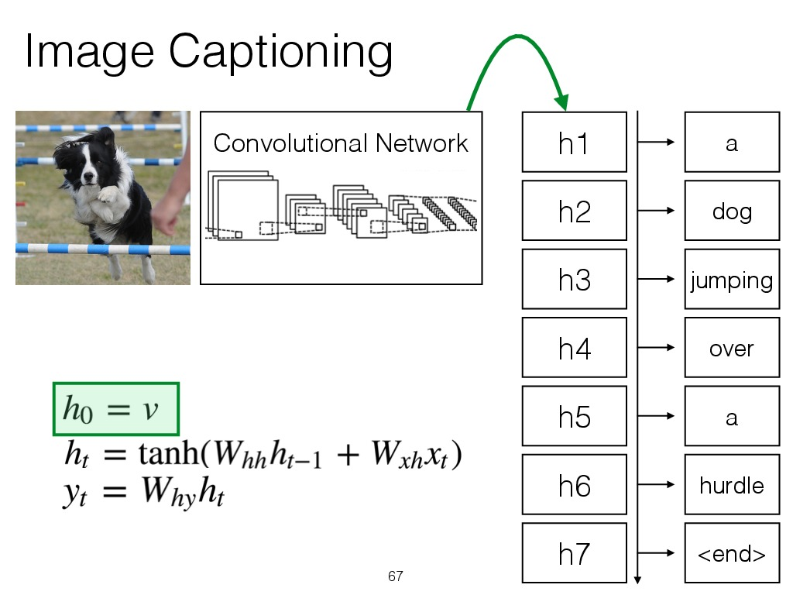
Slide from Andrej Karpathy

Slide 37
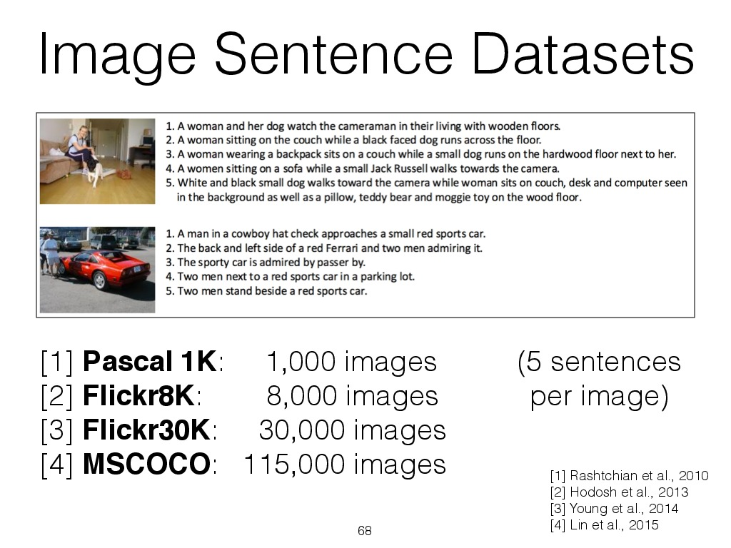
Slide from Andrej Karpathy

Slide 38
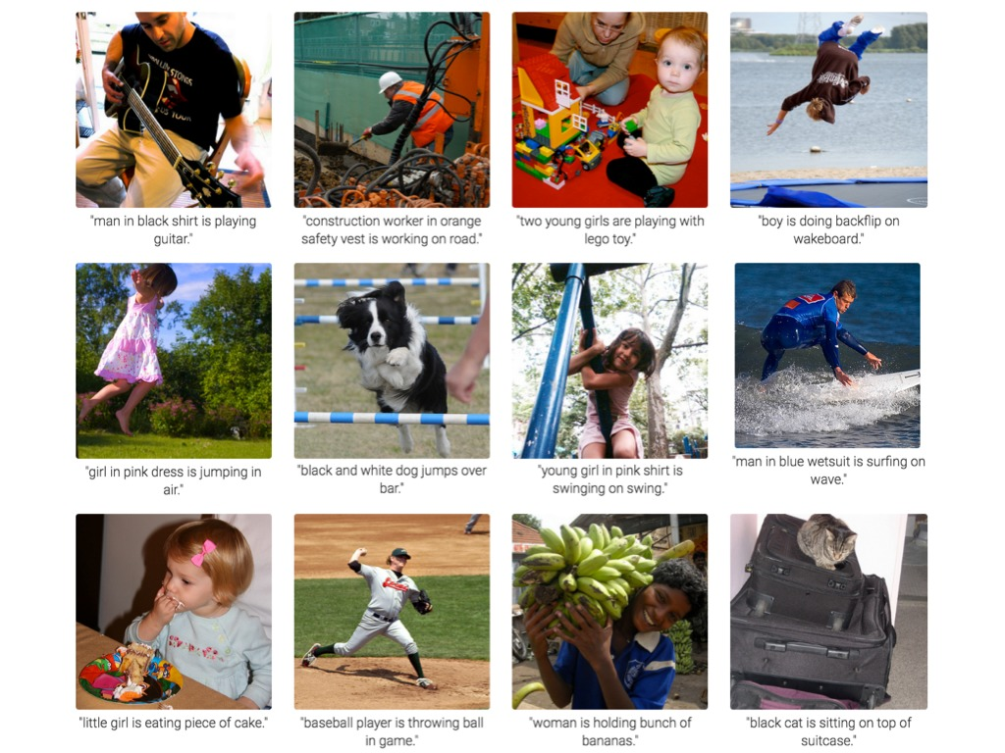
Slide from Andrej Karpathy

Slide 39
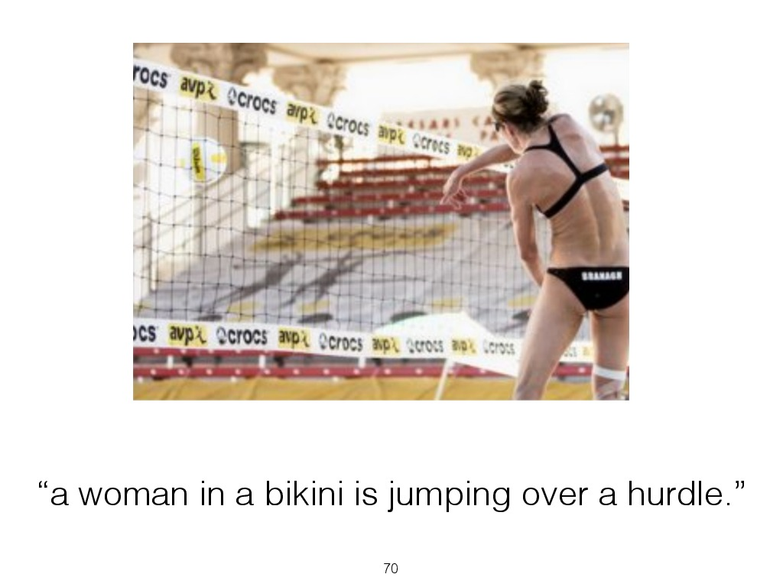
Example Error
Slide modified from Andrej Karpathy

Slide 40
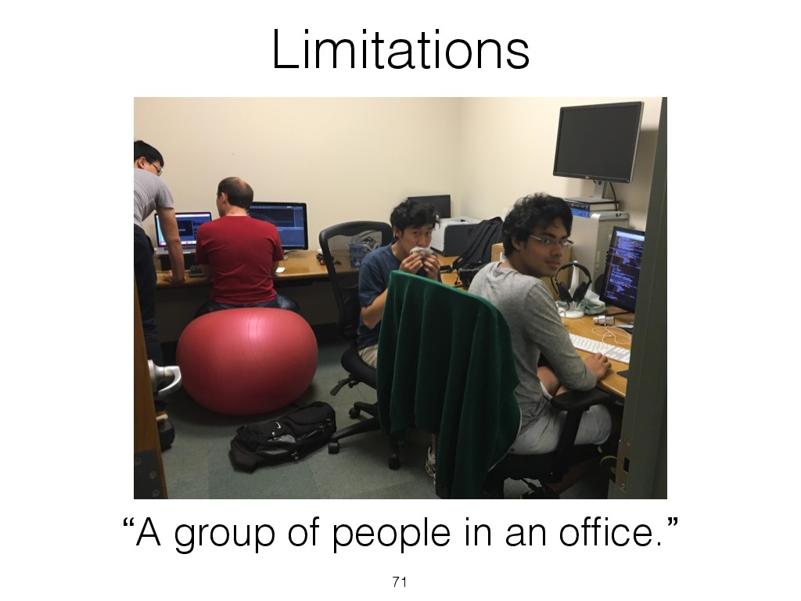
Slide from Andrej Karpathy

Slide 41
Can go even further...
Deep learning enabled addressing image caption generation in a much more natural way
  Also, cross-fertilization of ideas with machine translation (!)
  Framework is actually very similar to neural machine translation
Deep learning also enables solving new problems
  For instance, there is now work on breaking images down into regions (next slide)

Slide 42
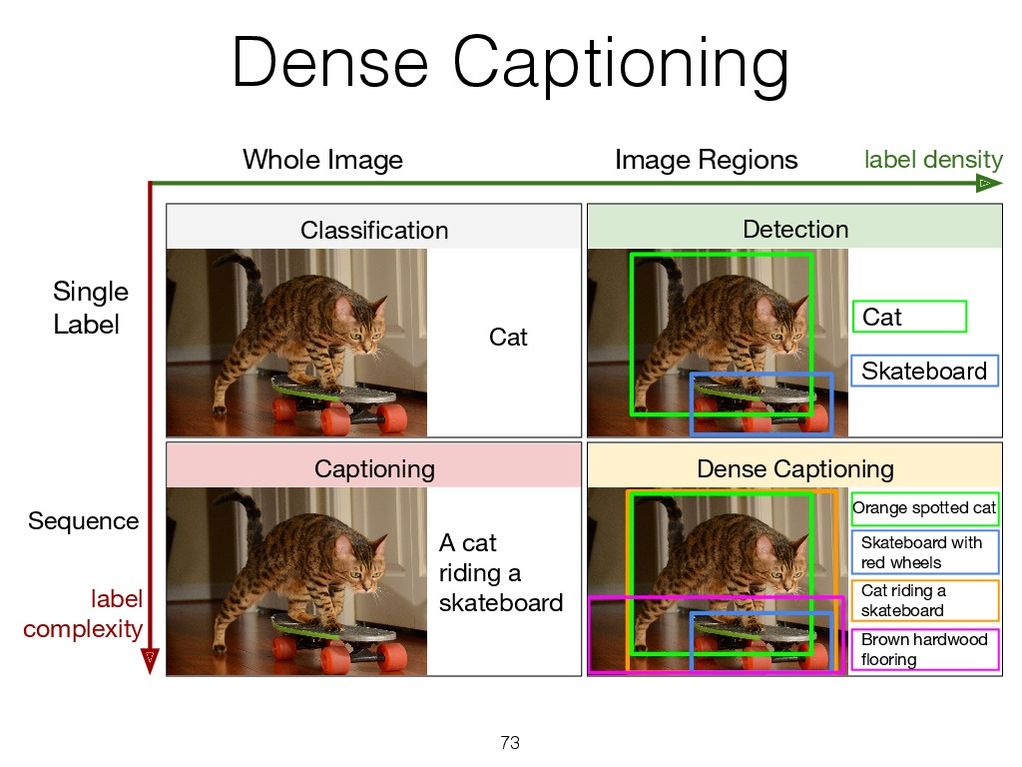
Slide from Andrej Karpathy

Slide 43
Putting it all together for IE
Near term: gains in (static) image processing performance will continue, video processing and ASR will make big improvements
IE: Here is an example of a state-of-the-art system for indexing multimodal news streams
  Primarily working with speech and text though, only limited support for images and video (at least in the 2013 version I looked at)

Slide 44
BBN Multimedia Monitoring System (M3S)
An example system for multimodal extraction is the BBN M3S system (version here from 2013)
Features:
  Automatic multi-lingual data collection and mirroring of user-identified Web sites, broadcast media, and social media (Twitter and Facebook)
  Automatic extraction and translation of text
  Search across multi-lingual sites, channels, and posts
  Visualization tools and automatic topic detection for enhanced analysis
  Collected media archived for later use
  Browser-based user interface with personalized user dashboards
  Story segmentation of broadcast media
  (From BBN website)

Slide 45
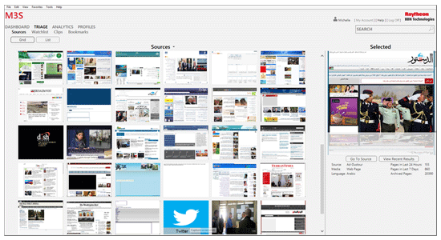
BBN Multimedia Monitoring System (M3S)
(Graphic from BBN website)

Slide 46
Discussion
Another prominent system: Europe Media Monitor
  Check out their website (free access to a good amount of functionality, also free tablet and smartphone apps; and a special medical system)
Overall: multimodal processing approaches are changing rapidly due to better modeling and new sub-tasks
Deep learning approaches should enable IE systems to reason in a more deep way about video/audio streams
  Much new academic work appearing here in many different venues

Slide 47
Slides
The slides for event extraction are from Heng Ji, who is a IE researcher at RPI
The slides on image captioning are from Andrej Karpathy (PhD student of Fei-Fei Li), now at OpenAI

Slide 48
Thank you for your attention!

Slide 49
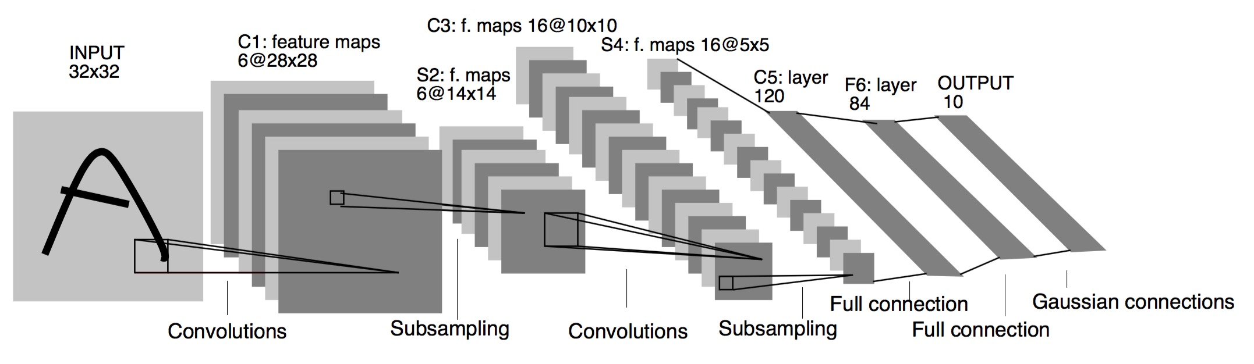
LeNet-5
convolutional neural network use sequence of 3 layers: convolution, pooling, non-linearity –> This may be the key feature of Deep Learning for images since this paper!
use convolution to extract spatial features
subsample using spatial average of maps
non-linearity in the form of tanh or sigmoids
multi-layer neural network (MLP) as final classifier
sparse connection matrix between layers to avoid large computational cost
(Graphic from Yann LeCun, Text from Culurciello et al.)

Slide 50
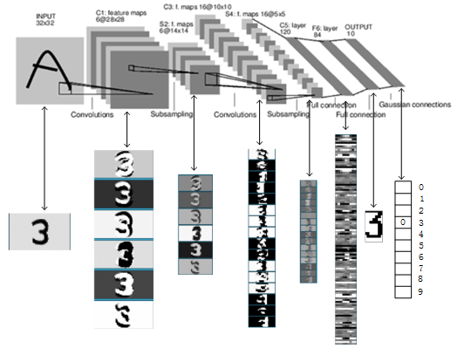
LeNet-5 recognizing "3"
(Graphic from Yann LeCun (and world4jason??))

