Slide 1
Information Extraction
Lecture 13 – More Machine Learning
CIS, LMU München
Winter Semester 2014-2015
Dr. Alexander Fraser, CIS

Slide 2
Administravia
Today is the last lecture
Please review all of the slides from the Vorlesung before next time
Next time: Klausur review
Time after that: Klausur (bring paper!)
PLEASE MAKE SURE YOU ARE REGISTERED FOR THE KLAUSUR IN LSF!
  Even if you somehow already registered at the beginning of the semester, check again now!

Slide 3
Lecture today
Today we will go into more details in machine learning, particularly for NER
  Also briefly discuss tagging different human languages
We'll discuss the models which are used in Wapiti
  Up until now we really only talked about the intuitions behind was is going on, rather than the real models (which are Maximum Entropy models, as we will see)
In the seminar slots next week, we'll look at sequence learning (rather than binary classification)
  We'll also look briefly at regularization

Slide 4
Supervised Learning based IE
‘Pipeline’ style IE
  Split the task into several components
  Prepare data annotation for each component
  Apply supervised machine learning methods to address each component separately
  Most state-of-the-art ACE IE systems were developed in this way
  Provide great opportunity to applying a wide range of learning models and incorporating diverse levels of linguistic features to improve each component
  Large progress has been achieved on some of these components such as name tagging and relation extraction
Slide from Heng Ji

Slide 5
Major IE Components
Name/Nominal Extraction
“Barry Diller”, “chief”
Entity Coreference Resolution
“Barry Diller” = “chief”
Time Identification
and Normalization
Wednesday (2003-03-04)
Relation Extraction
“Vivendi Universal Entertainment” is
located in “France”
“Barry Diller” is the person of
the end-position event
trigged by “quit”
Event Mention Extraction and
Event Coreference Resolution
Slide from Heng Ji
Notes:
5
This structure exists on many levels: the structure of names; the grammatical structure of sentences; and the coreference structure across a discourse (and even across multiple discourses). Each of these is important to IE … to figuring out the participants in an event. And each of these has been studied separately and quite intensively over the past decade. Annotated corpora have been prepared for each of these levels of structure, and a wide range of models and machine learning methods have been applied to construct analyzers (particularly for name and grammatical structure). Except for coreference analysis, the result of these efforts have in general been quite satisfactory levels of performance … on the order of 90% accuracy for names and for grammatical constituents

Slide 6
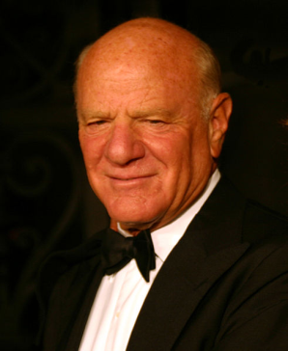

IE Output
(In this talk) Information Extraction (IE) =Identifying the instances of facts names/entities , relations and events from semi-structured or unstructured text; and convert them into structured representations (e.g. databases)
Barry Diller on Wednesday quit as chief of Vivendi Universal Entertainment.
Barry Diller
Vivendi Universal Entertainment
Trigger | Quit (a “Personnel/End-Position” event)
Arguments | Role = Person | Barry Diller
 | Role = Organization | Vivendi Universal Entertainment
 | Role = Position | Chief
 | Role = Time-within | Wednesday (2003-03-04)
Slide modified from Heng Ji
Notes:
6
Give example, to show event type, trigger and argument roles

Slide 7
Introduction
IE Overview
Supervised Name Tagging
  Features
  Models
Advanced Techniques and Trends
  Re-ranking and Global Features (Ji and Grishman, 05;06)
  Data Sparsity Reduction (Ratinov and Roth, 2009; Ji and Lin, 2009)
Slide from Heng Ji

Slide 8
Name Tagging
Recognition x Classification
  “Name Identification and Classification”
NER as:
  as a tool or component of IE and IR
  as an input module for a robust shallow parsing engine
  Component technology for other areas
    Question Answering (QA)
    Summarization
    Automatic translation
    Document indexing
    Text data mining
    Genetics
    …
Slide from Heng Ji

Slide 9
Name Tagging
NE Hierarchies
  Person
  Organization
  Location
  But also:
    Artifact
    Facility
    Geopolitical entity
    Vehicle
    Weapon
    Etc.
SEKINE & NOBATA (2004)
  150 types
  Domain-dependent
Abstract Meaning Representation (amr.isi.edu)
  200+ types
Slide from Heng Ji

Slide 10
Name Tagging
Handcrafted systems
  Knowledge (rule) based
    Patterns
    Gazetteers
Automatic systems
  Statistical
  Machine learning
  Unsupervised
  Analyze: char type, POS, lexical info, dictionaries
Hybrid systems
Slide from Heng Ji

Slide 11
Name Tagging
Handcrafted systems
  LTG
    F-measure of 93.39 in MUC-7 (the best)
    Ltquery, XML internal representation
    Tokenizer, POS-tagger, SGML transducer
  Nominator (1997)
    IBM
    Heavy heuristics
    Cross-document co-reference resolution
    Used later in IBM Intelligent Miner
Slide from Heng Ji

Slide 12
Name Tagging
Handcrafted systems
  LaSIE (Large Scale Information Extraction)
    MUC-6 (LaSIE II in MUC-7)
    Univ. of Sheffield’s GATE architecture (General Architecture for Text Engineering )
    JAPE language
  FACILE (1998)
    NEA language (Named Entity Analysis)
    Context-sensitive rules
  NetOwl (MUC-7)
    Commercial product
    C++ engine, extraction rules
Slide from Heng Ji

Slide 13
Automatic approaches
Learning of statistical models or symbolic rules
  Use of annotated text corpus
    Manually annotated
    Automatically annotated
“BIO” tagging
  Tags: Begin, Inside, Outside an NE
  Probabilities:
    Simple:
      P(tag i | token i)
    With external evidence:
      P(tag i | token i-1, token i, token i+1)
“OpenClose” tagging
  Two classifiers: one for the beginning, one for the end
Slide from Heng Ji

Slide 14
Automatic approaches
Decision trees
  Tree-oriented sequence of tests in every word
    Determine probabilities of having a BIO tag
  Use training corpus
  Viterbi, ID3, C4.5 algorithms
    Select most probable tag sequence
  SEKINE et al (1998)
  BALUJA et al (1999)
    F-measure: 90%
Slide from Heng Ji

Slide 15
Automatic approaches
HMM
  Markov models, Viterbi
  Separate statistical model for each NE category + model for words outside NEs
  Nymble (1997) / IdentiFinder (1999)
Maximum Entropy (ME)
  Separate, independent probabilities for every evidence (external and internal features) are merged multiplicatively
  MENE (NYU - 1998)
    Capitalization, many lexical features, type of text
    F-Measure: 89%
Slide from Heng Ji

Slide 16
Automatic approaches
Hybrid systems
  Combination of techniques
    IBM’s Intelligent Miner: Nominator + DB/2 data mining
  WordNet hierarchies
    MAGNINI et al. (2002)
  Stacks of classifiers
    Adaboost algorithm
  Bootstrapping approaches
    Small set of seeds
  Memory-based ML, etc.
Slide from Heng Ji

Slide 17
NER in various languages
Arabic
  TAGARAB (1998)
  Pattern-matching engine + morphological analysis
  Lots of morphological info (no differences in ortographic case)
Bulgarian
  OSENOVA & KOLKOVSKA (2002)
  Handcrafted cascaded regular NE grammar
  Pre-compiled lexicon and gazetteers
Catalan
  CARRERAS et al. (2003b) and MÁRQUEZ et al. (2003)
  Extract catalan NEs with spanish resources (F-measure 93%)
  Bootstrap using catalan texts
Slide from Heng Ji
Notes:
Linguistic-specific features for different languages

Slide 18
NER in various languages
Chinese & Japanese
  Many works
  Special characteristics
    Character or word-based
    No capitalization
  CHINERS (2003)
    Sports domain
    Machine learning
    Shallow parsing technique
  ASAHARA & MATSMUTO (2003)
    Character-based method
    Support Vector Machine
    87.2% F-measure in the IREX (outperformed most word-based systems)
Slide from Heng Ji

Slide 19
NER in various languages
Dutch
  DE MEULDER et al. (2002)
    Hybrid system
      Gazetteers, grammars of names
      Machine Learning Ripper algorithm
French
  BÉCHET et al. (2000)
    Decision trees
    Le Monde news corpus
German
  Non-proper nouns also capitalized
  THIELEN (1995)
    Incremental statistical approach
    65% of corrected disambiguated proper names
Slide from Heng Ji

Slide 20
NER in various languages
Greek
  KARKALETSIS et al. (1998)
    English – Greek GIE (Greek Information Extraction) project
    GATE platform
Italian
  CUCCHIARELLI et al. (1998)
    Merge rule-based and statistical approaches
    Gazetteers
    Context-dependent heuristics
    ECRAN (Extraction of Content: Research at Near Market)
    GATE architecture
    Lack of linguistic resources: 20% of NEs undetected
Korean
  CHUNG et al. (2003)
    Rule-based model, Hidden Markov Model, boosting approach over unannotated data
Slide from Heng Ji

Slide 21
NER in various languages
Portuguese
  SOLORIO & LÓPEZ (2004, 2005)
    Adapted CARRERAS et al. (2002b) spanish NER
    Brazilian newspapers
Serbo-croatian
  NENADIC & SPASIC (2000)
    Hand-written grammar rules
    Highly inflective language
      Lots of lexical and lemmatization pre-processing
    Dual alphabet (Cyrillic and Latin)
      Pre-processing stores the text in an independent format
Slide from Heng Ji

Slide 22
NER in various languages
Spanish
  CARRERAS et al. (2002b)
    Machine Learning, AdaBoost algorithm
    BIO and OpenClose approaches
Swedish
  SweNam system (DALIANIS & ASTROM, 2001)
    Perl
    Machine Learning techniques and matching rules
Turkish
  TUR et al (2000)
    Hidden Markov Model and Viterbi search
    Lexical, morphological and context clues
Slide from Heng Ji

Slide 23
Name Tagging: Task
Person (PER): named person or family
Organization (ORG): named corporate, governmental, or other organizational entity
Geo-political entity (GPE): name of politically or geographically defined location (cities, provinces, countries, international regions, bodies of water, mountains, etc.)
But also: Location, Artifact, Facility, Vehicle, Weapon, Product, etc.
Extended name hierarchy, 150 types, domain-dependent (Sekine and Nobata, 2004)
Convert it into a sequence labeling problem – “BIO” tagging:
<PER>George W. Bush</PER> discussed <GPE>Iraq</GPE>
B-PER
I-PER
I-PER
O
B-GPE
George
W.
Bush
discussed
Iraq
Slide from Heng Ji

Slide 24
Quiz Time!
Faisalabad's Catholic Bishop John Joseph, who had been campaigning against the law, shot himself in the head outside a court in Sahiwal district when the judge convicted Christian Ayub Masih under the law in 1998.
Next, film clips featuring Herrmann’s Hollywood music mingle with a suite from “Psycho,” followed by “La Belle Dame sans Merci,” which he wrote in 1934 during his time at CBS Radio.
Slide from Heng Ji
Notes:
Ask to choose the other annotator for agreement counting.

Slide 25
Supervised Learning for Name Tagging
Maximum Entropy Models (Borthwick, 1999; Chieu and Ng 2002; Florian et al., 2007)
Decision Trees (Sekine et al., 1998)
Class-based Language Model (Sun et al., 2002, Ratinov and Roth, 2009)
Agent-based Approach (Ye et al., 2002)
Support Vector Machines (Takeuchi and Collier, 2002)
Sequence Labeling Models
  Hidden Markov Models (HMMs) (Bikel et al., 1997; Ji and Grishman, 2005)
  Maximum Entropy Markov Models (MEMMs) (McCallum and Freitag, 2000)
  Conditional Random Fields (CRFs) (McCallum and Li, 2003)
Slide from Heng Ji

Slide 26
Typical Name Tagging Features
N-gram: Unigram, bigram and trigram token sequences in the context window of the current token
Part-of-Speech: POS tags of the context words
Gazetteers: person names, organizations, countries and cities, titles, idioms, etc.
Word clusters: to reduce sparsity, using word clusters such as Brown clusters (Brown et al., 1992)
Case and Shape: Capitalization and morphology analysis based features
Chunking: NP and VP Chunking tags
Global feature: Sentence level and document level features. For example, whether the token is in the first sentence of a document
Conjunction: Conjunctions of various features
Slide from Heng Ji

Slide 27
Markov Chain for a Simple Name Tagger
George:0.3
Transition
Probability
0.6
W.:0.3
Emission
Probability
Bush:0.3
PER
Iraq:0.1
0.2
$:1.0
0.3
0.1
END
START
LOC
0.2
0.3
0.2
0.2
0.3
0.3
0.1
George:0.2
0.5
0.2
X
Iraq:0.8
W.:0.3
0.5
discussed:0.7
Slide from Heng Ji
Notes:
From yesterday’s talk
Generative: center of distribution;
Discriminate: margin of distributions.
Hmm matches sequential sequence better…
Future…….T2N

Slide 28
Viterbi Decoding of Name Tagger
George
W.
Bush
discussed
Iraq
$
t=0
t=1
t=2
t=3
t=4
t=5
t=6
START
1
0
0
0
0
1
0
1*0.3*0.3
PER
0
0
0.09
0.0162
0.003
0
0.000008
0.0012
0.0003
LOC
0
0.004
0
0
0
0.000032
0
X
0
0
0.0054
0
0.0004
0
0
0.0036
END
0.00000016
0
0
0
0
0
0
0.0000096
Current = Previous * Transition * Emission
Slide from Heng Ji
Notes:
From this picture we can also that since we are assigning tag for each word, there are many other methods can be used to address this task.
One nice thing of HMM is it matches the character of the task – we are now focusing on a sentence.

Slide 29
Limitations of HMMs
Joint probability distribution p(y, x)
Assume independent features
Cannot represent overlapping features or long range dependencies between observed elements
  Need to enumerate all possible observation sequences
  Strict independence assumptions on the observations
Toward discriminative/conditional models
  Conditional probability P(label sequence y | observation sequence x) rather than joint probability P(y, x)
  Allow arbitrary, non-independent features on the observation sequence X
  The probability of a transition between labels may depend on past and future observations
  Relax strong independence assumptions in generative models
Slide modified from Heng Ji

Slide 30
Maximum Entropy
Why maximum entropy?
Maximize entropy = Minimize commitment
Model all that is known and assume nothing about what is unknown.
  Model all that is known: satisfy a set of constraints that must hold
  Assume nothing about what is unknown:
  choose the most “uniform” distribution
  ➔ choose the one with maximum entropy
Slide from Heng Ji

Slide 31
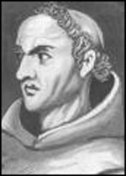
Why Try to be Uniform?
Most Uniform = Maximum Entropy
By making the distribution as uniform as possible, we don’t make any additional assumptions to what is supported by the data
Abides by the principle of Occam’s Razor
(least assumption = simplest explanation)
Less generalization errors (less over-fitting)
→more accurate predictions on test data
Slide from Heng Ji
Notes:
Mention…less generalization error…predict more accurately….won’t avoid overfitting….flat…won’t violate the observation…

Slide 32
Learning Coreference by
Maximum Entropy Model
Suppose that if the feature “Capitalization” = “Yes”
for token t, then
P (t is the beginning of a Name | (Captalization = Yes)) = 0.7
How do we adjust the distribution?
P (t is not the beginning of a name | (Capitalization = Yes)) = 0.3
If we don’t observe “Has Title = Yes” samples?
P (t is the beginning of a name | (Has Title = Yes)) = 0.5
P (t is not the beginning of a name | (Has Title = Yes)) = 0.5
Slide from Heng Ji

Slide 33
The basic idea
Goal: estimate p
Choose p with maximum entropy (or “uncertainty”) subject to the constraints (or “evidence”).
Slide from Heng Ji

Slide 34
Setting
From training data, collect (a, b) pairs:
  a: thing to be predicted (e.g., a class in a classification problem)
  b: the context
  Ex: Name tagging:
    a=person
    b=the words in a window and previous two tags
Learn the prob of each (a, b): p(a, b)
Slide from Heng Ji

Slide 35
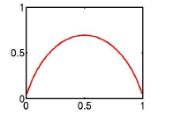
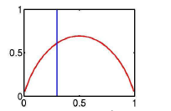
Ex1: Coin-flip example
(Klein & Manning 2003)
Toss a coin: p(H)=p1, p(T)=p2.
Constraint: p1 + p2 = 1
Question: what’s your estimation of p=(p1, p2)?
Answer: choose the p that maximizes H(p)
H
p1
p1=0.3
Slide from Heng Ji

Slide 36
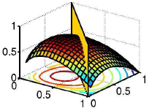
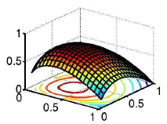
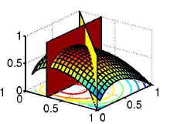
Coin-flip example (cont)
H
p1 + p2 = 1
p1
p2
p1+p2=1.0, p1=0.3
Slide from Heng Ji

Slide 37
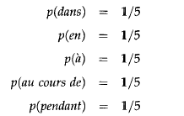
Ex2: An MT example
(Berger et. al., 1996)
Possible translation for the word “in” is:
Constraint:
Intuitive answer:
Slide from Heng Ji

Slide 38

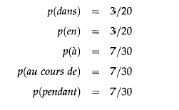
An MT example (cont)
Constraints:
Intuitive answer:
Slide from Heng Ji

Slide 39
Why ME?
Advantages
  Combine multiple knowledge sources
    Local
      Word prefix, suffix, capitalization (POS - (Ratnaparkhi, 1996))
      Word POS, POS class, suffix (WSD - (Chao & Dyer, 2002))
      Token prefix, suffix, capitalization, abbreviation (Sentence Boundary - (Reynar & Ratnaparkhi, 1997))
    Global
      N-grams (Rosenfeld, 1997)
      Word window
      Document title (Pakhomov, 2002)
      Structurally related words (Chao & Dyer, 2002)
      Sentence length, conventional lexicon (Och & Ney, 2002)
  Combine dependent knowledge sources
Slide from Heng Ji

Slide 40
Why ME?
Advantages
  Add additional knowledge sources
  Implicit smoothing
Disadvantages
  Computational
    Expected value at each iteration
    Normalizing constant
  Overfitting
    Feature selection
      Cutoffs
      Basic Feature Selection (Berger et al., 1996)
Slide from Heng Ji

Slide 41
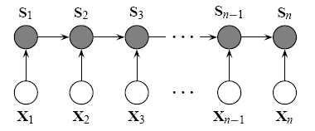
Maximum Entropy Markov Models (MEMMs)
A conditional model that representing the probability of reaching a state given an observation and the previous state
Consider observation sequences to be events to be conditioned upon.
Have all the advantages of Conditional Models
No longer assume that features are independent
Do not take future observations into account (no forward-backward)
Subject to Label Bias Problem: Bias toward states with fewer outgoing transitions
Slide from Heng Ji

Slide 42
Conditional Random Fields (CRFs)
Conceptual Overview
  Each attribute of the data fits into a feature function that associates the attribute and a possible label
    A positive value if the attribute appears in the data
    A zero value if the attribute is not in the data
  Each feature function carries a weight that gives the strength of that feature function for the proposed label
    High positive weights: a good association between the feature and the proposed label
    High negative weights: a negative association between the feature and the proposed label
    Weights close to zero: the feature has little or no impact on the identity of the label
CRFs have all the advantages of MEMMs without label bias problem
  MEMM uses per-state exponential model for the conditional probabilities of next states given the current state
  CRF has a single exponential model for the joint probability of the entire sequence of labels given the observation sequence
Weights of different features at different states can be traded off against each other
CRFs provide the benefits of discriminative models
Slide from Heng Ji

Slide 43
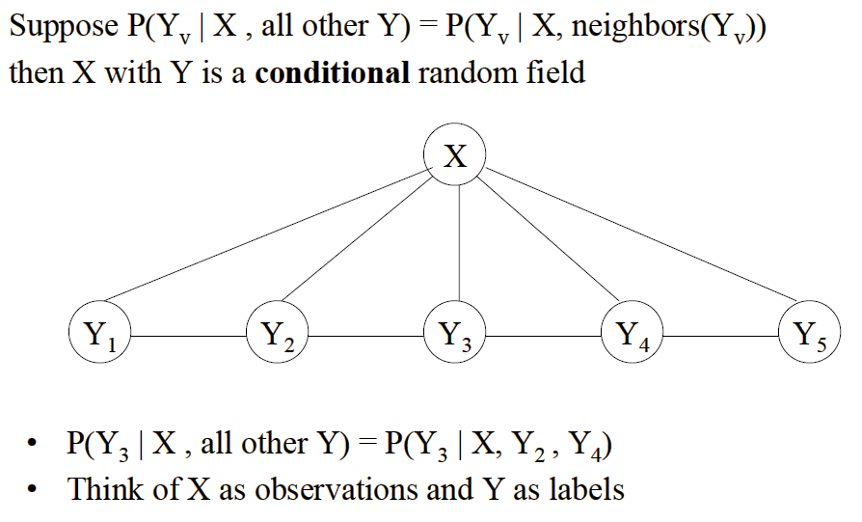
Example of CRFs
Slide from Heng Ji

Slide 44
Sequential Model Trade-offs
 | Speed | Discriminative vs. Generative | Normalization
HMM | very fast | generative | local
MEMM | mid-range | discriminative | local
CRF | relatively slow | discriminative | global
Slide from Heng Ji

Slide 45
State-of-the-art and Remaining Challenges
State-of-the-art Performance
  On ACE data sets: about 89% F-measure (Florian et al., 2006; Ji and Grishman, 2006; Nguyen et al., 2010; Zitouni and Florian, 2008)
  On CONLL data sets: about 91% F-measure (Lin and Wu, 2009; Ratinov and Roth, 2009)
Remaining Challenges
  Identification, especially on organizations
    Boundary: “Asian Pulp and Paper Joint Stock Company , Lt. of Singapore”
    Need coreference resolution or context event features: “FAW has also utilized the capital market to directly finance, and now owns three domestic listed companies” (FAW = First Automotive Works)
  Classification
    “Caribbean Union”: ORG or GPE?
Slide from Heng Ji

Slide 46
Slides
The slides on machine learning are from Heng Ji, who is a IE researcher at RPI
Literature:
  Dan Klein and Chris Manning. Maxent Models, Conditional Estimation, and Optimization, without the Magic. Tutorial presented at NAACL 2003 and ACL 2003.
  Available from Dan Klein's web page (at the bottom):
    http://www.cs.berkeley.edu/~klein
  See also the two papers mentioned in the slides:
    Ratnaparkhi's 1998 thesis
    Adam Berger, Stephen Della Pietra, and Vincent Della Pietra. A maximum entropy approach to natural language processing. Computational Linguistics (22-1). March 1996
  CRF (and MEMM) paper:
    John Lafferty, Andrew McCallum, and Fernando C.N. Pereira. "Conditional Random Fields: Probabilistic Models for Segmenting and Labeling Sequence Data" Departmental Papers (CIS) (2001).
    Available at: http://works.bepress.com/andrew_mccallum/4

Slide 47
Thank you for your attention!

