Slide 1
Information Extraction
Lecture 10 – Ontological and Open IE
CIS, LMU München
Winter Semester 2014-2015
Dr. Alexander Fraser, CIS

Slide 2
Ontological IE
In the last two lectures, we discussed how to extract relations and events from text
  We looked in detail at relations expressed in a single sentence
  Event extraction captures relations which can be expressed at either the sentence or at the document level (i.e., in multiple sentences)
    Consider the CMU Seminar task – the task is to extract events (seminars), with speaker, location, start time and end time
Today we will discuss updating a knowledge base with the extracted relations or events
  This is called "Ontological IE"

Slide 3
Before I start, two topics I wanted to briefly talk about today:
  Semantic role labeling
  Wikification

Slide 4
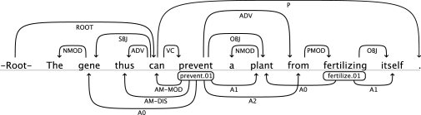
Semantic Role Labeling
Example from Kozhevnikov and Titov
List of SRL tools (see also the comments):
http://www.kenvanharen.com/2012/11/comparison-of-semantic-role-labelers.html

Slide 5






Wikification: The Reference Problem
Blumenthal (D) is a candidate for the U.S. Senate seat now held by Christopher Dodd (D), and he has held a commanding lead in the race since he entered it. But the Times report has the potential to fundamentally reshape the contest in the Nutmeg State.
Blumenthal (D) is a candidate for the U.S. Senate seat now held by Christopher Dodd (D), and he has held a commanding lead in the race since he entered it. But the Times report has the potential to fundamentally reshape the contest in the Nutmeg State.
Slide from ACL 2014 Roth Tutorial
Notes:
Let’s start with what is wikification
Read wiki titles slower

Slide 6
Wikification: Motivation
Dealing with Ambiguity of Natural Language
  Mentions of entities and concepts could have multiple meanings
Dealing with Variability of Natural Language
  A given concept could be expressed in many ways
Wikification addresses these two issues in a specific way:
The Reference Problem
  What is meant by this concept? (WSD + Grounding)
  More than just co-reference (within and across documents)
Slide from ACL 2014 Roth Tutorial
Notes:
. We expect this idea to inspire a completely new philosophy for fact
extraction which will be essential for the creation of a high-quality StructNet.
Incorporate arbitrary global features and soft constraints;
Features are automatically learned selectively
Save some human knowledge engineering efforts
Capture inter-dependency knowledge on the entire structure
Efficient linear-time beam search by joint learning and decoding
No need to model joint/conditional distribution with a large number of variables
Extract all facts jointly in a unified framework
Local predictions can be mutually improved
Avoid error compounding problem

Slide 7
Ontologies
An ontology is a consistent knowledge base
without redundancy
Person | Nationality
Angela Merkel | German
Merkel | Germany
Merkel | French
✗
Entity | Relation | Entity
Angela Merkel | citizenOf | Germany
✓
Every entity appears only with exactly the same name
There are no semantic contradictions
Slide from Suchanek

Slide 8
Ontological IE
Ontological Information Extraction (IE) aims to create or extend an ontology.
Entity | Relation | Entity
Angela Merkel | citizenOf | Germany
Angela Merkel is the German chancellor....
...Merkel was born in Germany...
...A. Merkel has French nationality...
Person | Nationality
Angela Merkel | German
Merkel | Germany
Merkel | French
Slide from Suchanek

Slide 9
Ontological IE Challenges
Challenge 1:
Map names to names that are already known
Entity | Relation | Entity
Angela Merkel | citizenOf | Germany
Merkel
Angie
A. Merkel
Slide from Suchanek

Slide 10
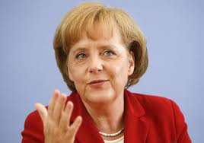

Ontological IE Challenges
Challenge 2:
Be sure to map the names to the right known names
Entity | Relation | Entity
Angela Merkel | citizenOf | Germany
Una Merkel | citizenOf | USA
?
Merkel is great!
Slide from Suchanek

Slide 11
Ontological IE Challenges
Challenge 3:
Map to known relationships
Entity | Relation | Entity
Angela Merkel | citizenOf | Germany
… has nationality …
… has citizenship …
… is citizen of …
Slide from Suchanek

Slide 12
Ontological IE Challenges
Challenge 4:
Take care of consistency
Entity | Relation | Entity
Angela Merkel | citizenOf | Germany
✗
Angela Merkel is French…
Slide from Suchanek

Slide 13
Triples
A triple (in the sense of ontologies) is a tuple of an entity, a relation name and another entity:
Entity | Relation | Entity
Angela Merkel | citizenOf | Germany
Most ontological IE approaches produce triples as output. This decreases the variance in schema.
Person | Country
Angela | Germany
Citizen | Nationality
Angela | Germany
Person | Birthdate | Country
Angela | 1980 | Germany
Slide from Suchanek

Slide 14

Triples
A triple can be represented in multiple forms:
Entity | Relation | Entity
Angela Merkel | citizenOf | Germany
=
citizenOf
=
<Angela Merkel, citizenOf, Germany>
Slide from Suchanek

Slide 15
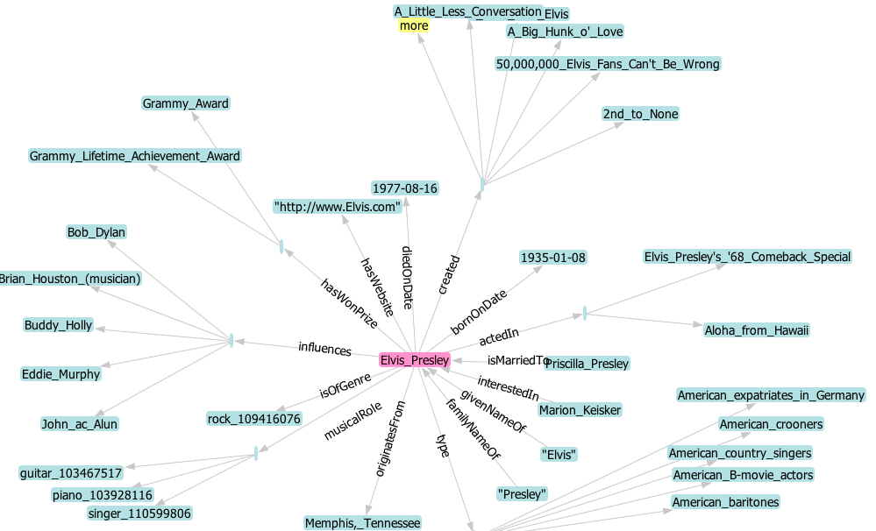
YAGO
Example: Elvis in YAGO
Slide from Suchanek

Slide 16
Let's talk about ontological IE using extraction from Wikipedia as an example
Then we will go on to open IE, which uses similar ideas to extract from all the text on the web!

Slide 17

Wikipedia
Wikipedia is a free online encyclopedia
3.4 million articles in English
16 million articles in dozens of languages
Why is Wikipedia good for information extraction?
It is a huge, but homogenous resource
  (more homogenous than the Web)
It is considered authoritative
(more authoritative than a random Web page)
It is well-structured with infoboxes and categories
It provides a wealth of meta information
(inter article links, inter language links, user discussion,...)
Slide from Suchanek

Slide 18

Ontological IE from Wikipedia
Wikipedia is a free online encyclopedia
3.4 million articles in English
16 million articles in dozens of languages
Every article is (should be) unique
=> We get a set of unique entities
that cover numerous areas of interest
Germany
Angela_Merkel
Una_Merkel
Theory_of_Relativity
Slide from Suchanek

Slide 19
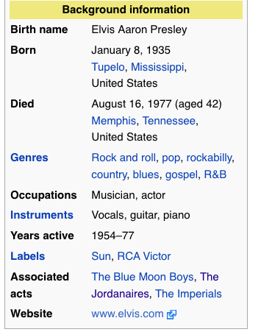
Wikipedia Source
Example: Elvis on Wikipedia
|Birth_name = Elvis Aaron Presley
|Born = {{Birth date|1935|1|8}}<br />
[[Tupelo, Mississippi|Tupelo]]
Slide from Suchanek

Slide 20
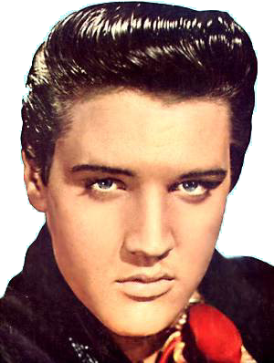
IE from Wikipedia
bornOnDate = 1935
(hello regexes!)
Elvis Presley
Blah blah blub fasel (do not read this, better listen to the talk) blah blah Elvis blub (you are still reading this) blah Elvis blah blub later became astronaut blah
~Infobox~
Born: 1935
...
born
1935
Exploit Infoboxes
Categories: Rock singers
Slide from Suchanek

Slide 21
IE from Wikipedia
Rock Singer
Elvis Presley
type
Blah blah blub fasel (do not read this, better listen to the talk) blah blah Elvis blub (you are still reading this) blah Elvis blah blub later became astronaut blah
~Infobox~
Born: 1935
...
born
1935
Exploit Infoboxes
Exploit conceptual categories
Categories: Rock singers
Slide from Suchanek

Slide 22

IE from Wikipedia
Every singer is a person
WordNet
Person
Person
subclassOf
subclassOf
Singer
Singer
subclassOf
Rock Singer
Elvis Presley
type
Blah blah blub fasel (do not read this, better listen to the talk) blah blah Elvis blub (you are still reading this) blah Elvis blah blub later became astronaut blah
~Infobox~
Born: 1935
...
born
1935
Exploit Infoboxes
Exploit conceptual categories
Categories: Rock singers
Slide from Suchanek

Slide 23
Consistency Checks
Person
subclassOf
Singer
subclassOf
Guitar
Guitarist
Rock Singer
type
1977
diedInPlace
born
1935
Check uniqueness of functional arguments
Check domains and ranges of relations
Check type coherence
Slide from Suchanek

Slide 24


Ontological IE from Wikipedia
YAGO
3m entities, 28m facts
focus on precision 95%
(automatic checking of facts)
http://yago-knowledge.org
DBpedia
3.4m entities
1b facts (also from non-English Wikipedia)
large community
http://dbpedia.org
Community project on top of Wikipedia
(bought by Google, but still open)
http://freebase.com
Slide from Suchanek

Slide 25
Ontological IE by Reasoning
born
1935
Elvis was born in 1935
Recap: The challenges:
died in, was killed in
deliver canonic relations
Elvis, Elvis Presley, The King
deliver canonic entities
deliver consistent facts
born (Elvis, 1970)
born (Elvis, 1935)
Idea: These problems are interleaved,
solve all of them together.
Slide from Suchanek

Slide 26


Using Reasoning
Ontology
First Order Logic
type(Elvis_Presley,singer)
subclassof(singer,person)
...
appears(“Elvis”,”was born in”,
”1935”)
...
means(“Elvis”,Elvis_Presley,0.8)
means(“Elvis”,Elvis_Costello,0.2)
...
born(X,Y) & died(X,Z) => Y<Z
appears(A,P,B) & R(A,B)
=> expresses(P,R)
appears(A,P,B) & expresses(P,R)
=> R(A,B)
...
Documents
born
1935
Elvis was born in 1935
Consistency Rules
birthdate<deathdate
SOFIE
system
Slide from Suchanek

Slide 27
Ontological IE by Reasoning
Reasoning-based approaches use logical rules
to extract knowledge from natural language documents.
Current approaches use either
Weighted MAX SAT
or Datalog
or Markov Logic
Input:
often an ontology
manually designed rules
Condition:
homogeneous corpus helps
Slide from Suchanek

Slide 28
Ontological IE Summary
Ontological Information Extraction (IE) tries to create or extend an ontology through information extraction.
nationality
Current hot approaches:
extraction from Wikipedia
reasoning-based approaches
integrating uncertainty
Slide modified from Suchanek

Slide 29
Open Information Extraction
Open Information Extraction/Machine Reading
aims at information extraction from the entire Web.
Vision of Open Information Extraction:
the system runs perpetually, constantly gathering
new information
the system creates meaning on its own
from the gathered data
the system learns and becomes more intelligent,
i.e. better at gathering information
Slide from Suchanek

Slide 30
Open Information Extraction
Open Information Extraction/Machine Reading
aims at information extraction from the entire Web.
Rationale for Open Information Extraction:
We do not need to care for every single sentence,
but just for the ones we understand
The size of the Web generates redundancy
The size of the Web can generate synergies

Slide 31

KnowItAll &Co
KnowItAll, KnowItNow and TextRunner are projects
at the University of Washington (in Seattle, WA).
Subject | Verb | Object | Count
Egyptians | built | pyramids | 400
Americans | built | pyramids | 20
... | ... | ... | ...
Valuable
common sense
knowledge
(if filtered)
http://www.cs.washington.edu/research/textrunner/
Slide from Suchanek

Slide 32
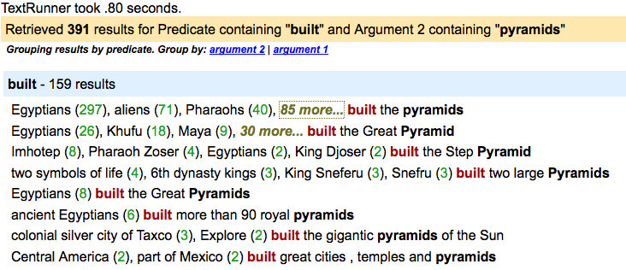
KnowItAll &Co
http://www.cs.washington.edu/research/textrunner/
Slide from Suchanek

Slide 33
Read the Web
“Read the Web” is a project at the
Carnegie Mellon University in Pittsburgh, PA.
Initial Ontology
Table Extractor
Krzewski Blue Angels
Miller Red Angels
Natural Language
Pattern Extractor
Krzewski coaches the Blue Devils.
Mutual exclusion
sports coach != scientist
Type Check
If I coach, am I a coach?
http://rtw.ml.cmu.edu/rtw/
Slide from Suchanek

Slide 34
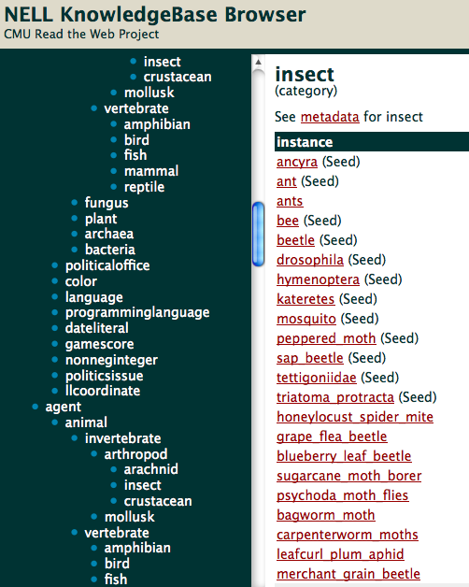
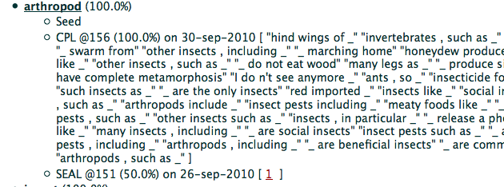
Open IE: Read the Web
http://rtw.ml.cmu.edu/rtw/
Slide from Suchanek

Slide 35
Open Information Extraction
Open Information Extraction/Machine Reading
aims at information extraction from the entire Web.
Main hot projects
TextRunner (University of Washington)
Read the Web (Carnegie Mellon)
Prospera/SOFIE (Max-Planck Informatics Saarbrücken)
Input
The Web
Read the Web: Manual rules
Read the Web: initial ontology
Conditions
none
Slide modified from Suchanek

Slide 36
Slide sources
  Most of the slides today are from Fabian Suchanek (Télécom ParisTech)

Slide 37
Thank you for your attention!

