Slide 1
Information Extraction
CIS, LMU München
Winter Semester 2013-2014
Dr. Alexander Fraser, CIS

Slide 2
Information Extraction – Administravia - I
Vorlesung
  Learn the basics of Information Extraction (IE)
Seminar
  Each student who wants a Schein will present a research paper on IE
    25 minutes (powerpoint, LaTeX, Mac)
Also: two or three practical sessions
Full test is three pieces:
  Klausur (this is associated with the Vorlesung)
  Referat (25 minutes)
  Hausarbeit (write-up of the Referat) (6 pages, due 3 weeks after you hold your Referat)
  CIS-ler: No Notenverbesserung (everyone: ask in your Fachschaft)

Slide 3
Information Extraction - Administravia - II
WE WILL HAVE A SEMINAR TOMORROW!
  Room 067, too small (we will change)
  Ungraded quiz (so that I can see what you already know)
    Optionally anonymous (you either put your name, or don't)
  I will also collect information on who you are
  And what you want to learn in this class!
Syllabus: updated dynamically on my web page
  Brief idea at end of this slide deck (if we finish, then today)
List of Referatsthemen
  This will be presented in the seminar slot next week
Literature: Sunita Sarawagi. Information Extraction. Foundations and Trends in Databases
  Please read the introduction for next week

Slide 4
Questions?

Slide 5
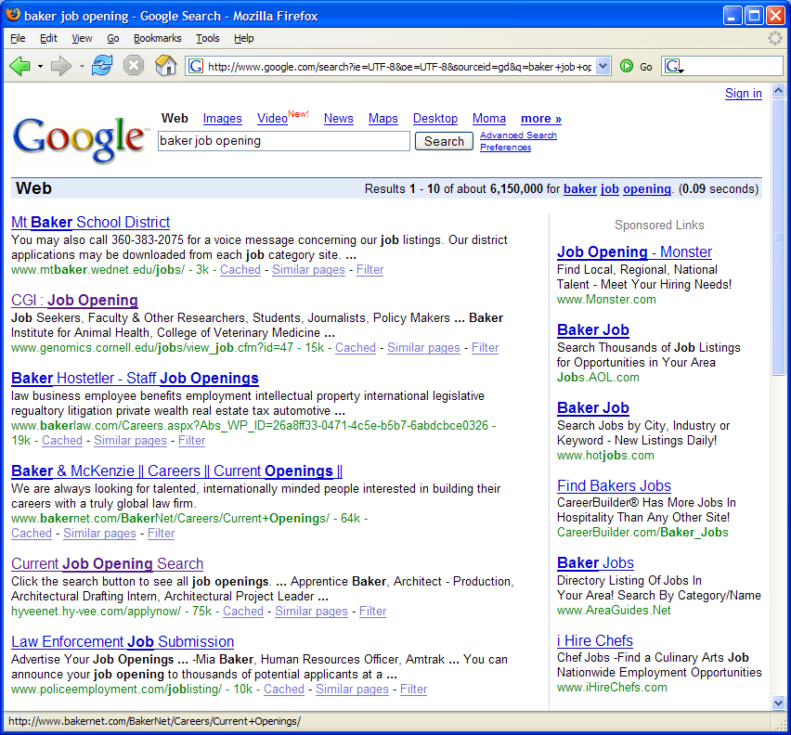
A problem
Mt. Baker, the school district
Baker Hostetler, the company
Baker, a job opening
Genomics job
Slide from Cohen/Mccallum

Slide 6
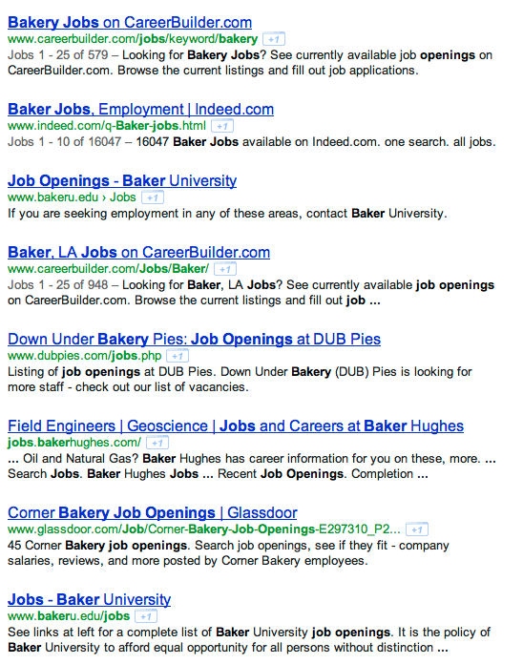
Slide from Kauchak

Slide 7
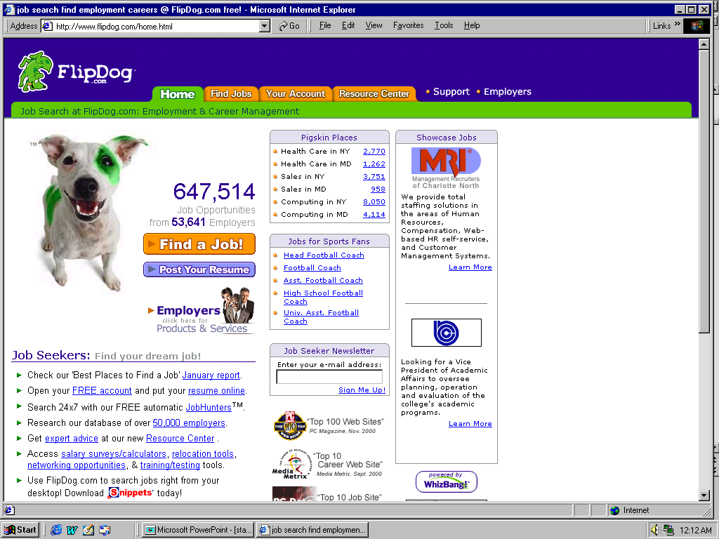
A solution
Slide from Cohen/McCallum

Slide 8
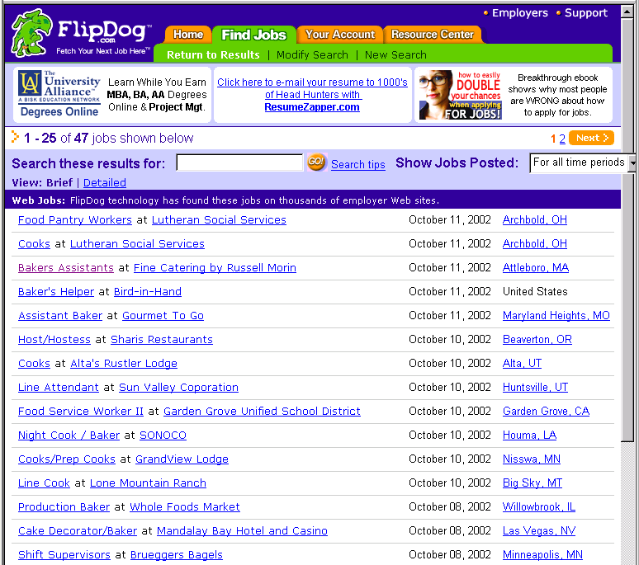
Job Openings:
Category = Food Services
Keyword = Baker
Location = Continental U.S.
Slide from Cohen/McCallum

Slide 9

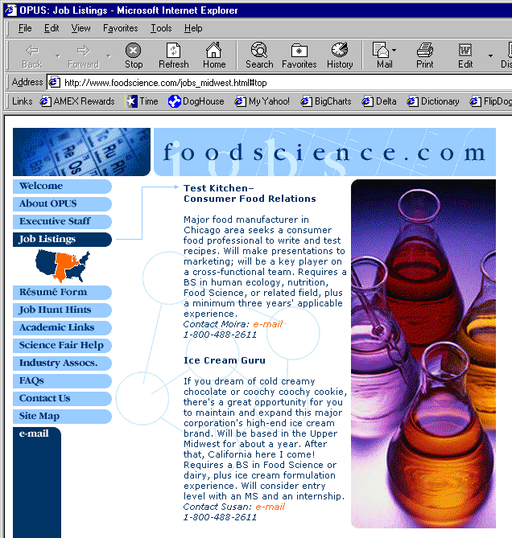
Extracting Job Openings from the Web
Title: Ice Cream Guru
Description: If you dream of cold creamy…
Contact: susan@foodscience.com
Category: Travel/Hospitality
Function: Food Services
Slide from Cohen/McCallum

Slide 10
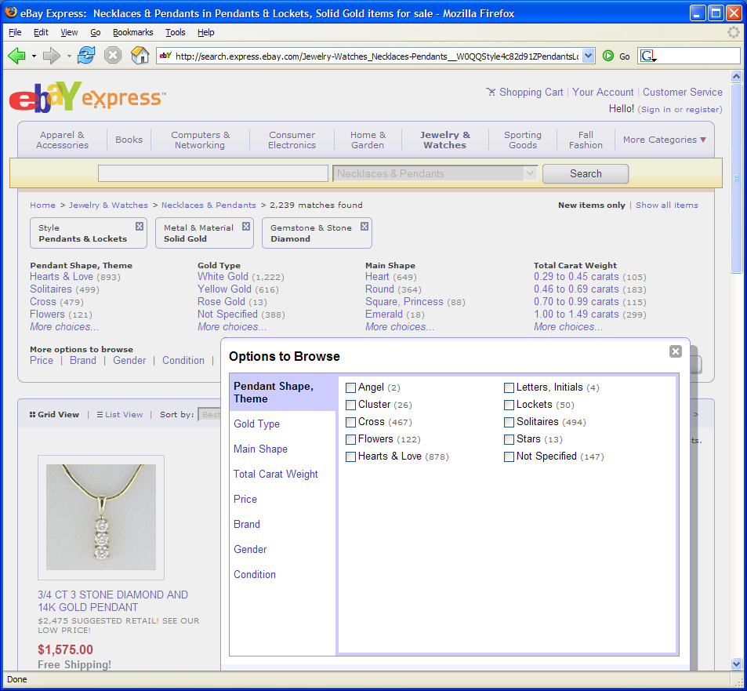
Another Problem
Slide from Cohen/McCallum

Slide 11
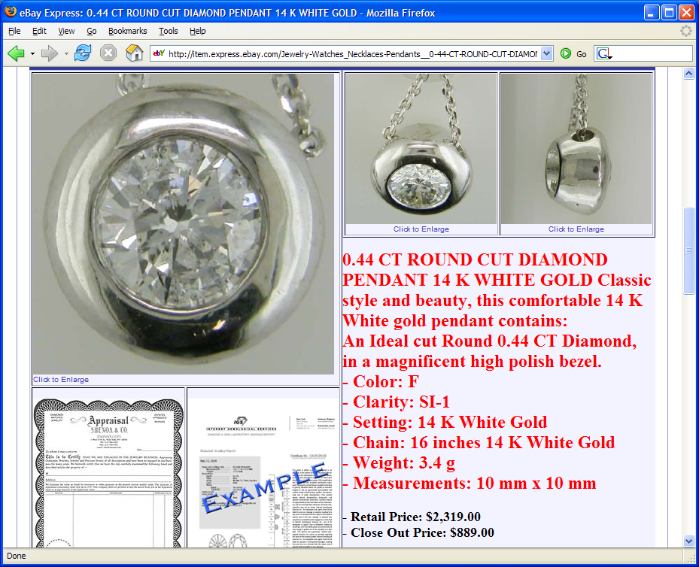
Often structured information in text
Slide from Cohen/McCallum

Slide 12
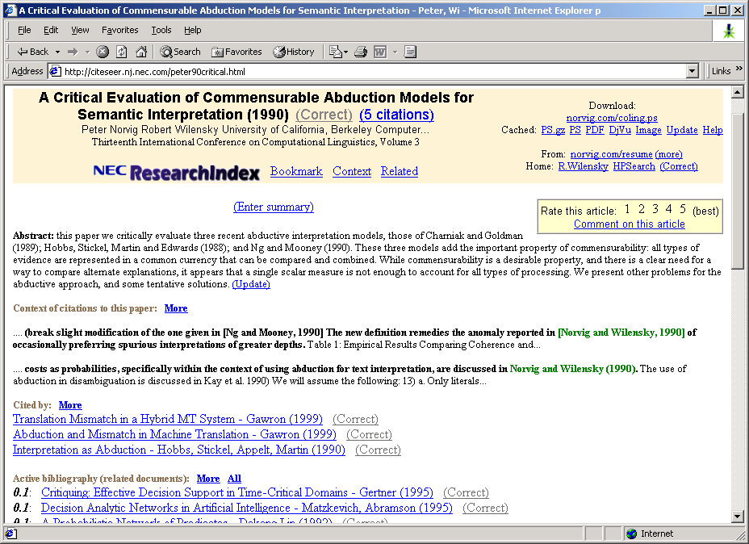
Another Problem
Slide from Cohen/McCallum

Slide 13
Definition of IE
Information Extraction (IE) is the process
of extracting structured information (e.g., database tables) from unstructured machine-readable documents
(e.g., Web documents).
Information
Extraction
GName | FName | Occupation
Elvis | Presley | singer
Elvis | Hunter | painter
... | ...
Elvis Presley was a famous rock singer.
...
Mary once remarked that the only attractive thing about the painter Elvis Hunter was his first name.
“Seeing the Web as a table”
Slide from Suchanek

Slide 14
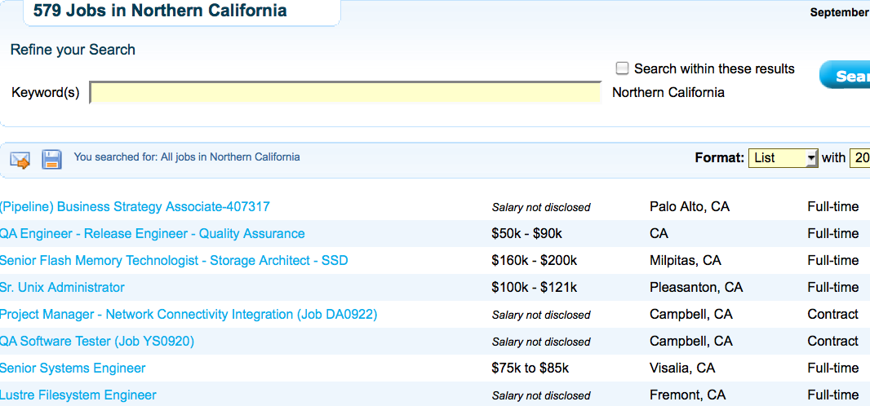
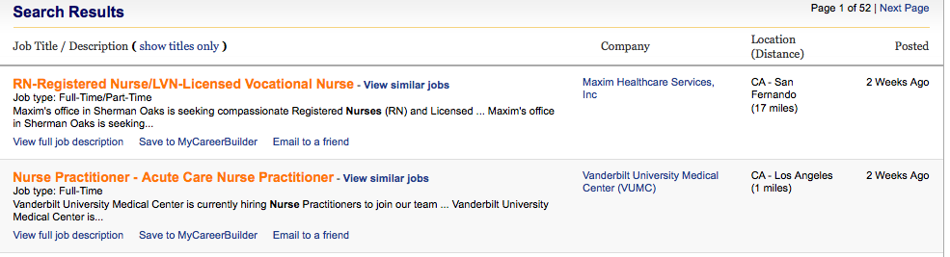
Motivating Examples
Title | Type | Location
Business strategy Associate | Part time | Palo Alto, CA
Registered Nurse | Full time | Los Angeles
... | ...
Slide from Suchanek

Slide 15
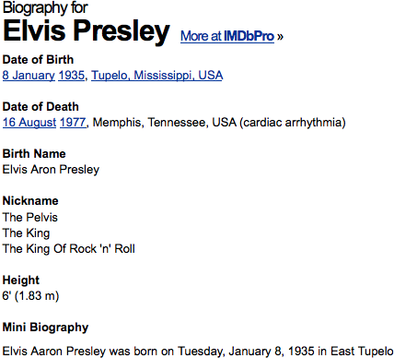
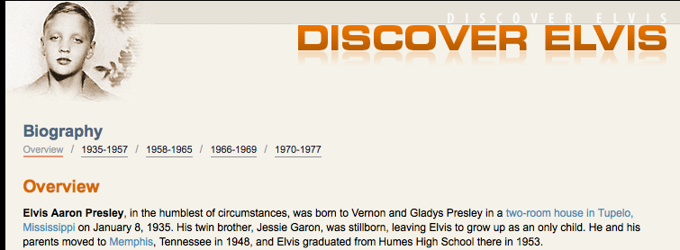
Motivating Examples
Name | Birthplace | Birthdate
Elvis Presley | Tupelo, MI | 1935-01-08
... | ...
Slide from Suchanek

Slide 16
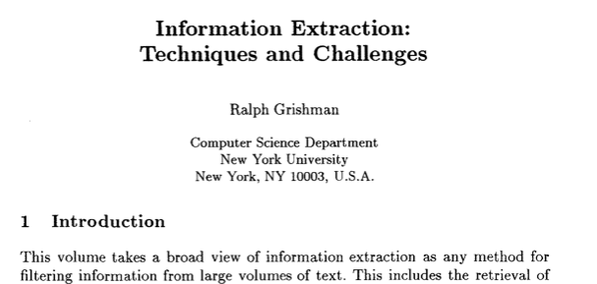
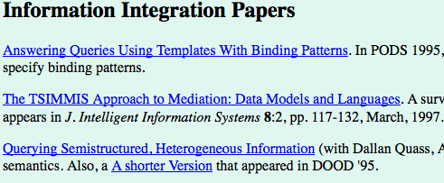
Motivating Examples
Author | Publication | Year
Grishman | Information Extraction... | 2006
... | ... | ...
Slide from Suchanek

Slide 17
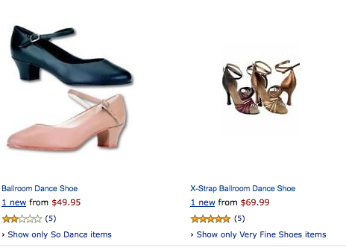
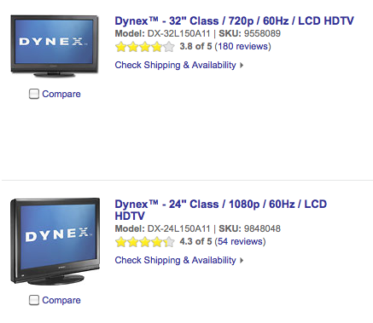
Motivating Examples
Product | Type | Price
Dynex 32” | LCD TV | $1000
... | ...
Slide from Suchanek

Slide 18
Information Extraction
and beyond
Information Extraction (IE) is the process
of extracting structured information
from unstructured machine-readable documents
Ontological
Information
Extraction
Fact
Extraction
Instance
Extraction
Named Entity
Recognition
Elvis Presley | singer
Angela Merkel | politician
Tokenization&
Normalization
Source
Selection
...married Elvis
on 1967-05-01
05/01/67
→
1967-05-01
?
Slide from Suchanek

Slide 19
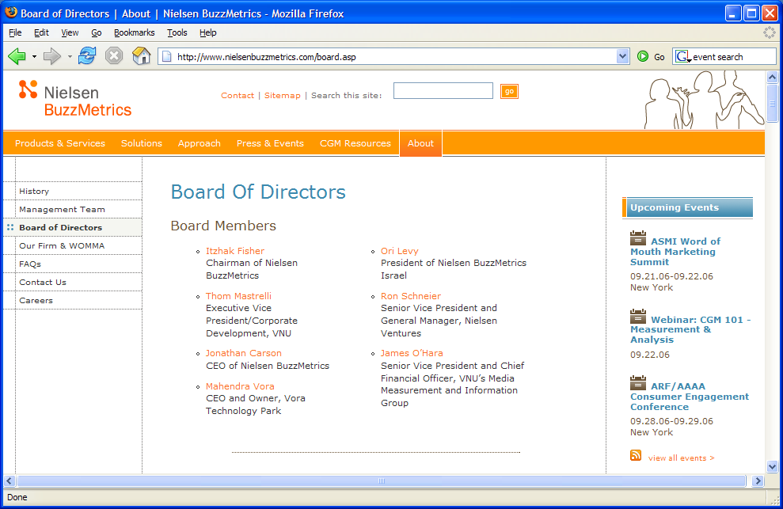
Information Extraction
Traditional definition: Recovering structured data from text
What are some of the sub-problems/challenges?
Slide from Nigam/Cohen/McCallum

Slide 20
Information Extraction?
Recovering structured data from text
  Identifying fields (e.g. named entity recognition)
Slide from Nigam/Cohen/McCallum

Slide 21
Information Extraction?
Recovering structured data from text
  Identifying fields (e.g. named entity recognition)
  Understanding relations between fields (e.g. record association)
Slide from Nigam/Cohen/McCallum

Slide 22
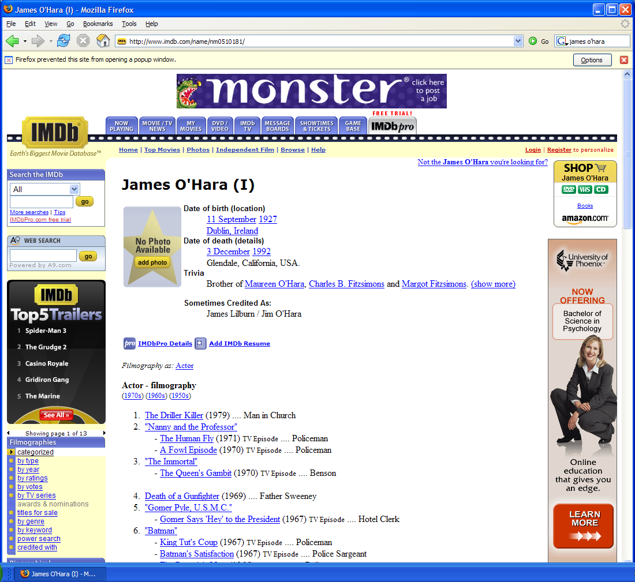
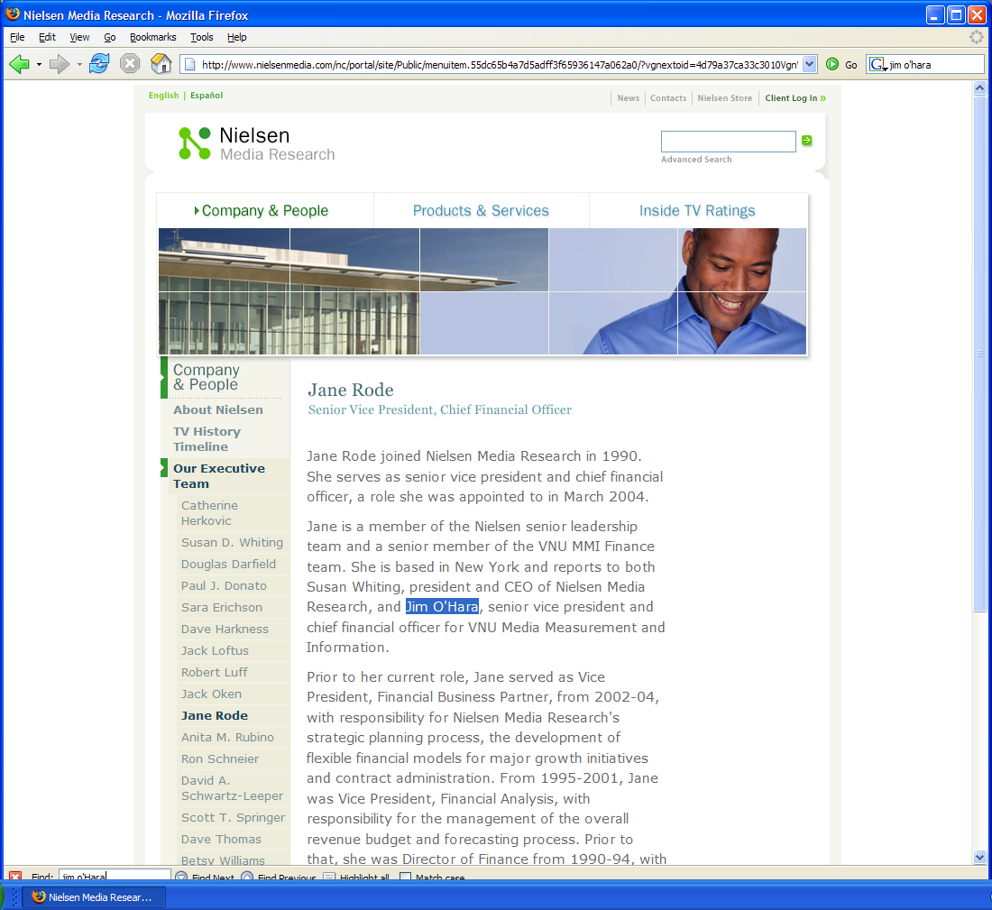
Information Extraction?
Recovering structured data from text
  Identifying fields (e.g. named entity recognition)
  Understanding relations between fields (e.g. record association)
  Normalization and deduplication
Slide from Nigam/Cohen/McCallum

Slide 23

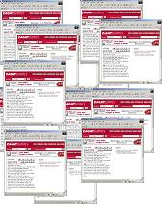
Information extraction
Input: Text Document
  Various sources: web, e-mail, journals, …
Output: Relevant fragments of text and relations possibly to be processed later in some automated way
IE
User Queries
Slide from McCallum

Slide 24
Not all documents are created equal…
Varying regularity in document collections
Natural or unstructured
  Little obvious structural information
Partially structured
  Contain some canonical formatting
Highly structured
  Often, automatically generated
Slide from McCallum

Slide 25
Natural Text: MEDLINE
Journal Abstracts
Extract number of subjects, type of study, conditions, etc.
BACKGROUND: The most challenging aspect of revision hip surgery is the management of bone loss. A reliable and valid measure of bone loss is important since it will aid in future studies of hip revisions and in preoperative planning. We developed a measure of femoral and acetabular bone loss associated with failed total hip arthroplasty. The purpose of the present study was to measure the reliability and the intraoperative validity of this measure and to determine how it may be useful in preoperative planning. METHODS: From July 1997 to December 1998, forty-five consecutive patients with a failed hip prosthesis in need of revision surgery were prospectively followed. Three general orthopaedic surgeons were taught the radiographic classification system, and two of them classified standardized preoperative anteroposterior and lateral hip radiographs with use of the system. Interobserver testing was carried out in a blinded fashion. These results were then compared with the intraoperative findings of the third surgeon, who was blinded to the preoperative ratings. Kappa statistics (unweighted and weighted) were used to assess correlation. Interobserver reliability was assessed by examining the agreement between the two preoperative raters. Prognostic validity was assessed by examining the agreement between the assessment by either Rater 1 or Rater 2 and the intraoperative assessment (reference standard). RESULTS: With regard to the assessments of both the femur and the acetabulum, there was significant agreement (p < 0.0001) between the preoperative raters (reliability), with weighted kappa values of >0.75. There was also significant agreement (p < 0.0001) between each rater's assessment and the intraoperative assessment (validity) of both the femur and the acetabulum, with weighted kappa values of >0.75. CONCLUSIONS: With use of the newly developed classification system, preoperative radiographs are reliable and valid for assessment of the severity of bone loss that will be found intraoperatively.
Slide from Kauchak

Slide 26
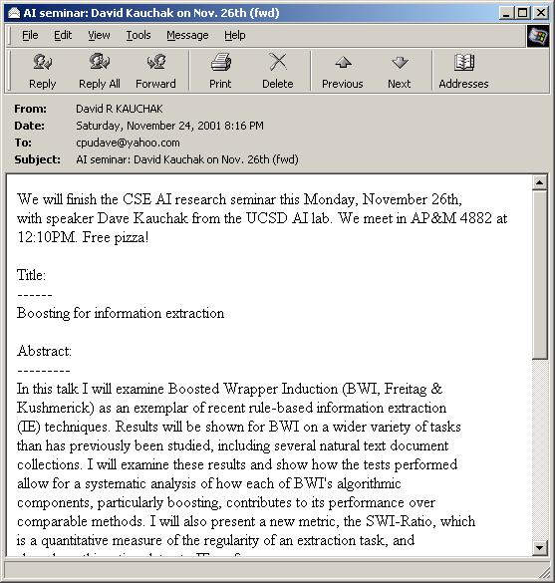
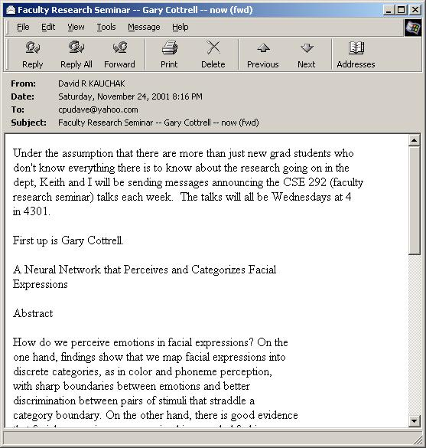
Partially Structured:
Seminar Announcements
Extract time, location, speaker, etc.
Slide from Kauchak

Slide 27
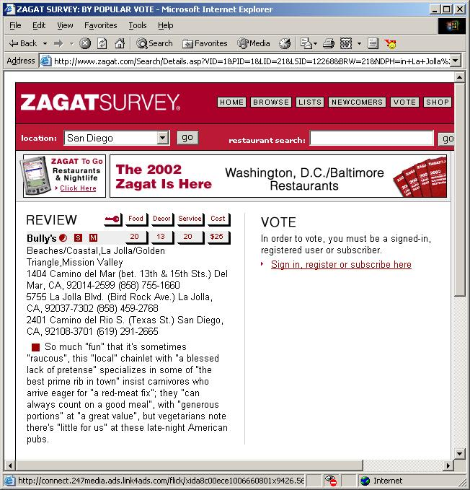
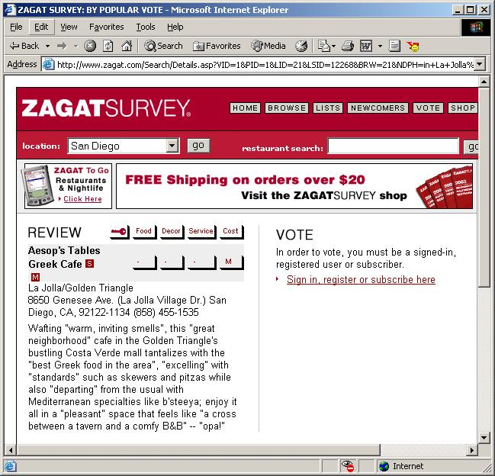
Highly Structured:
Zagat’s Reviews
Extract restaurant, location, cost, etc.
Slide from Kauchak

Slide 28
Information extraction pipeline
For years, Microsoft Corporation CEO Bill Gates was against open source. But today he appears to have changed his mind. "We can be open source. We love the concept of shared source," said Bill Veghte, a Microsoft VP. "That's a super-important shift for us in terms of code access.“
Richard Stallman, founder of the Free Software Foundation, countered saying…
Name Title Organization
Bill Gates CEO Microsoft
Bill Veghte VP Microsoft
Richard Stallman Founder Free Soft..
Slide from McCallum

Slide 29
The Full Task of Information Extraction
As a family of techniques:
Information Extraction =
segmentation + classification + association + clustering
For years, Microsoft Corporation CEO Bill Gates railed against the economic philosophy of open-source software with Orwellian fervor, denouncing its communal licensing as a "cancer" that stifled technological innovation.
Now Gates himself says Microsoft will gladly disclose its crown jewels--the coveted code behind the Windows operating system--to select customers.
"We can be open source. We love the concept of shared source," said Bill Veghte, a Microsoft VP. "That's a super-important shift for us in terms of code access.“
Richard Stallman, founder of the Free Software Foundation, countered saying…
Microsoft Corporation
CEO
Bill Gates
Gates
Microsoft
Bill Veghte
Microsoft
VP
Richard Stallman
founder
Free Software Foundation
Free Soft..
Microsoft
Microsoft
TITLE ORGANIZATION
founder
CEO
VP
Stallman
Veghte
NAME
Bill Gates
Richard
Bill
Slide from McCallum

Slide 30
An Even Broader View
Create ontology
Spider
Filter by relevance
IE
Segment
Classify
Associate
Cluster
Database
Load DB
Document
collection
Train extraction models
Query,
Search
Label training data
Data mine
Slide from McCallum

Slide 31
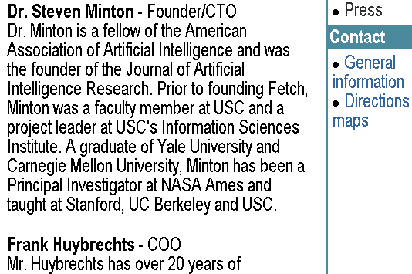
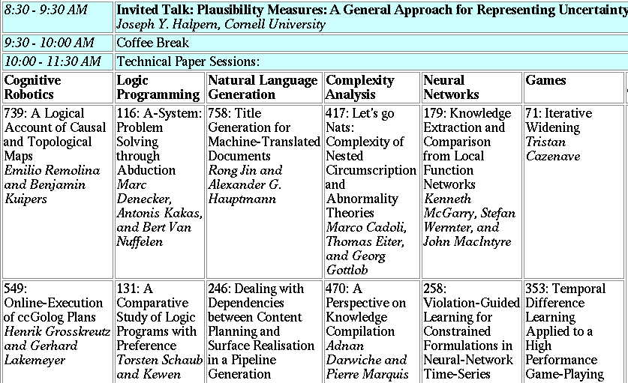
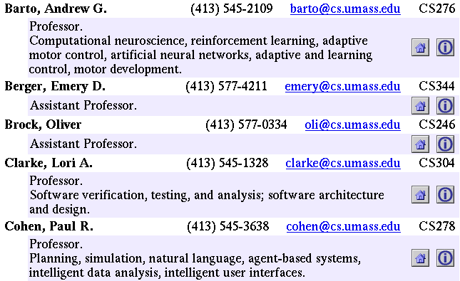
Landscape of IE Tasks:
Document Formatting
Text paragraphs
without formatting
Grammatical sentences
and some formatting & links
Astro Teller is the CEO and co-founder of BodyMedia. Astro holds a Ph.D. in Artificial Intelligence from Carnegie Mellon University, where he was inducted as a national Hertz fellow. His M.S. in symbolic and heuristic computation and B.S. in computer science are from Stanford University.
Tables
Non-grammatical snippets,
rich formatting & links
Slide from McCallum

Slide 32
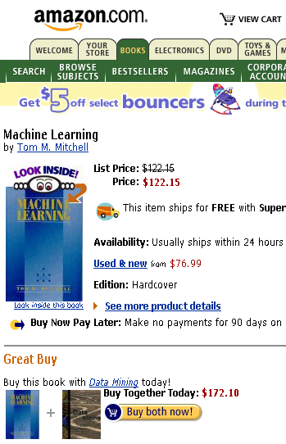
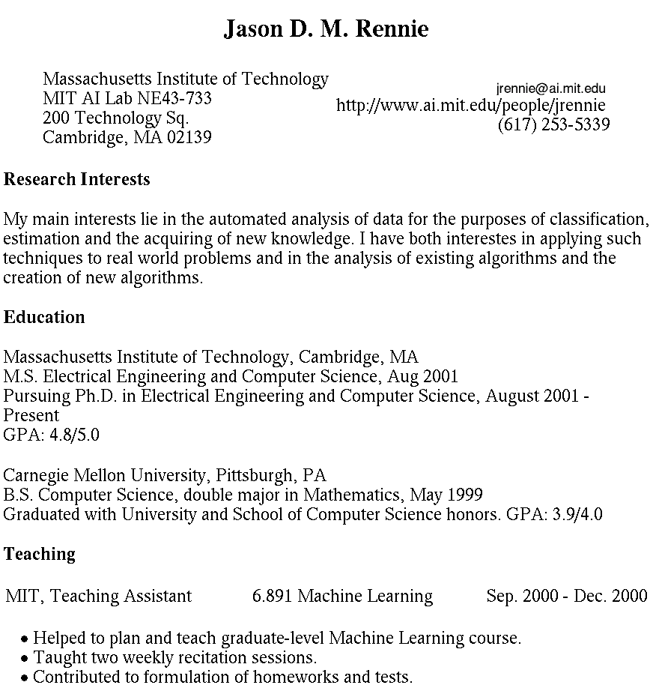

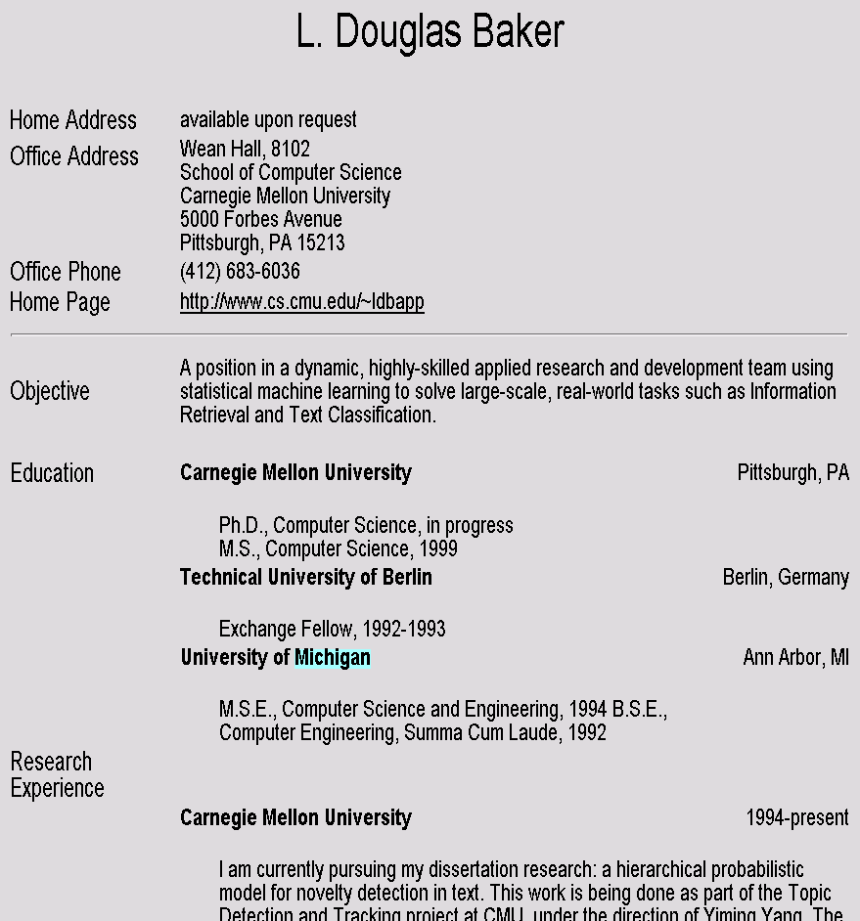
Landscape of IE Tasks
Intended Breadth of Coverage
Web site specific
Genre specific
Wide, non-specific
Formatting
Layout
Language
Amazon.com Book Pages
Resumes
University Names
Slide from McCallum

Slide 33
Landscape of IE Tasks :
Complexity of entities/relations
Closed set
Regular set
U.S. states
U.S. phone numbers
He was born in Alabama…
Phone: (413) 545-1323
The big Wyoming sky…
The CALD main office is 412-268-1299
Ambiguous patterns, needing context and many sources of evidence
Complex pattern
U.S. postal addresses
Person names
University of Arkansas
P.O. Box 140
Hope, AR 71802
…was among the six houses sold by Hope Feldman that year.
Headquarters:
1128 Main Street, 4th Floor
Cincinnati, Ohio 45210
Pawel Opalinski, Software
Engineer at WhizBang Labs.
Slide from McCallum

Slide 34
Landscape of IE Tasks:
Arity of relation
Jack Welch will retire as CEO of General Electric tomorrow. The top role
at the Connecticut company will be filled by Jeffrey Immelt.
Single entity
Binary relationship
N-ary record
Person: Jack Welch
Relation: Person-Title
Person: Jack Welch
Title: CEO
Relation: Succession
Company: General Electric
Title: CEO
Out: Jack Welsh
In: Jeffrey Immelt
Person: Jeffrey Immelt
Location: Connecticut
Relation: Company-Location
Company: General Electric
Location: Connecticut
"Named entity" extraction
Slide from McCallum

Slide 35
Association task = Relation Extraction
Checking if groupings of entities are instances of a relation
Manually engineered rules
  Rules defined over words/entities: “<company> located in <location>”
  Rules defined over parsed text:
    “((Obj <company>) (Verb located) (*) (Subj <location>))”
Machine Learning-based
  Supervised: Learn relation classifier from examples
  Partially-supervised: bootstrap rules/patterns from “seed” examples
Slide from Manning

Slide 36
Relation Extraction: Disease Outbreaks
May 19 1995, Atlanta -- The Centers for Disease Control
and Prevention, which is in the front line of the world's
response to the deadly Ebola epidemic in Zaire ,
is finding itself hard pressed to cope with the crisis…
Date | Disease Name | Location
Jan. 1995 | Malaria | Ethiopia
July 1995 | Mad Cow Disease | U.K.
Feb. 1995 | Pneumonia | U.S.
May 1995 | Ebola | Zaire
Information
Extraction System
Slide from Manning

Slide 37
Relation Extraction: Protein Interactions
“We show that CBF-A and CBF-C interact
with each other to form a CBF-A-CBF-C complex
and that CBF-B does not interact with CBF-A or
CBF-C individually but that it associates with the
CBF-A-CBF-C complex.“
interact
complex
CBF-A CBF-C
CBF-B CBF-A-CBF-C complex
associates
Slide from Manning

Slide 38
Binary Relation Association as Binary Classification
Christos Faloutsos conferred with Ted Senator, the KDD 2003 General Chair.
Person
Person
Role
Person-Role (Christos Faloutsos, KDD 2003 General Chair) → NO
Person-Role ( Ted Senator, KDD 2003 General Chair) → YES
Slide from Manning

Slide 39
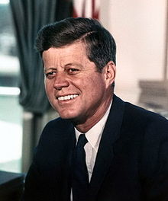
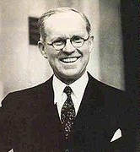
Resolving coreference
(both within and across documents)
John Fitzgerald Kennedy was born at 83 Beals Street in Brookline, Massachusetts on Tuesday, May 29, 1917, at 3:00 pm,[7] the second son of Joseph P. Kennedy, Sr., and Rose Fitzgerald; Rose, in turn, was the eldest child of John "Honey Fitz" Fitzgerald, a prominent Boston political figure who was the city's mayor and a three-term member of Congress. Kennedy lived in Brookline for ten years and attended Edward Devotion School, Noble and Greenough Lower School, and the Dexter School, through 4th grade. In 1927, the family moved to 5040 Independence Avenue in Riverdale, Bronx, New York City; two years later, they moved to 294 Pondfield Road in Bronxville, New York, where Kennedy was a member of Scout Troop 2 (and was the first Boy Scout to become President).[8] Kennedy spent summers with his family at their home in Hyannisport, Massachusetts, and Christmas and Easter holidays with his family at their winter home in Palm Beach, Florida. For the 5th through 7th grade, Kennedy attended Riverdale Country School, a private school for boys. For 8th grade in September 1930, the 13-year old Kennedy attended Canterbury School in New Milford, Connecticut.
Slide from Manning

Slide 40
Rough Accuracy of Information Extraction
Information type | Accuracy
Entities | 90-98%
Attributes | 80%
Relations | 60-70%
Events | 50-60%
Errors cascade (error in entity tag → error in relation extraction)
These are very rough, actually optimistic, numbers
  Hold for well-established tasks, but lower for many specific/novel IE tasks
Slide from Manning

Slide 41
What we will cover in this class (briefly)
History of IE, Related Fields
Source Selection (which text?)
Tokenization and Normalization
Named Entity Recognition
Instance Extraction
Fact/Event Extraction
Ontological IE
IE for multilingual applications
Open IE
Your suggestions, which you will give tomorrow in the seminar

Slide 42
Thank you for your attention!

