Slide 1
Statistical Machine Translation
Part IV - Assignments and Advanced Topics
Alex Fraser
Institute for Natural Language Processing
University of Stuttgart
2008.07.24 EMA Summer School

Slide 2
Outline
Assignment 1 – Model 1 and EM
  Comments on implementation
  Study questions
Assignment 2 – Decoding with Moses
Advanced topics

Slide 3
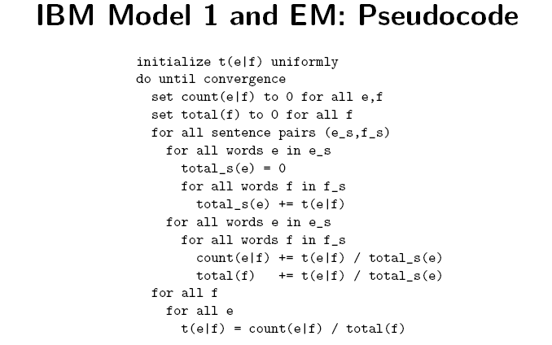
Slide from Koehn 2008

Slide 4
Assignment 1
The first problem is finding data structures for t(e|f) and count(e|f)
  Hashes are a good choice for both of these
  However, if you have really large matrices, you can be even more efficient:
    First collect the set of all e and f that cooccur in any sentence
    Then build a data structure which for each f has a pointer to a block of memory
    Each block of memory consists of (e,float) pairs, they are ordered by e
    When you need to look up the float for (e,f), first go to the f block, then do binary search for the right e
  This solution is used by the GIZA++ aligner if compiled with the –DBINARY_SEARCH_FOR_TTABLE option (on by default)
  Important: binary search is slower than a hash!

Slide 5

Next problem is how to determine the Viterbi alignment
  This is the alignment of highest probability

Slide 6
Speed, if you use C++ on a fast workstation
  de-en: 5 iterations in 3 to 4 seconds
  fr-en: 5 iterations in 2 to 3 seconds
Other questions on implementation?

Slide 7
Assignment 1 – Study questions
Word alignments are usually calculated over lowercased data. Compare your alignments with mixed case versus lowercase. Do you seen an improvement? Where?
  The alignment of the first word improves if it was rarely observed in the first position but frequently in other positions (lowercased)
  Conflating the case of English proper nouns and common nouns (e.g., Bush vs. bush) does not usually hurt performance

Slide 8
How are non-compositional phrases aligned, do you seen any problems?
  Non-compositional phrases like: „to play a role“
  These are virtually never right in Model 1
    Unless they can be translated word-for-word into other language
  Need features that rely on proximity
    Model 4 will get some of these (relative position distortion model)

Slide 9
Generate an alignment in the opposite direction (e.g. swap the English and French files (or English and German) and generate another alignment). Does one direction seem to work well to you?
The direction that is shorter on average works well as the source language
  German for German/English
  English for French/English
1-to-N assumption is particularly important for compounds words
  German > English > French

Slide 10
Look for the longest English token, and the longest French or German token. Are they aligned well? Why?
longest en token: democratically-elected
longest de token: selbstbeschränkungsvereinbarungen
longest fr token: recherche-développement
Frequency of the longest token will usually be one (Zipf‘s law)
Words observed in only one sentence will often be aligned wrong
  Particularly if they are compounds!
  Exception: if all other words in sentence are frequent, pigeon-holing may save the alignment
    Not the case here

Slide 11
Assignment 1 - Advanced Questions
Implement union and intersection of the two alignments you have generated. What are the differences between them? Consider the longest tokens again, is there an improvement?
  Intersection results in extremely sparse alignments, but the links are right
    High precision
  Union results in dense alignments, with many wrong alignment links
    High recall
  The longest tokens are not improved; left unaligned in intersection

Slide 12
Are all cognates aligned correctly? How could we force them to be aligned correctly?
An example of this is „Cunha“ in sentence 17
Other examples include numbers
One way to do this
Extract cognates from the parallel sentences
  Add them as pseudo-sentences
    add „cunha“ on a line by itself to end of both sentence files
  This dramatically improves chances of this being linked
  In first iteration, this will contribute 0.5 count to „cunha“ -> „cunha“, and 0.5 count to NULL -> „cunha“
  After normalization it will have virtually no chance of being generated by NULL

Slide 13
The Porter stemmer is a simple widely available tool for reducing English morphology, e.g., mapping a plural variant and singular variant to the same token. Compare an alignment with porter stemming versus one without.
  Porter stemmer maps „energy“ and „energies“ to „energi“
  There are more counts for the two combined (energies only occurs once)
  Alignment improves

Slide 14
Assignment 2 – Building an SMT System
Tokenize and lowercase data
  Also filter out long sentences
Build language model
Run training script
  This runs GIZA++ as a sub-process in both directions
    See large files in giza.en-fr and giza.fr-en which contain Model 4 alignment
  Applies „grow-diag-final-and“ heuristic (see slide towards end of lecture 2)
    Clearly better than both union and intersection
  Extracts unfiltered phrase table
    See model subdirectory

Slide 15
Steps continued
Run MERT training
  Starts by filtering phrase table for development set
  Optimally set lambda using loop from lecture 3
  Ran 13 iterations to convergence for fr-en system
  Look at last line of each *.log file
    Shows BLEU score of best point
    Before tuning: 0.187 (first line of run1 log)
    Iteration 1: 0.210
    Iteration 13: 0.222
Decode test set using optimal lambdas
  Results in lowercased test set
Post process test set
  Recapitalize
    This uses Moses again as a translator from lowercased to mixedcase!
  Detokenize

Slide 16
Final BLEU scores
French to English: 0.2119
German to English: 0.1527
These numbers are directly comparable because English reference is the same
German to English system is much lower quality than French to English system
Why?
Motivates rest of talk…

Slide 17
Outline
Improved word alignments
Morphology
Syntax

Slide 18
Improved word alignments
My dissertation was on word alignment
Three main pieces of work
  Measuring alignment quality (F-alpha)
  A new generative model with many-to-many structure
  A hybrid discriminative/generative training technique for word alignment

Slide 19
Improved word alignments
My dissertation was on word alignment
Three main pieces of work
  Measuring alignment quality (F-alpha)
  A new generative model with many-to-many structure
  A hybrid discriminative/generative training technique for word alignment
I will now tell you about several years in…
…10 slides

Slide 20
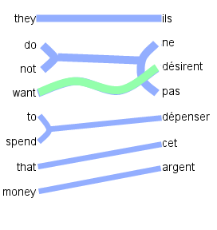
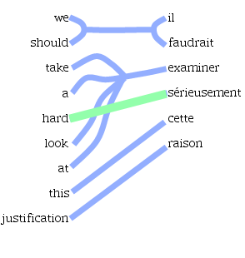
Modeling the Right Structure
1-to-N assumption
  Multi-word “cepts” (words in one language translated as a unit) only allowed on target side. Source side limited to single word “cepts”.
Phrase-based assumption
  “cepts” must be consecutive words

Slide 21
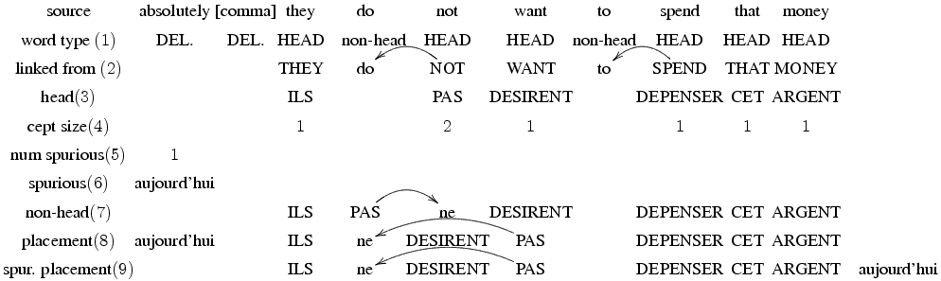
LEAF Generative Story
Explicitly model three word types:
  Head word: provide most of conditioning for translation
    Robust representation of multi-word cepts (for this task)
    This is to semantics as ``syntactic head word'' is to syntax
  Non-head word: attached to a head word
  Deleted source words and spurious target words (NULL aligned)

Slide 22
LEAF Generative Story
Once source cepts are determined, exactly one target head word is generated from each source head word
Subsequent generation steps are then conditioned on a single target and/or source head word
See EMNLP 2007 paper for details

Slide 23
Discussion
LEAF is a powerful model
But, exact inference is intractable
  We use hillclimbing search from an initial alignment
Models correct structure: M-to-N discontiguous
  First general purpose statistical word alignment model of this structure!
  Head word assumption allows use of multi-word cepts
    Decisions robustly decompose over words
  Not limited to only using 1-best prediction (unlike 1-to-N models combined with heuristics)

Slide 24
New knowledge sources for word alignment
It is difficult to add new knowledge sources to generative models
  Requires completely reengineering the generative story for each new source
Existing unsupervised alignment techniques can not use manually annotated data

Slide 25
Decomposing LEAF
Decompose each step of the LEAF generative story into a sub-model of a log-linear model
  Add backed off forms of LEAF sub-models
  Add heuristic sub-models (do not need to be related to generative story!)
  Allows tuning of vector λ which has a scalar for each sub-model controlling its contribution
How to train this log-linear model?

Slide 26
Semi-Supervised Training
Define a semi-supervised algorithm which alternates increasing likelihood with decreasing error
  Increasing likelihood is similar to EM
  Discriminatively bias EM to converge to a local maxima of likelihood which corresponds to “better” alignments
    “Better” = higher F_{α}-score on small gold standard corpus

Slide 27
The EMD Algorithm
Bootstrap
Viterbi
alignments
Translation
Tuned
lambda
vector
Initial
sub-model
parameters
E-Step
D-Step
Viterbi
alignments
M-Step
Sub-model
parameters

Slide 28
Discussion
Usual formulation of semi-supervised learning: “using unlabeled data to help supervised learning”
  Build initial supervised system using labeled data, predict on unlabeled data, then iterate
  But we do not have enough gold standard word alignments to estimate parameters directly!
EMD allows us to train a small number of important parameters discriminatively, the rest using likelihood maximization, and allows interaction
  Similar in spirit (but not details) to semi-supervised clustering

Slide 29
Contributions
Found a metric for measuring alignment quality which correlates with MT quality
Designed LEAF, the first generative model of M-to-N discontiguous alignments
Developed a semi-supervised training algorithm, the EMD algorithm
Obtained large gains of 1.2 BLEU and 2.8 BLEU points for French/English and Arabic/English tasks

Slide 30
Morphology
Up until now, integration of morphology into SMT has been disappointing
Inflection
  The best ideas here are to strip redundant morphology – e.g. case markings that are not used in target language
  Can also add pseudo-words
    One interesting paper looks at translating Czech to English
    Inflection which should be translated to a pronoun is simply replaced by a pseudo-word to match the pronoun in preprocessing
Compounds
  Split these using word frequencies of components
  Akt-ion-plan vs. Aktion-plan
Some new ideas coming
  There is one high performance Arabic/English alignment and decoding system from IBM
  But needed a lot of manual engineering specific to this language pair
This would make a good dissertation topic…

Slide 31
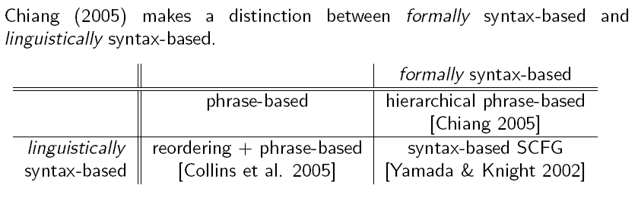
Syntactic Models
Slide from Koehn and Lopez 2008

Slide 32
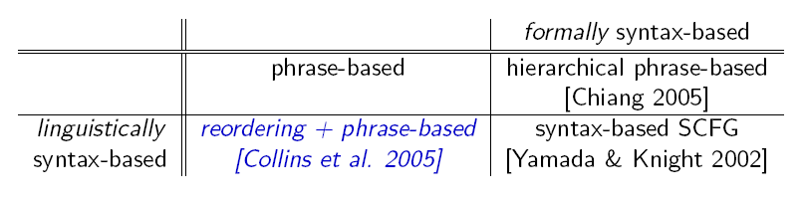
Slide from Koehn and Lopez 2008

Slide 33
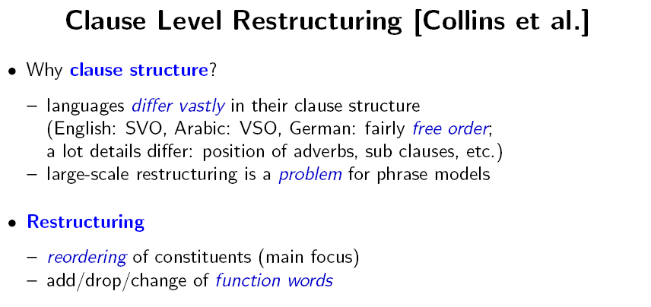
Slide from Koehn and Lopez 2008

Slide 34
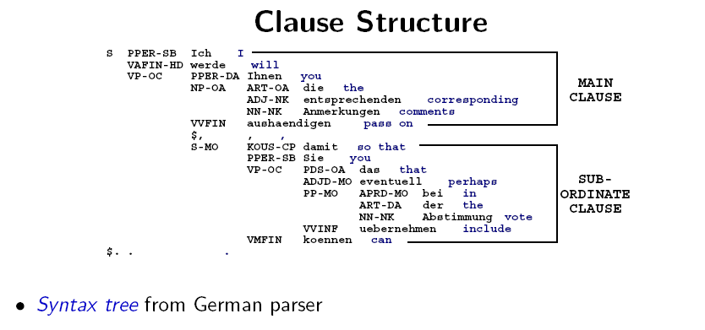
Slide from Koehn and Lopez 2008

Slide 35
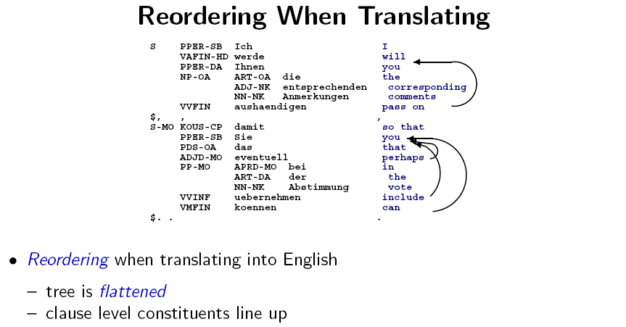
Slide from Koehn and Lopez 2008

Slide 36
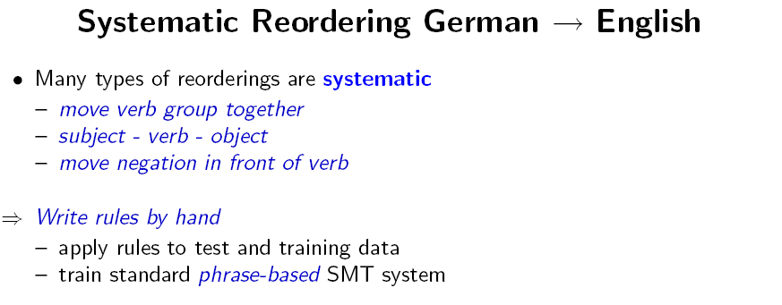
Slide from Koehn and Lopez 2008

Slide 37
Related work of interest
Learning reordering rules automatically using word alignment
Other hand-written rules for local phenomena
  French/English adjective/noun inversion
  Restructuring questions so that wh- word in right position

Slide 38
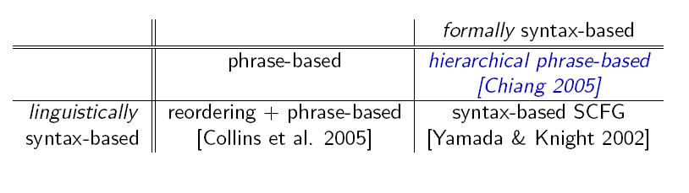
Slide from Koehn and Lopez 2008

Slide 39
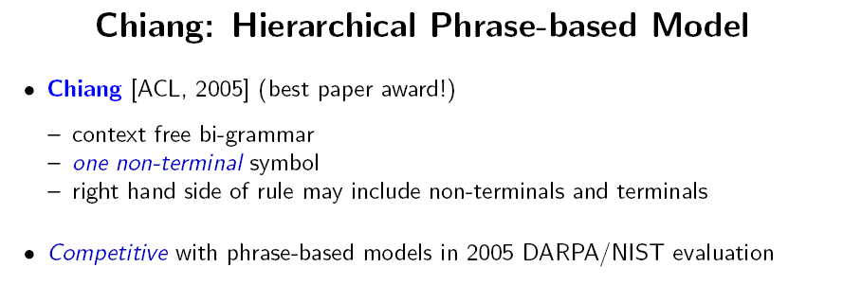
Slide from Koehn and Lopez 2008

Slide 40
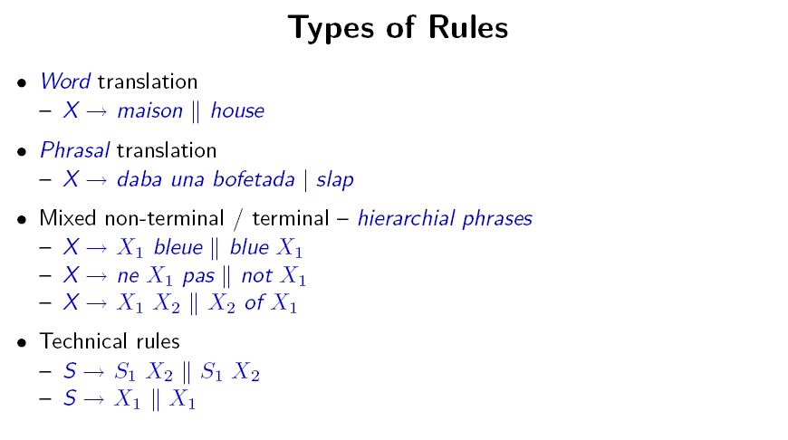
Slide from Koehn and Lopez 2008

Slide 41
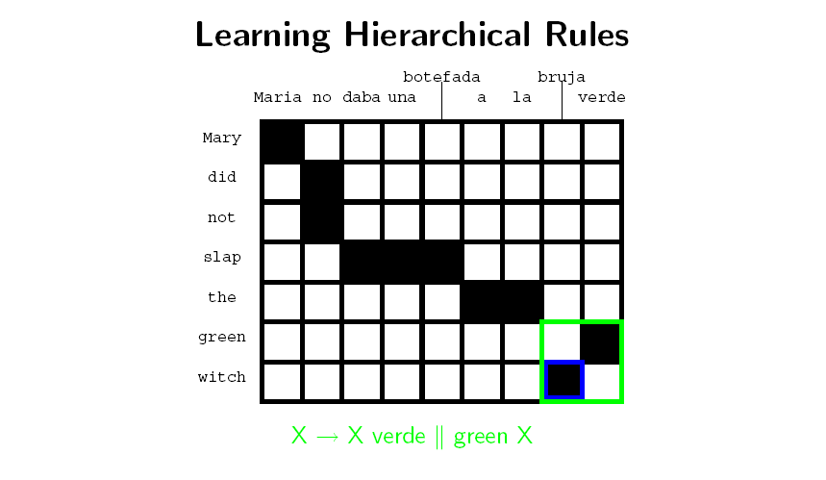
Slide from Koehn and Lopez 2008

Slide 42
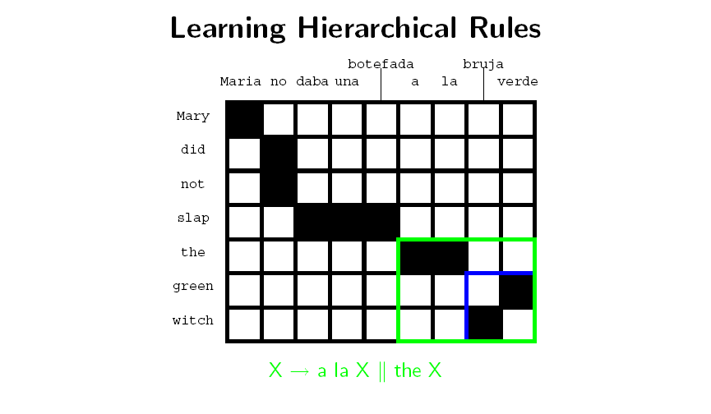
Slide from Koehn and Lopez 2008

Slide 43
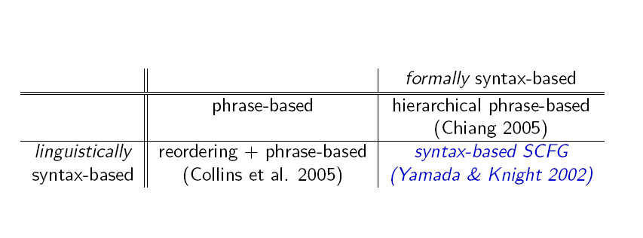
Slide from Koehn and Lopez 2008

Slide 44
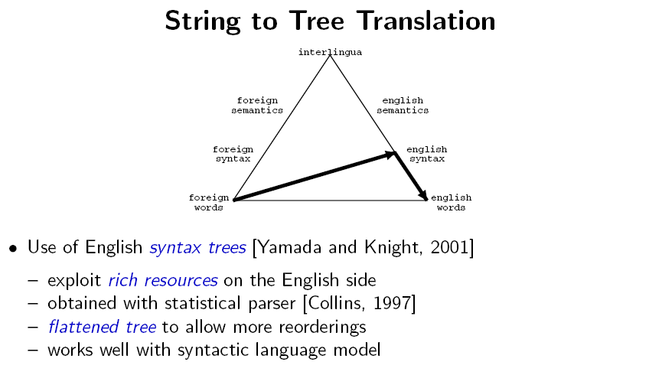
Slide from Koehn and Lopez 2008

Slide 45
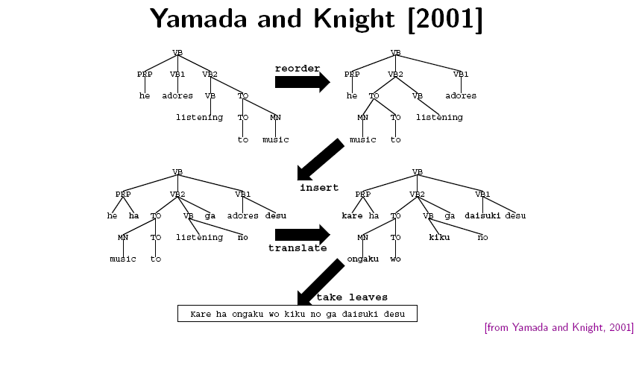

Slide 46
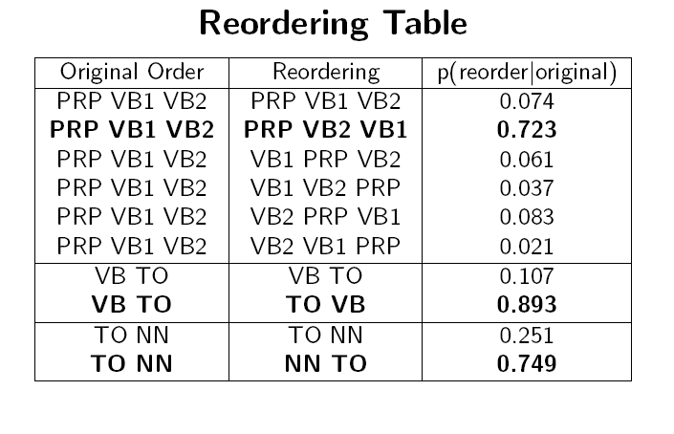
Slide from Koehn and Lopez 2008

Slide 47
Conclusion
Lecture 1 covered background, parallel corpora, sentence alignment and introduced modeling
Lecture 2 was on word alignment using both exact and approximate EM
Lecture 3 was on phrase-based modeling and decoding
Lecture 4 briefly touched on new research areas

Slide 48
Bibliography
Please see web page for updated version!
Measuring translation quality
  Papineni et al 2001: defines BLEU metric
  Callison-Burch et al 2007: compares automatic metrics
Measuring alignment quality
  Fraser and Marcu 2007: F-alpha
Generative alignment models
  Kevin Knight 1999: tutorial on basics, Model 1 and Model 3
  Brown et al 1993: IBM Models
  Vogel et al 1996: HMM model (best model that can be trained using exact EM. See also several recent papers citing this paper)
Discriminative word alignment models
  Fraser and Marcu 2007: hybrid generative/discriminative model
  Moore et al 2006: pure discriminative model

Slide 49
Phrase-based modeling
  Och and Ney 2004: Alignment Templates (first phrase-based model)
  Koehn, Och, Marcu 2003: Phrase-based SMT
Phrase-based decoding
  Koehn: manual of Pharaoh
Syntactic modeling
  Galley et al 2004: string-to-tree, generalizes Yamada and Knight
  Chiang 2005: using formal grammars (without syntactic parses)

Slide 50
General text book
  Philipp Koehn‘s SMT text book (from which some of my slides were derived) will be out soon
Watch www.statmt.org for shared tasks and participate
  Only need to follow steps in assignment 2 on all of the data
If you are in Stuttgart, participate in our reading group on Thursday mornings
  See my web page

Slide 51
Thank you!

