Slide 1
Statistical Machine Translation Part III – Phrase-based SMT / Decoding
Alex Fraser
Institute for Natural Language Processing
University of Stuttgart
2008.07.23 EMA Summer School

Slide 2
Outline
Phrase-based translation
Log-linear model
Tuning log-linear model
Decoding

Slide 3
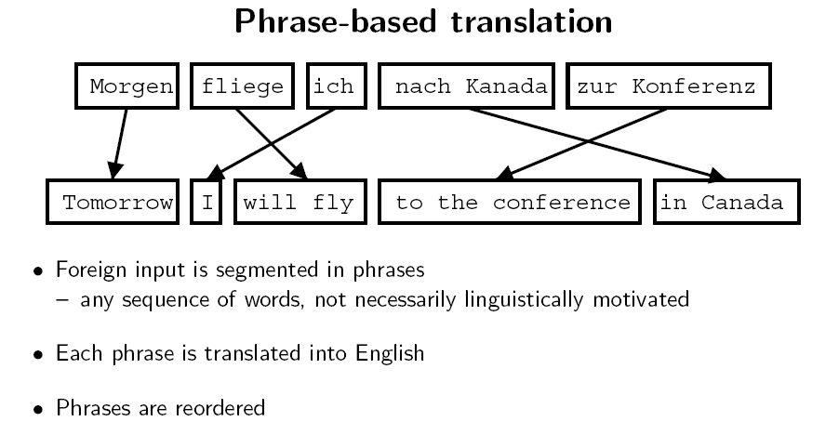
Slide from Koehn 2008

Slide 4
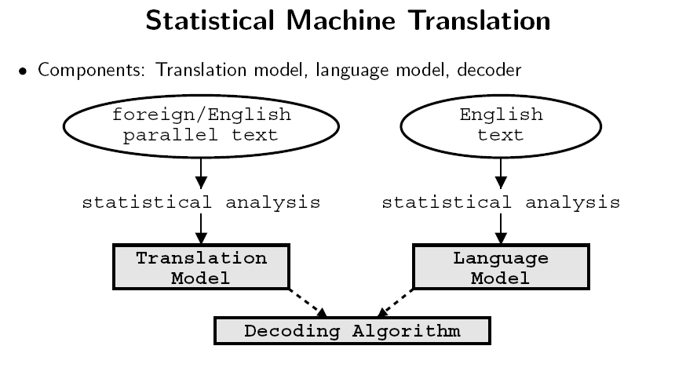
Slide from Koehn 2008

Slide 5
Language Model
Usually a trigram language model is used for p(e)
P(the man went home) = p(the | START) p(man | START the) p(went | the man) p(home | man went)
Language models work well for comparing the grammaticality of strings of the same length
However, when comparing short strings with long strings they favor short strings
For this reason, a very important component of the language model is the length bonus
This is a constant > 1 multiplied for each English word in the hypothesis

Slide 6
d
Modified from Koehn 2008

Slide 7
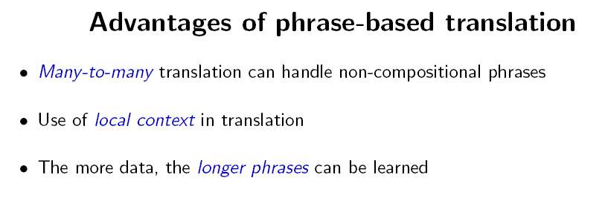
Slide from Koehn 2008

Slide 8
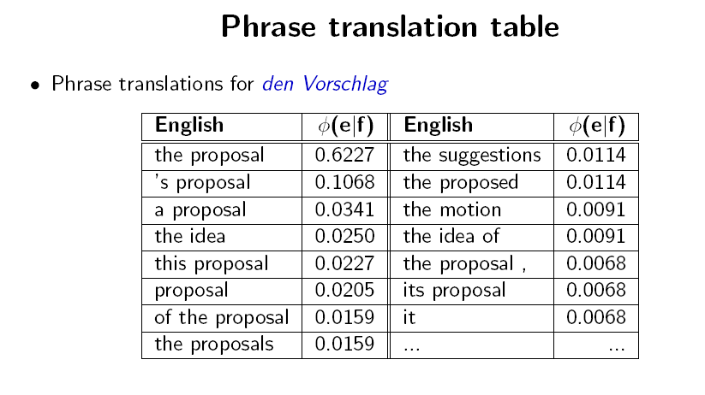
Slide from Koehn 2008

Slide 9
Slide from Koehn 2008

Slide 10
Slide from Koehn 2008

Slide 11
Slide from Koehn 2008

Slide 12
Slide from Koehn 2008

Slide 13
Slide from Koehn 2008

Slide 14
Slide from Koehn 2008

Slide 15
Slide from Koehn 2008

Slide 16
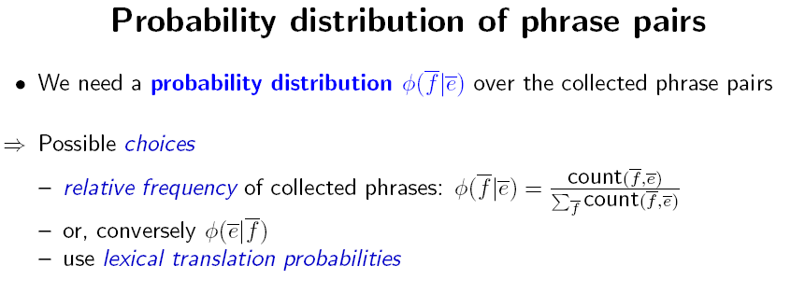
Slide from Koehn 2008

Slide 17
Slide from Koehn 2008

Slide 18
Outline
Phrase-based translation
Log-linear model
Tuning log-linear model
Decoding

Slide 19
Slide from Koehn 2008

Slide 20
Slide from Koehn 2008

Slide 21
Slide from Koehn 2008

Slide 22
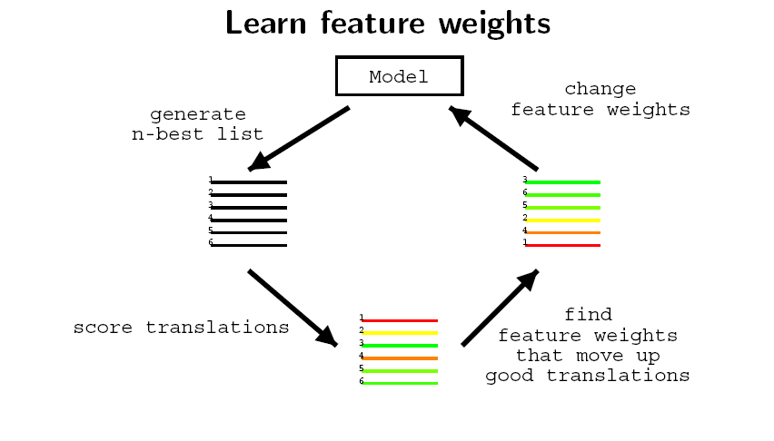
Slide from Koehn 2008

Slide 23
Slide from Koehn 2008

Slide 24
Slide from Koehn 2008

Slide 25
Slide from Koehn 2008

Slide 26
Slide from Koehn 2008

Slide 27
Outline
Phrase-based translation model
Log-linear model
Tuning log-linear model automatically
Decoding

Slide 28
Outline
Phrase-based translation model
Log-linear model
Tuning log-linear model automatically
Decoding
Basic phrase-based decoding
Dealing with complexity
Recombination
Pruning
Future cost estimation
Decoding output

Slide 29
Slide from Koehn 2008

Slide 30
Slide from Koehn 2008

Slide 31
Slide from Koehn 2008

Slide 32
Slide from Koehn 2008

Slide 33
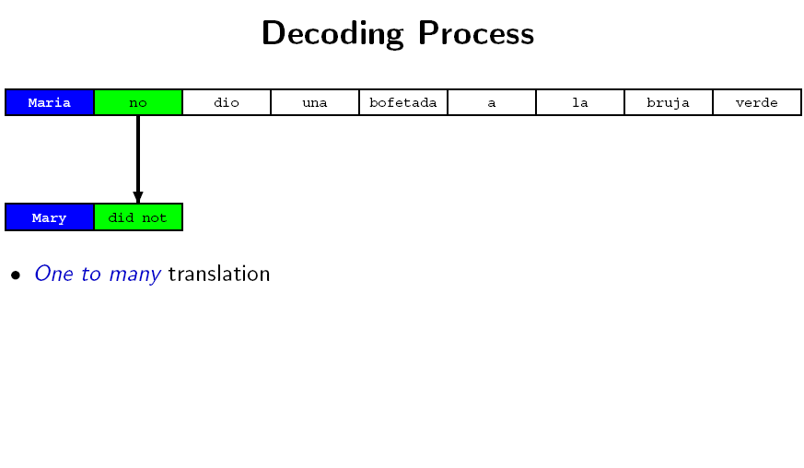
Slide from Koehn 2008

Slide 34
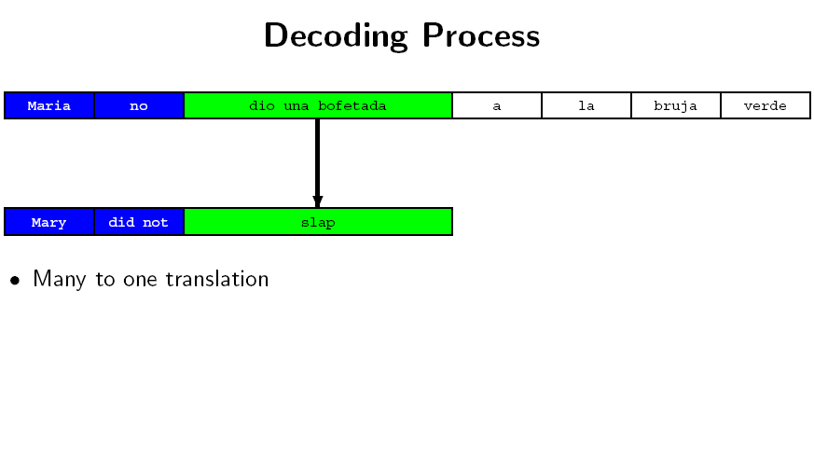
Slide from Koehn 2008

Slide 35
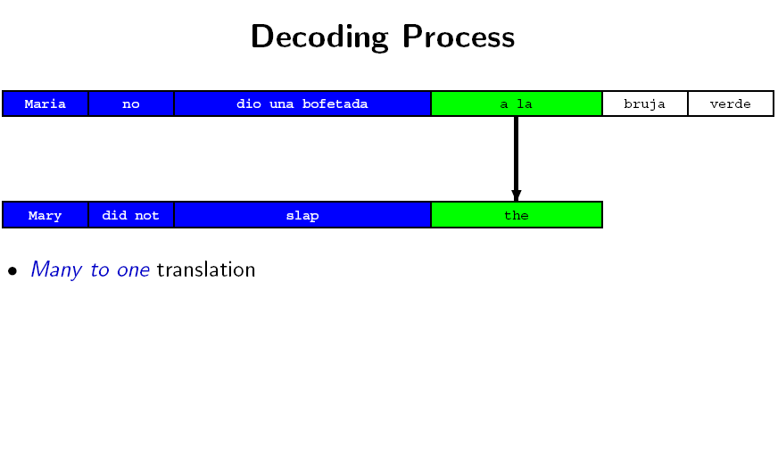
Slide from Koehn 2008

Slide 36
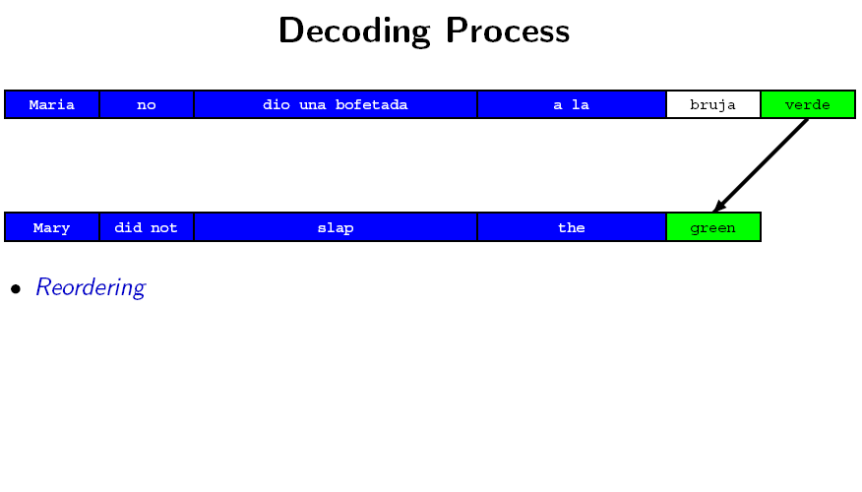
Slide from Koehn 2008

Slide 37
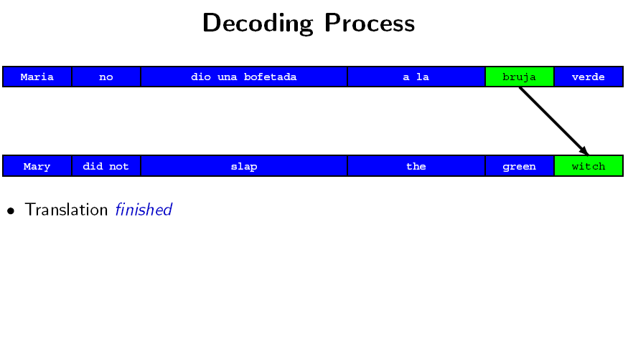
Slide from Koehn 2008

Slide 38
Slide from Koehn 2008

Slide 39
Slide from Koehn 2008

Slide 40
Slide from Koehn 2008

Slide 41
Slide from Koehn 2008

Slide 42
Slide from Koehn 2008

Slide 43
Slide from Koehn 2008

Slide 44
Slide from Koehn 2008

Slide 45
Slide from Koehn 2008

Slide 46
Slide from Koehn 2008

Slide 47
Slide from Koehn 2008

Slide 48
Slide from Koehn 2008

Slide 49
Slide from Koehn 2008

Slide 50
Slide from Koehn 2008

Slide 51
Slide from Koehn 2008

Slide 52
Slide from Koehn 2008

Slide 53
Slide from Koehn 2008

Slide 54
Slide from Koehn 2008

Slide 55
Slide from Koehn 2008

Slide 56
Slide from Koehn 2008

Slide 57
Slide from Koehn 2008

Slide 58
Slide from Koehn 2008

Slide 59
Slide from Koehn 2008

Slide 60
Assignment 2
Build a state of the art phrase-based SMT system!
German to English or French to English
Using a small amount of data
This is a „learning by doing“ exercise
See my home page again

Slide 61
Thank you!

