Slide 1
Statistical Machine Translation
Part II – Word Alignments and EM
Alex Fraser
Institute for Natural Language Processing
University of Stuttgart
2008.07.22 EMA Summer School

Slide 2
Word Alignments
Recall that we build translation models from word-aligned parallel sentences
  The statistics involved in state of the art SMT decoding models are simple
  Just count translations in the word-aligned parallel sentences
But what is a word alignment, and how do we obtain it?

Slide 3
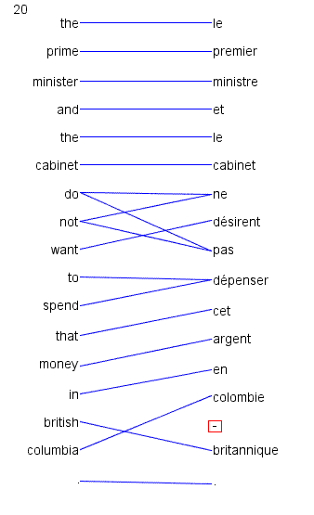
Word alignment is annotation of minimal translational correspondences
  Annotated in the context in which they occur
  Not idealized translations!
(solid blue lines annotated by a bilingual expert)

Slide 4
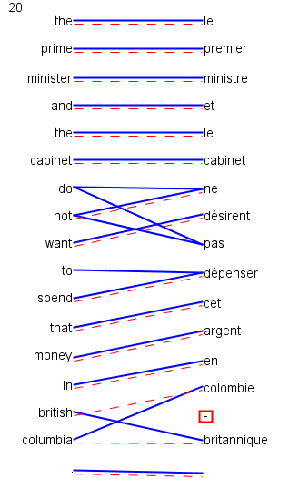
Automatic word alignments are typically generated using a model called IBM Model 4
No linguistic knowledge
No correct alignments are supplied to the system
  unsupervised learning
  (red dashed line = automatically generated hypothesis)

Slide 5
Uses of Word Alignment
Multilingual
  Machine Translation
  Cross-Lingual Information Retrieval
  Translingual Coding (Annotation Projection)
  Document/Sentence Alignment
  Extraction of Parallel Sentences from Comparable Corpora
Monolingual
  Paraphrasing
  Query Expansion for Monolingual Information Retrieval
  Summarization
  Grammar Induction

Slide 6
Outline
Measuring alignment quality
Types of alignments
IBM Model 1
  Training IBM Model 1 with Expectation Maximization
IBM Models 3 and 4
  Approximate Expectation Maximization
Heuristics for high quality alignments from the IBM models

Slide 7
How to measure alignment quality?
If we want to compare two word alignment algorithms, we can generate a word alignment with each algorithm for fixed training data
  Then build an SMT system from each alignment
  Compare performance of the SMT systems using BLEU
But this is slow, building SMT systems can take days of computation
  Question: Can we have an automatic metric like BLEU, but for alignment?
  Answer: yes, by comparing with gold standard alignments

Slide 8
Measuring Precision and Recall
Precision is percentage of links in hypothesis that are correct
  If we hypothesize there are no links, have 100% precision
Recall is percentage of correct links we hypothesized
  If we hypothesize all possible links, have 100% recall

Slide 9
F_{α}-score
3
=
(e3,f4) wrong
Gold
f1 f2 f3 f4 f5
e1 e2 e3 e4
4
3
(e2,f3)
(e3,f5)
not in hyp
=
5
Hypothesis
f1 f2 f3 f4 f5
e1 e2 e3 e4
Called F_{α}-score to differentiate
from ambiguous term F-Measure

Slide 10
Alpha allows trade-off between precision and recall
But alpha must be set correctly for the task!
Alpha between 0.1 and 0.4 works well for SMT
  Biased towards recall

Slide 11
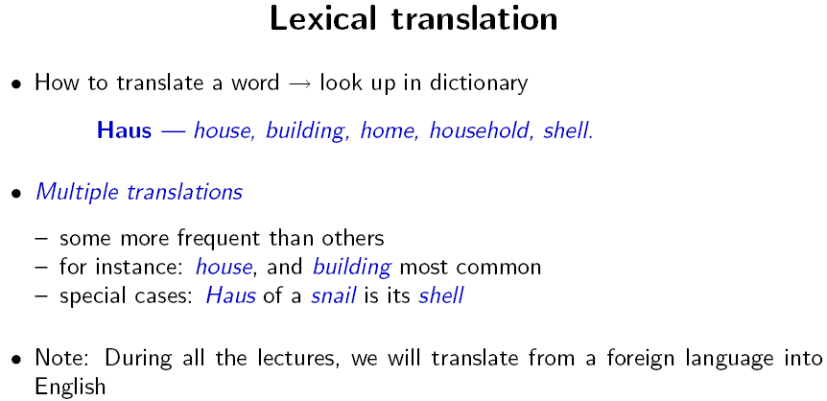
Slide from Koehn 2008

Slide 12
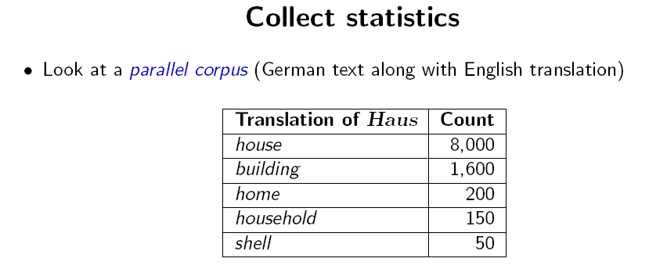
Slide from Koehn 2008

Slide 13
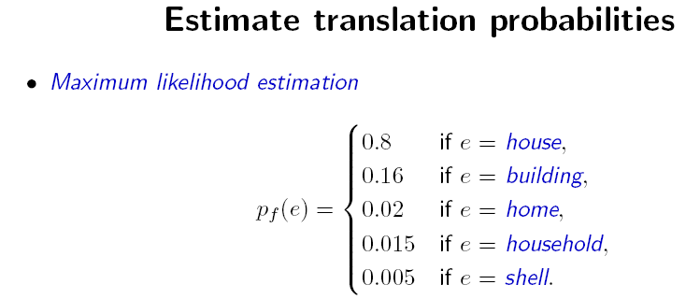
Slide from Koehn 2008

Slide 14
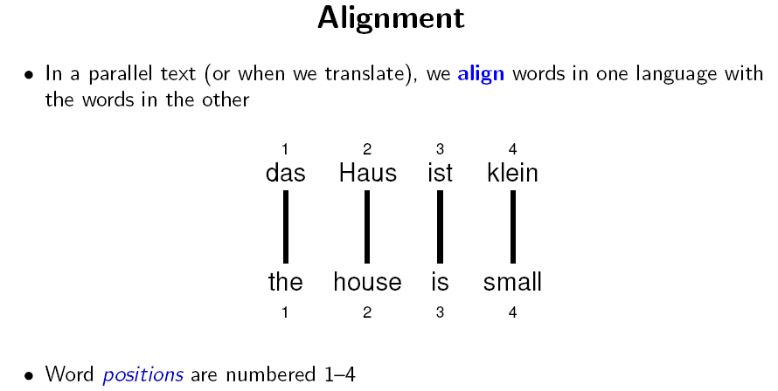
Slide from Koehn 2008

Slide 15
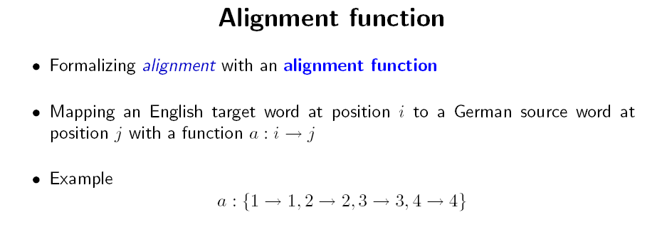
Slide from Koehn 2008

Slide 16
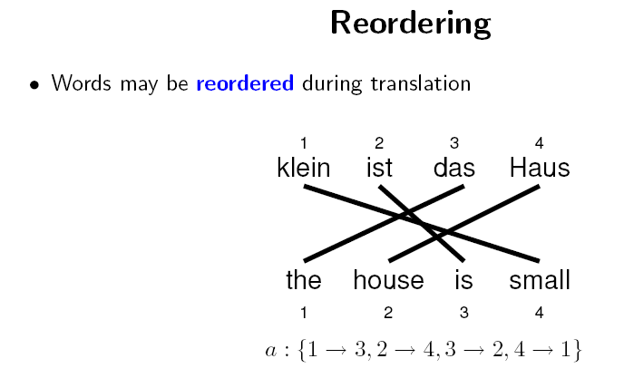
Slide from Koehn 2008

Slide 17
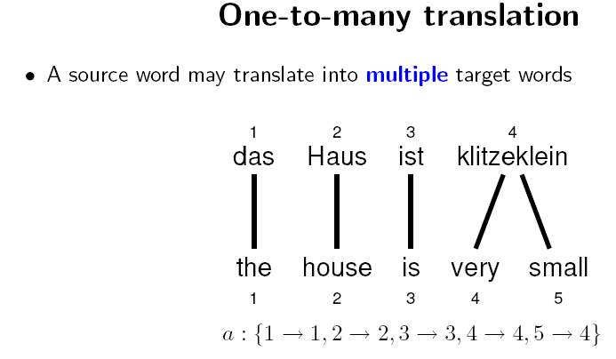
Slide from Koehn 2008

Slide 18
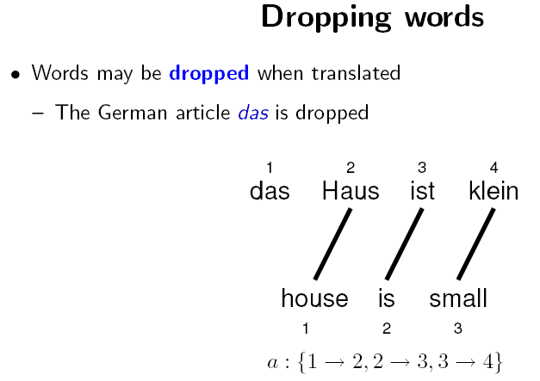
Slide from Koehn 2008

Slide 19
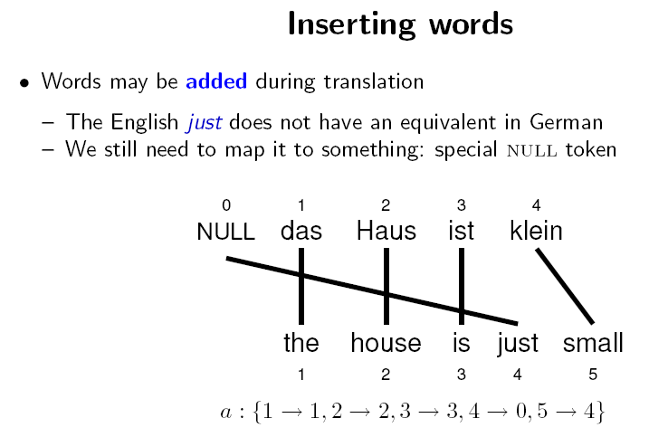
Slide from Koehn 2008

Slide 20
Generative Word Alignment Models
We observe a pair of parallel sentences (e,f)
We would like to know the highest probability alignment a for (e,f)
Generative models are models that follow a series of steps
  We will pretend that e has been generated from f
  The sequence of steps to do this is encoded in the alignment a
  A generative model associates a probability p(e,a|f) to each alignment
    In words, this is the probability of generating the alignment a and the English sentence e, given the foreign sentence f

Slide 21
IBM Model 1
A simple generative model, start with:
  foreign sentence f
  a lexical mapping distribution t(EnglishWord|ForeignWord)
How to generate an English sentence e from f:
Pick a length for the English sentence at random
Pick an alignment function at random
For each English position generate an English word by looking up the aligned ForeignWord in the alignment function

Slide 22
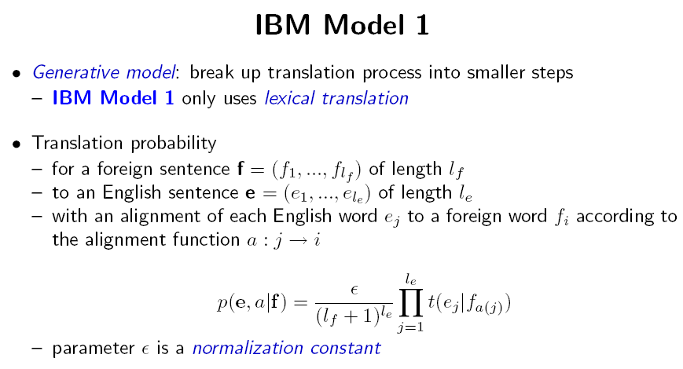
Slide from Koehn 2008

Slide 23
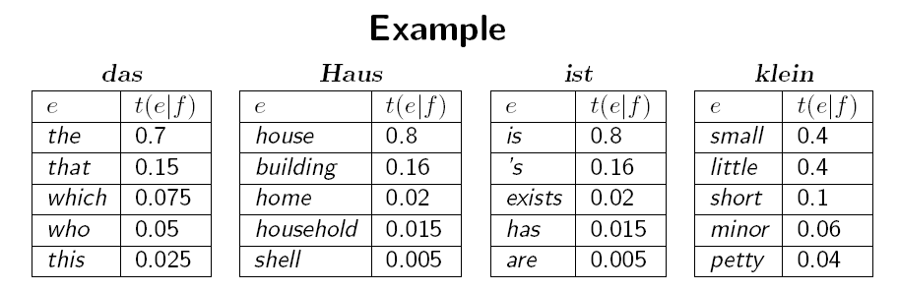
p(e,a|f) =
Є
× t(the|das) × t(house|Haus) × t(is|ist) × t(small|klein)
5⁴
=
Є
× 0.7 × 0.8 × 0.8 × 0.4
625
=
0.00029Є
Slide modified from Koehn 2008

Slide 24
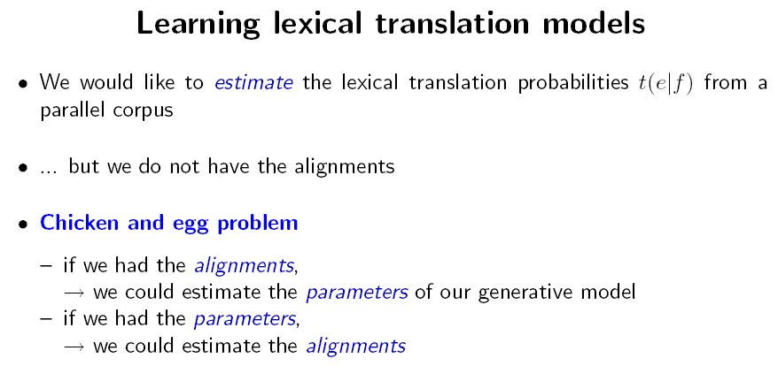
Slide from Koehn 2008

Slide 25
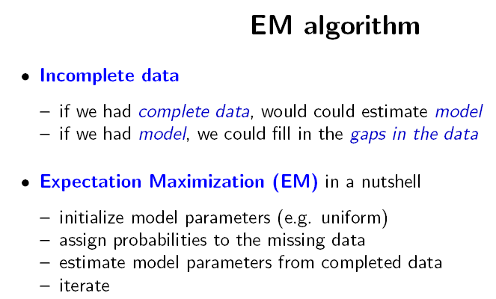
Slide from Koehn 2008

Slide 26
Unsupervised Training with EM
Expectation Maximization (EM)
  Unsupervised learning
  Maximize the likelihood of the training data
    Likelihood is (informally) the probability the model assigns to the training data
  E-Step: predict according to current parameters
  M-Step: reestimate parameters from predictions
  Amazing but true: if we iterate E and M steps, we increase likelihood!

Slide 27
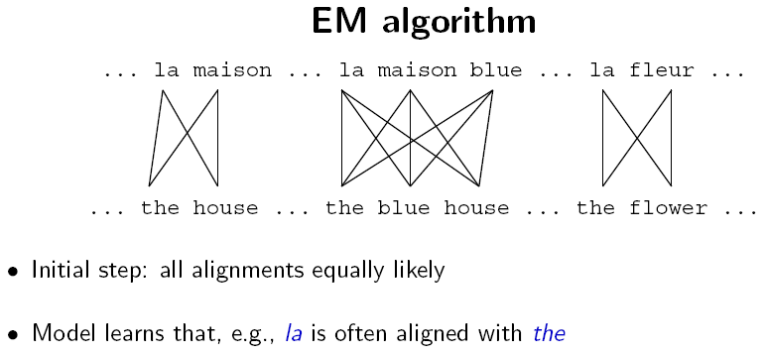
Slide from Koehn 2008

Slide 28
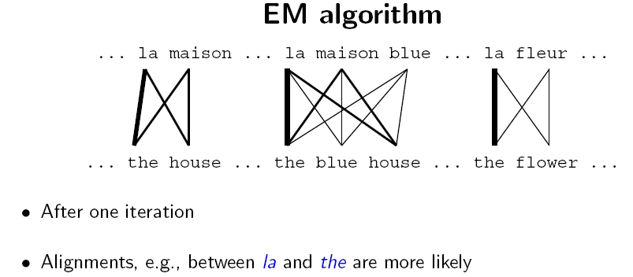
Slide from Koehn 2008

Slide 29
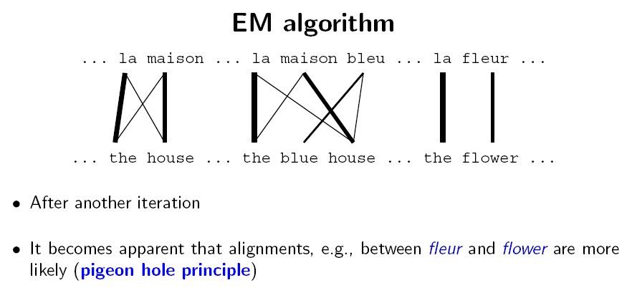
Slide from Koehn 2008

Slide 30
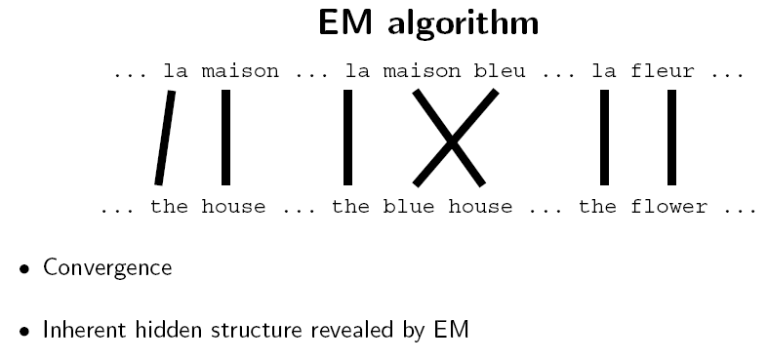
Slide from Koehn 2008

Slide 31
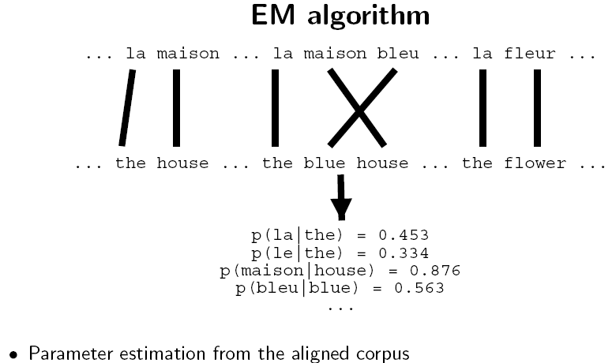
Slide from Koehn 2008

Slide 32
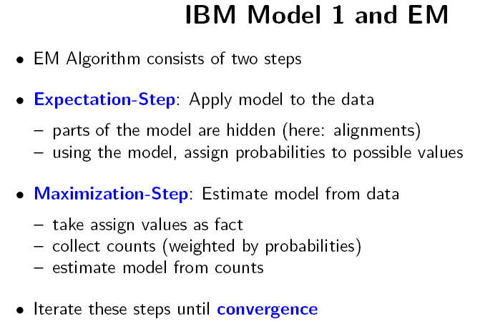
Slide from Koehn 2008

Slide 33
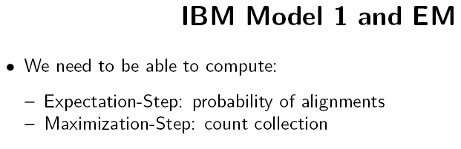
Slide from Koehn 2008

Slide 34
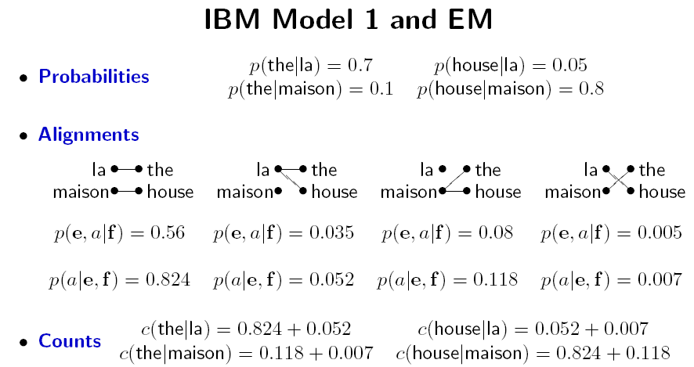
Slide from Koehn 2008

Slide 35
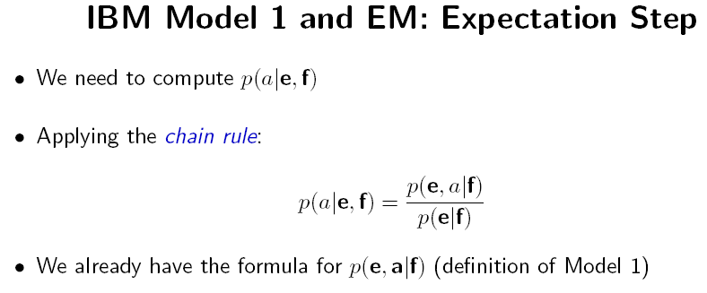
Slide from Koehn 2008

Slide 36
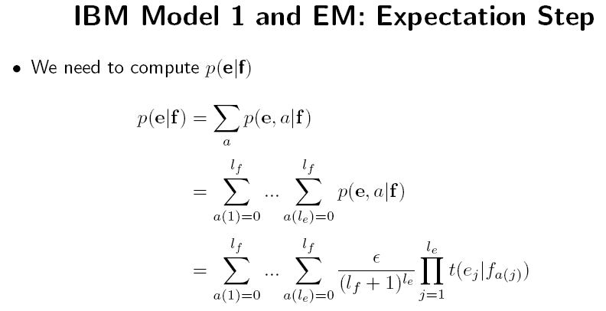
Slide from Koehn 2008

Slide 37
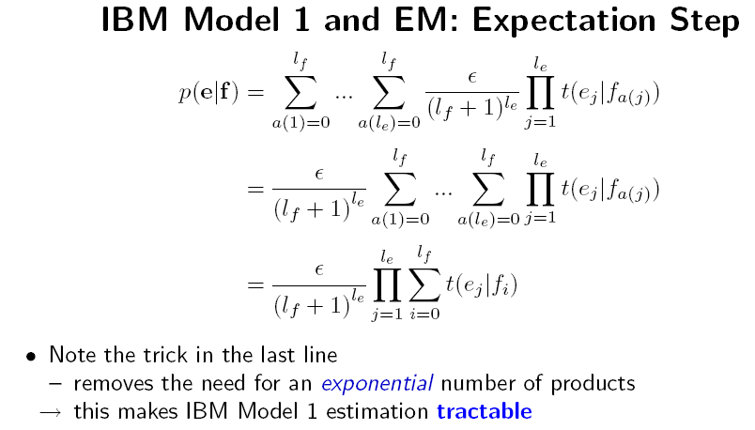
Slide from Koehn 2008

Slide 38
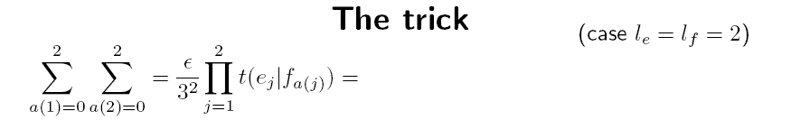
= t(e₁|f₀) t(e₂|f₀) + t(e₁|f₀) t(e₂|f₁) + t(e₁|f₀) t(e₂|f₂)
+ t(e₁|f₁) t(e₂|f₀) + t(e₁|f₁) t(e₂|f₁) + t(e₁|f₁) t(e₂|f₂)
+ t(e₁|f₂) t(e₂|f₀) + t(e₁|f₂) t(e₂|f₁) + t(e₁|f₂) t(e₂|f₂)
= t(e₁|f₀) [t(e₂|f₀) + t(e₂|f₁) + t(e₂|f₂) ]
+ t(e₁|f₁) [t(e₂|f₀) + t(e₂|f₁) + t(e₂|f₂)]
+ t(e₁|f₂) [t(e₂|f₀) + t(e₂|f₁) + t(e₂|f₂)]
= [t (e₁|f₀) + t(e₁|f₁) + t(e₁|f₂) ] [t(e₂|f₀) + t(e₂|f₁) + t(e₂|f₂) ]
Slide modified from Koehn 2008

Slide 39
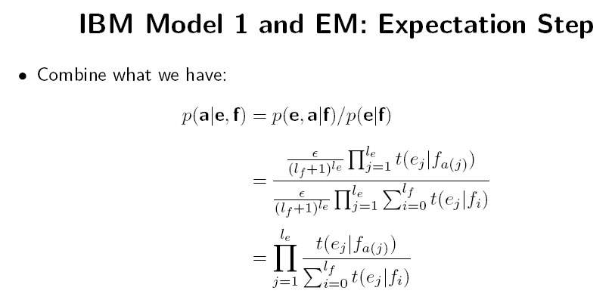
Slide from Koehn 2008

Slide 40
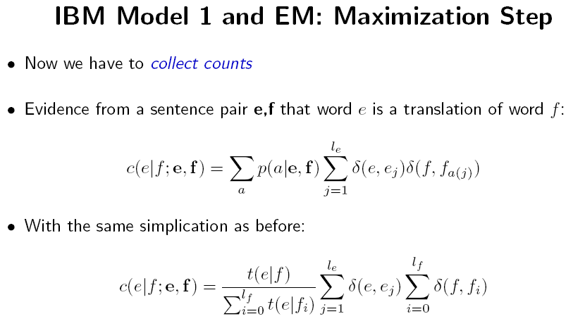
Slide from Koehn 2008

Slide 41
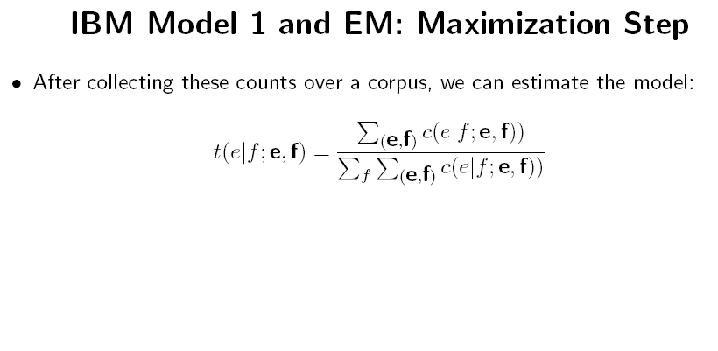
Slide from Koehn 2008

Slide 42
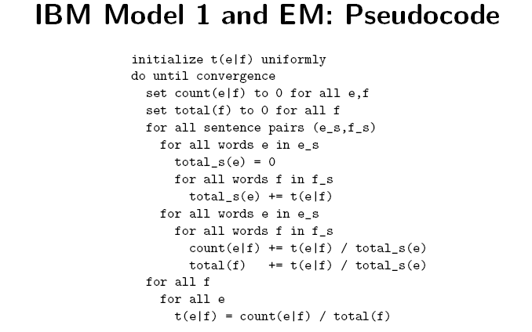
Slide from Koehn 2008

Slide 43
Outline
Measuring alignment quality
Types of alignments
IBM Model 1
  Training IBM Model 1 with Expectation Maximization
IBM Models 3 and 4
  Approximate Expectation Maximization
Heuristics for improving IBM alignments

Slide 44
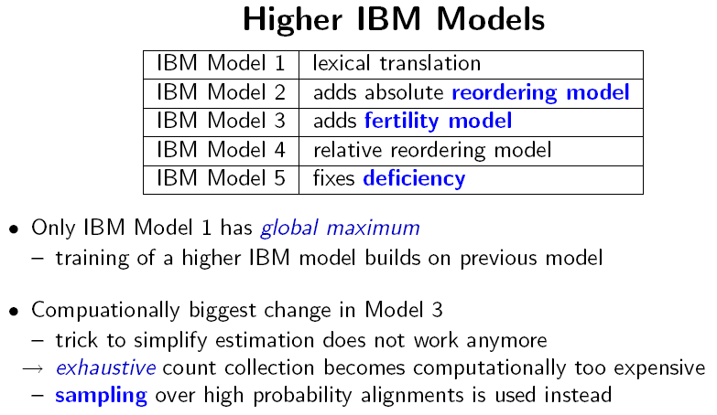
Slide from Koehn 2008

Slide 45
Training IBM Models 3/4/5
Approximate Expectation Maximization
  Focusing probability on small set of most probable alignments

Slide 46
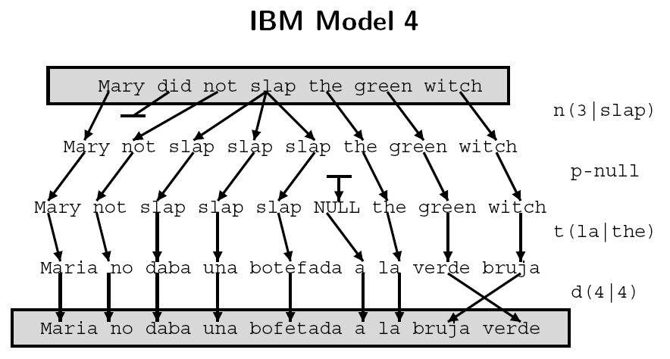
Slide from Koehn 2008

Slide 47
Maximum Approximation
Mathematically, P(e| f) = ∑ P(e, a | f)
An alignment represents one way e could be generated from f
But for IBM models 3, 4 and 5 we approximate
Maximum approximation:
  P(e| f) = argmax P(e , a | f)
Another approximation close to this will be discussed in a few slides
a
a

Slide 48
Model 3/4/5 training: Approx. EM
Bootstrap
Viterbi
alignments
Translation
Model
Initial
parameters
E-Step
Viterbi
alignments
Refined
parameters
M-Step

Slide 49
Model 3/4/5 E-Step
E-Step: search for Viterbi alignments
Solved using local hillclimbing search
  Given a starting alignment we can permute the alignment by making small changes such as swapping the incoming links for two words
Algorithm:
  Begin: Given starting alignment, make list of possible small changes (e.g. list every possible swap of the incoming links for two words)
  for each possible small change
    Create new alignment A2 by copying A and applying small change
    If score(A2) > score(best) then best = A2
  end for
  Choose best alignment as starting point, goto Begin:

Slide 50
Model 3/4/5 M-Step
M-Step: reestimate parameters
  Count events in the neighborhood of the Viterbi
    Neighborhood approximation: consider only those alignments reachable by one change to the alignment
    Calculate p(e,a|f) only over this neighborhood, then divide to sum to 1 to get p(a|e,f)
  Sum counts over sentences, weighted by p(a|e,f)
  Normalize counts to sum to 1

Slide 51
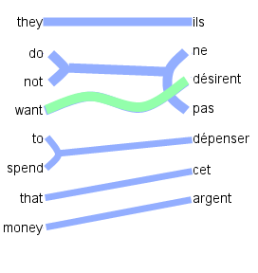
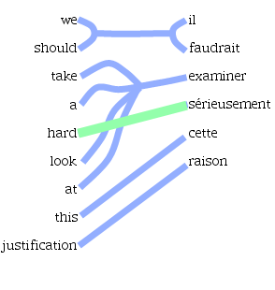
IBM Models: 1-to-N Assumption
1-to-N assumption
  Multi-word “cepts” (words in one language translated as a unit) only allowed on target side. Source side limited to single word “cepts”.
  Forced to create M-to-N alignments using heuristics

Slide 52
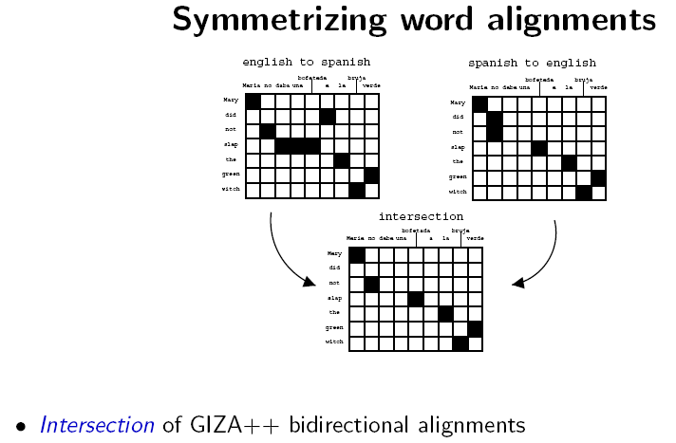
Slide from Koehn 2008

Slide 53
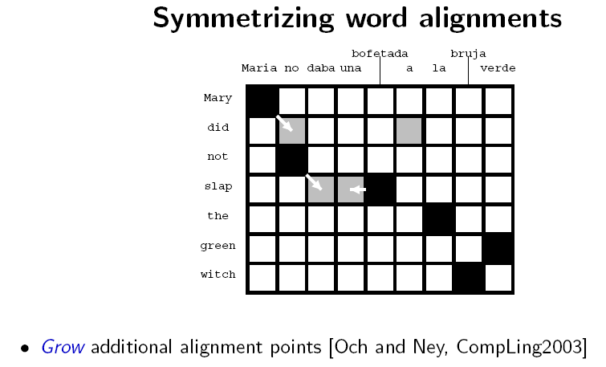
Slide from Koehn 2008

Slide 54
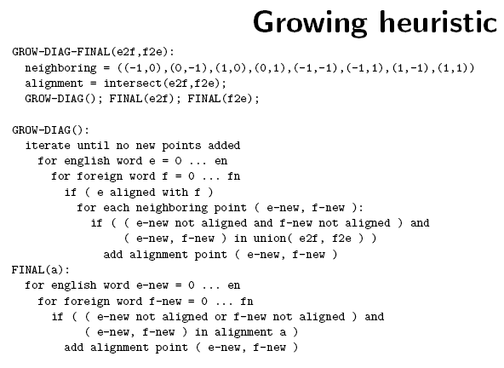
Slide from Koehn 2008

Slide 55
Discussion
Most state of the art SMT systems are built as presented here
Use IBM Models to generate both:
  one-to-many alignment
  many-to-one alignment
Combine these two alignments using symmetrization heuristic
  output is a many-to-many alignment
  used for building decoder
Moses toolkit for implementation: www.statmt.org
  Uses Och GIZA++ tool for Model 1, HMM, Model 4
However, there is newer work on alignment that is interesting!

Slide 56
Practice 1
  Implement EM for IBM Model 1
  Please see my home page:
  http://www.ims.uni-stuttgart.de/~fraser
Stuck? My office is two doors away from this room
Lecture tomorrow: 14:00, this room, phrase-based modeling and decoding

Slide 57
Thank You!

